Slide 1
Legal Empowerment Learning Lab
2020-2021

Slide 2
Where We Have Been, Where Are We Going
Oct 202o
March 2021
Introduction to Legal Empowerment
Participatory Data Collection
2020 |  |  |  | 2021
Future
Summer 2021
Nov 2020
Jan 2021
Shared Struggles, Carrying Complexity
Collective Data Analysis
Ethics and Care
Responding to Delegitimation
What can we nurture into the future?
Introduction to Participatory Action Research
Community-led Research Design
Notes:
Sukti

Slide 3
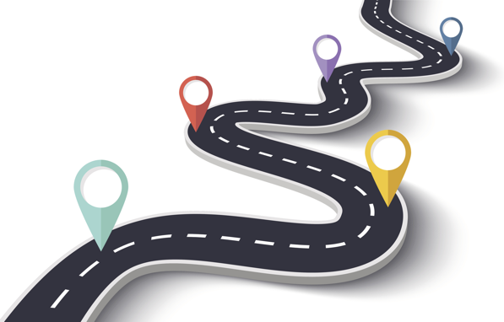
Roadmap
Our week together
Tree of Hope
Break
You and PAR: Pairs
You and PAR: Collective
What can we continue to nurture into the future?
Dance party!
One word
Notes:
Sukti

Slide 4
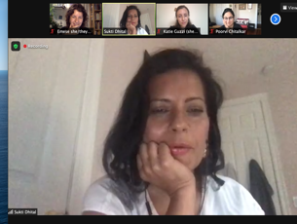
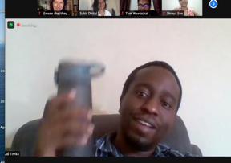
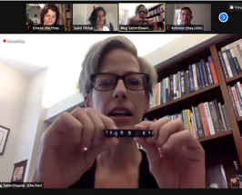
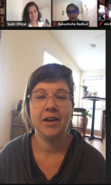
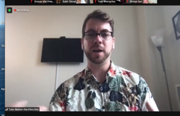
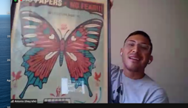
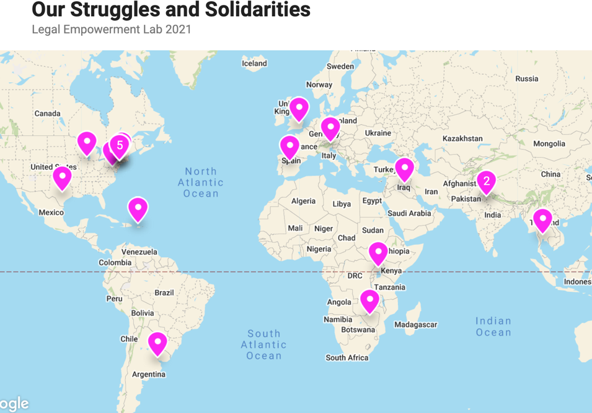
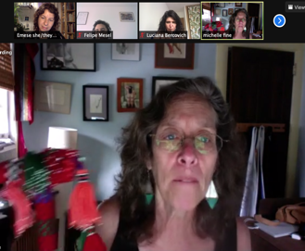
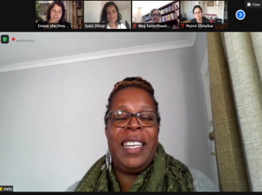
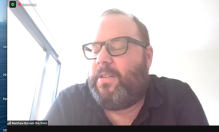
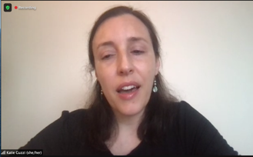
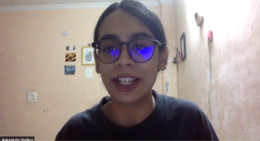
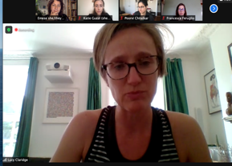
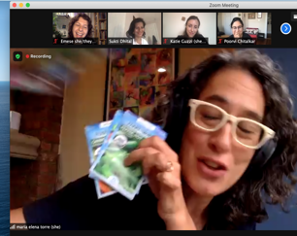
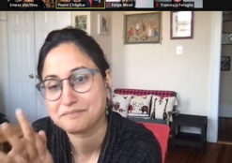
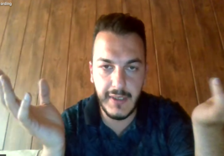
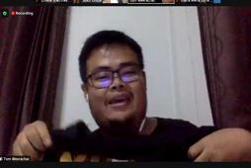
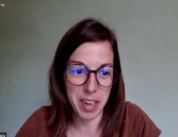
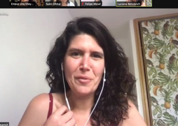
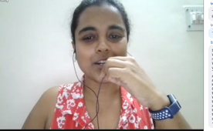
Notes:
Link to padlet
https://padlet.com/emeseilyes/e08ewnuo7porjcxc

Slide 5
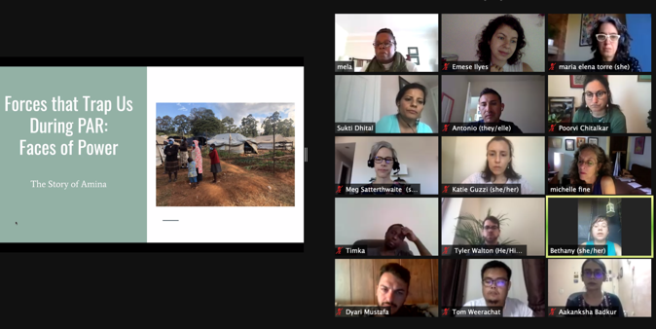
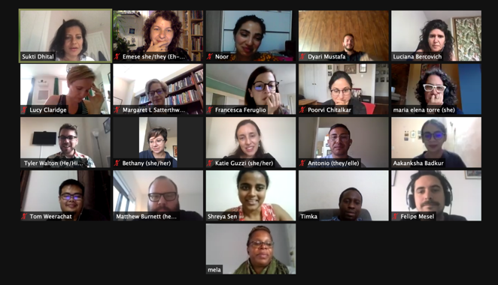
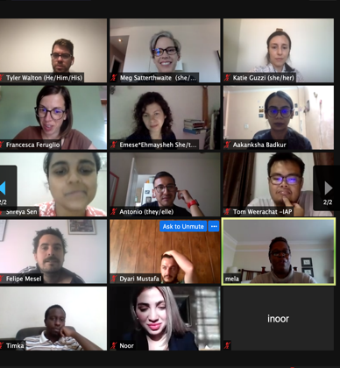
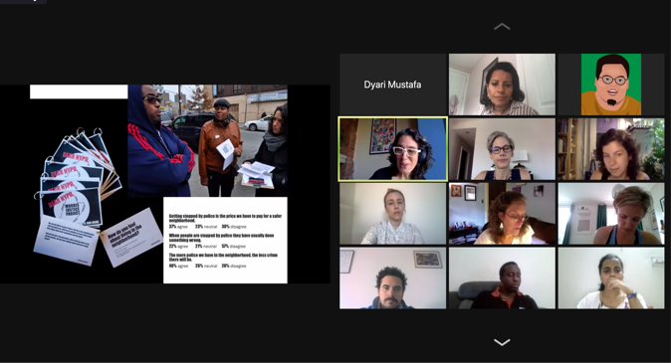
Ethics
Solidarities & Struggles
Responding to Delegitimation
Collaborative Data Analysis
Notes:
Padlet link

Slide 6
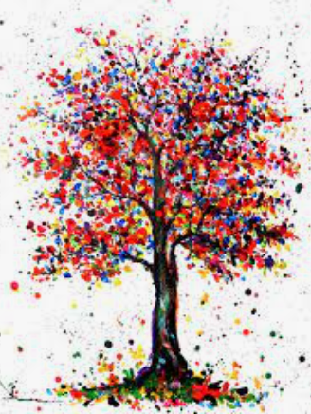
Tree of Hope
Roots - Our histories
Trunk - Our gifts that keep us standing
Branches - Our hopes and dreams
Leaves - Our ancestors
Fruits - Legacies passed onto us
Flowers and Seeds - Legacies we hope to leave
© Kspersee
Notes:
Sukti

Slide 7
Reflection
What has the Lab stirred up for you in your work?
How will you use what you experienced in the LE Lab in your work/life?
What continues to feel like an issue that you want to explore more?
Notes:
Meg

Slide 8
Looking Ahead
Notes:
Meg

