Slide 1
Legal Empowerment Learning Lab
2020-2021

Slide 2
Today: Accountability and Ethics
Opening Meditation
Tea Time
Reflective Walk in a Photo Gallery
Ethics in PAR: Consent, Confidentiality, Safety and Care
Break
Spider Web: Faces of Power
Closing Circle
One Word
Notes:
Sukti

Slide 3
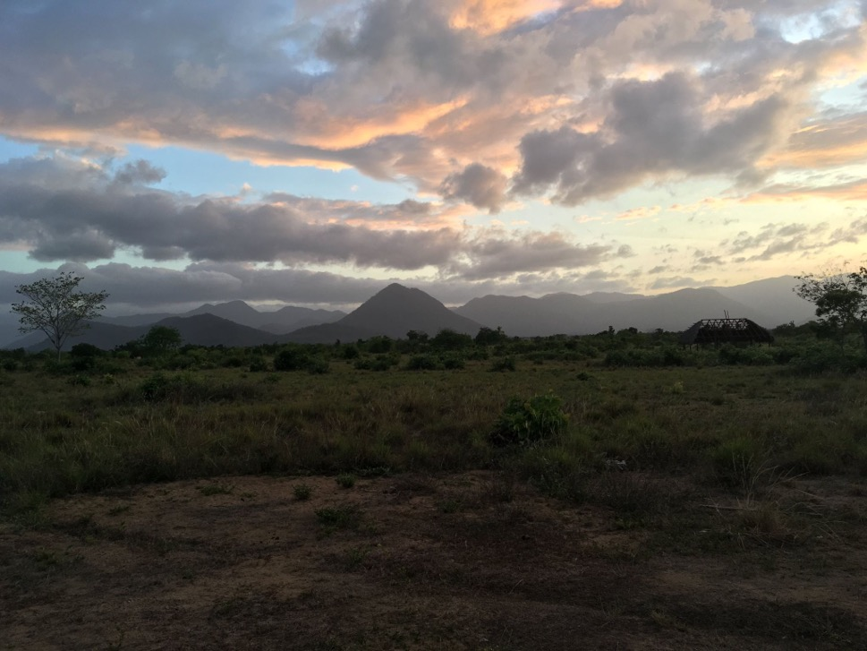
Opening
Meditation
Photo: Wapichan wiiz (Indigenous Wapichan territory), Guyana

Slide 4
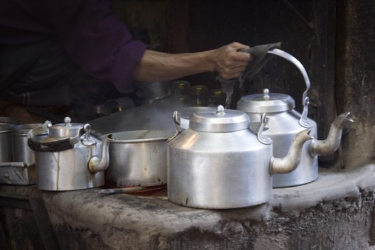
Tea Time
Have you ever been involved in a research process?
Who did you feel had more power? How did it feel?
If you would change one thing in the research process, what would you change?
Notes:
Meg--Random Pairs for 10 mins

Slide 5
Accountability and Ethics
What are the pictures telling us?
Notes:
Meg

Slide 6
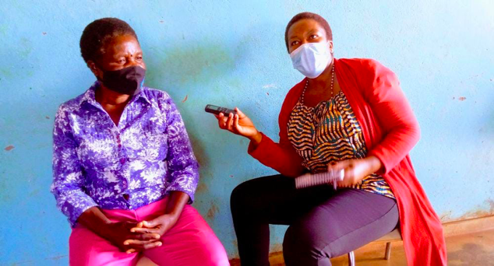
Consent has been given. But what does the picture tell us?

Slide 7
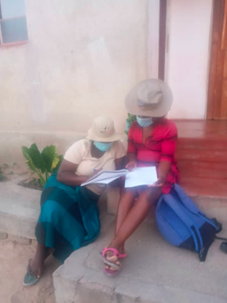
And what it this picture telling us?

Slide 8
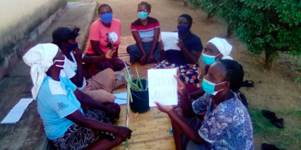
Who do you think owns the knowledge, and why?

Slide 9
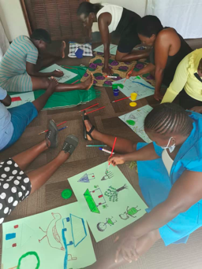
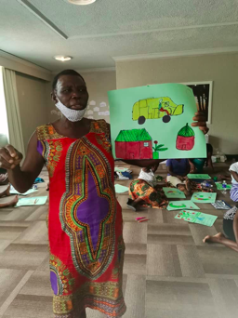
Knowledge Construction in PAR

Slide 10
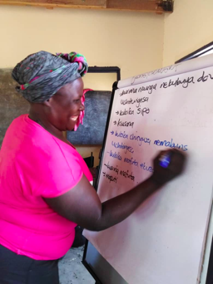
Constructing
Knowledge

Slide 11
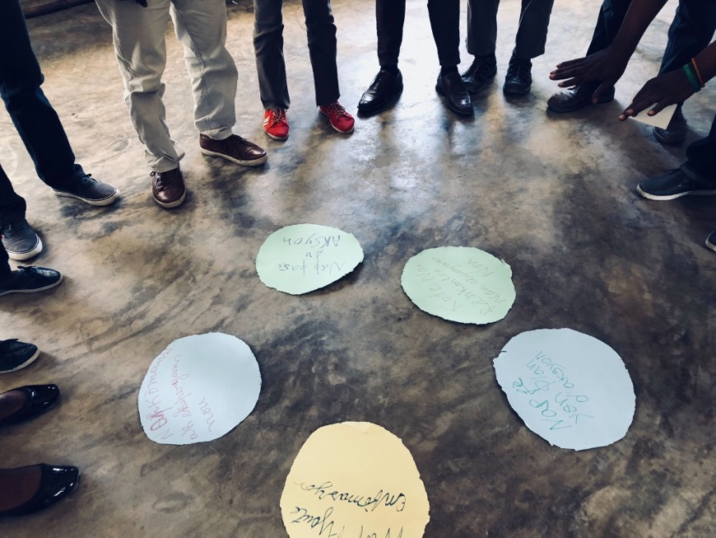
Research Ethics
in PAR
Consent, Confidentiality, Safety and Care
Photo: community co-learning workshop on the right to water in Cadouche, Haiti, 2018
Notes:
Opening Question: What comes to mind when you hear the phrase “research ethics”? [type in the chat—read some out]

Slide 12
What do you think of when you hear the phrase “research ethics?

Slide 13
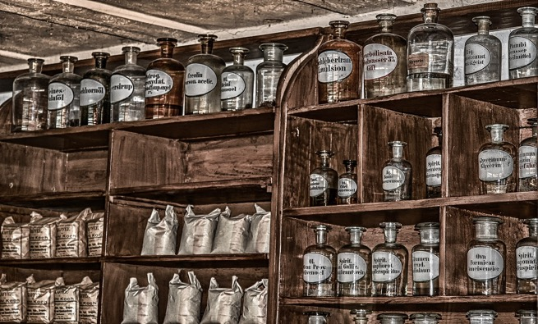
“Research ethics” bound up in extractive & abusive research
Research on enslaved people and colonized populations was at heart of US and European medical and social science for centuries
Settler colonialists experimented on Native American/First Nations communities. In US, continued unjust experiments through the Indian Health Service
Colonial medicine often entailed forced examinations and research and experimental treatments
This context often forgotten through “colonial unknowing” (Sheeva Sabati)
Notes:
Historically, “research ethics” have been bound up in extractive forms of research
Research institutions have been the home of some of the worst forms of extractive and exploitative research, in which oppressed communities were used as research “subjects” with the benefits going to oppressors
Following WWII, decolonial struggles, and the civil rights movement, there was a push to reexamine research ethics
· Nuremberg War Crime Trials
o Nuremberg code was drafted as a set of standards for judging physicians and scientists who had conducted biomedical experiments on concentration camp prisoners
· Belmont Report in US—identified core principles to protect research subjects; similar to formulations used globally [see next slide]

Slide 14
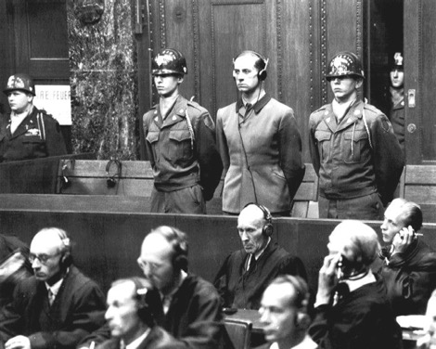
Calls for Accountability Led to Changes in Research Ethics
Nazi science → Nuremberg War Crimes Trials
Decolonization → Postcolonial Research Ethics
U.S. Pub. Health Svc. syphilis study → Belmont Report; IRBs
But the background power dynamics and forces of oppression remain.
Example: U.S. Torture Program used experimental forms of torture on Muslim men between 2002-2008

Slide 15
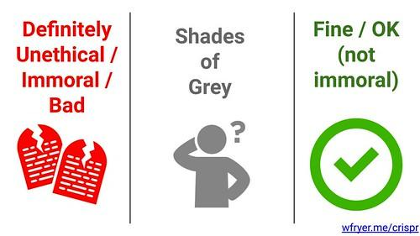
Core Elements of Modern Research Ethics
o “Respect for persons”
Respect for autonomy
Protection for those with diminished autonomy
o “Beneficence”
Do no harm
Maximize benefits
Minimize harms
o “Justice”
Who enjoys the benefits of research
Informed Consent
o Information
o Comprehension
o Voluntariness
Designed to deal with most severe abuses--but at an individual level
And without disrupting structural violence, injustice, and ongoing harm
Notes:
Designed to deal with most severe abuses
But at individual level
And without disrupting structural injustice, inequality and ongoing harm

Slide 16
How might Research Ethics be different in PAR?
Notes:
Add your thoughts to the chat

Slide 17
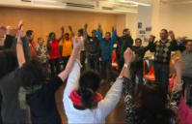
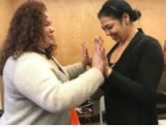
Some ways research ethics are different in PAR
PAR begins with the ethics the community already has
No “research subjects”—all are co-researchers or partners in research
Research is aimed directly at benefiting those conducting the research—it’s not only about knowledge, but also about shifting power & seeking justice
Ethics are important for community as a whole, not only individuals
Ethics are woven throughout the PAR process
PAR’s ethics take into account structural injustice and seek to shift power

Slide 18
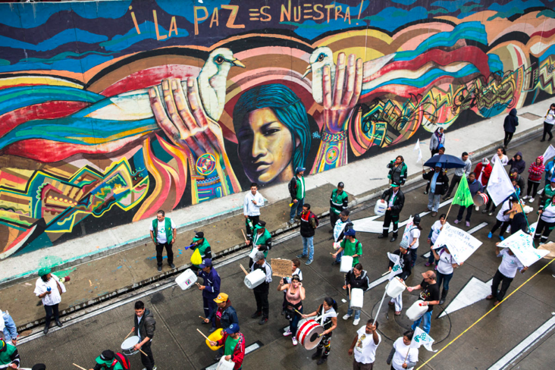
Creating an Ethics Protocol
If PAR is built on the ways communities already care for each other, can we identify those caring ways, amplify them, and agree to them as guiding our PAR?
What is an Ethics Protocol?
Some communities already have formal protocols or IRBs
What are some elements to consider for inclusion and how might they be re/envisioned in PAR?
Photo: Juan Arredondo/Getty Images/Images of Empowerment
Notes:
Potential elements for an Ethics Protocol
Respect for individual autonomy and community integrity
Beneficence
Justice
Safety and security
No Deception or Exaggeration
Feminist Ethics of Wellbeing and Care
Commitment to Reflexively Examining Hidden Power in PAR

Slide 19
At the end of the Research Project, all data shall be given to the Navajo Nation Data Resource Center. (Intellectual & Cultural Property owned by the Navajo Nation)
https://www.nnhrrb.navajo-nsn.gov/aboutNNHRRB.html

Slide 20
Break

Slide 21
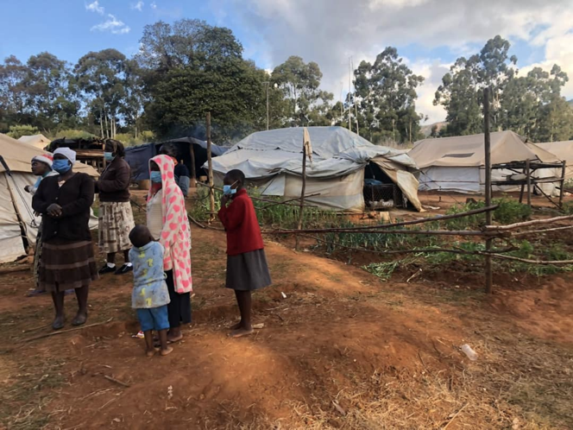
Forces that Trap Us During PAR:
Faces of Power
The Story of Amina

Slide 22
Example: What Killed Amina?
Making Visible a Web of Injustice and Systemic Violence
Gender-Based Violence
Type here
Lack of Water
Type here
Type here
Type here
Type here
Type here
Type here
Type here
Notes:
Each group can type in the boxes the forces that killed Amina and draw connection among them. They can move the labels to different places.

Slide 23
title
words
words
words
Notes:
Meg

Slide 24
Thank you!

