Slide 1
Intro to Big Law:
10 Questions to Ask Yourself in Choosing a Practice Area
New York University Law School • October 2022

Slide 2

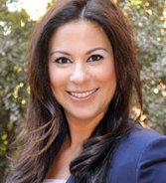
Introduction
Who are we?
It’s never too early to think about your career
General framework
Ru Bhatt
—
Partner, Associate Practice Group
Stephanie
Biderman
—
Partner, Associate Practice Group

Slide 3
Self Assessment Takes Work
Self-assessment is an ongoing process — your values, skills and interests may change over time.
Your basic personality, however, does not change much over time.
It is worthwhile to look at all factors that make up who you are, what gets you going, and what talents come naturally to you.

Slide 4
What does Self Assessment Do?
Allows you to make informed career decisions in line with:
  Your values
  Your skills
  Your likes and dislikes
  Your innate strengths
  The most important aspects of your personality
Without a proper self-assessment…
  Career satisfaction becomes a gamble rather than a thought out game plan
  Big potential for, “Help — get me out of here!”

Slide 5
What is Your Ideal Job?
It nourishes important aspects of your personality.
It reflects who you are.
It lets you use your innate strengths in ways that come naturally.
It doesn’t force you to do things you don’t do well.

Slide 6
What is Big Law?
Am Law 200 firms primarily represent corporate clients
Practices area framework:
  Litigation
  Corporate/transactional
  Regulatory

Slide 7
Various Paths
What are the various paths to consider?
  Law Firm (large vs. boutique)
  Government
  In-House
  Non-Profit
  Options outside of practicing

Slide 8
COVID Impact
How has COVID impacted the legal industry?
  Remote working / Hybrid
  Training and mentorship
  Geographic flexibility
How should you evaluate your career in light of these changes?

Slide 9
Why This Matters
Switching practice areas rarely occurs
Associates get branded early
Law firm economics
  Salary scale
  Billing rate structure

Slide 10
Questions
What topics are you attracted to?
How do you envision your role as an attorney?
Do you mind facing moral conundrums in your practice?
Do you want to be an expert or a generalist?
Would you be attracted to a “code-based practice”?
Are you comfortable with an adversarial practice?
How important is a predictable schedule?
Where can your law degree take you outside of a law firm?
Where do you want to live?
How might the current market conditions impact your practice group selection?

Slide 11
1
What topics are you attracted to?

Slide 12




1. What topics are you attracted to?
People | Ideas | Things | Money/Business
Employment Entertainment Executive Compensation Family law Immigration Plaintiffs in class actions Trusts & Estates White Collar Criminal | Antitrust Appellate ERISA IP Litigation Litigation Tax | Asset Finance Project Finance Real Estate (Finance, Transactions) Renewable energy | Bankruptcy Corporate Finance Securities

Slide 13
2
How do you envision your role as the attorney?

Slide 14
2. How do you envision your role as the attorney?
Leader
Appellate
Bankruptcy litigation
Litigation
Trusts & Estates
White Collar Criminal
Team Member
40 Act
Corporate
ERISA Counseling
Executive Compensation
Real Estate Transactional
Tax

Slide 15
3
Do you mind facing
moral conundrums
In your practice?

Slide 16
3. Do you mind facing moral conundrums in your practice?
Yes
Administrative
Corporate
Entertainment
Executive Compensation
IP
Real Estate Transactional
Tax
No
Class Action Litigation
Environmental
Family Law
Insurance Coverage/Defense
Labor & Employment
Product Liability
Project Finance
Trusts & Estates
White Collar Criminal

Slide 17
4
Do you want to be an expert or a generalist?

Slide 18
4. Do you want to be an expert or a generalist?
Expert
Bankruptcy
Corporate (New York)
Corporate Governance
ERISA
Executive Compensation
Family Law
Immigration
IP Litigation (hard sciences)
Labor & Employment
Tax
Trusts & Estates
Generalist
Corporate (DC/California)
General Litigation

Slide 19
5
Would you be attracted to a “code-based practice”?

Slide 20
5. Would you be attracted to a “code-based practice”?
Yes
40 Act
Administrative
Antitrust
Executive Compensation
Regulatory
Securities
Tax
No
Corporate
Litigation

Slide 21
6
Are you comfortable with an adversarial practice?

Slide 22
6. Are you comfortable with an adversarial practice?
Yes
Employment
Family Law
Real Estate
Trusts & Estates (litigation)
Litigation
Corporate (day-to-day)
No
Administrative
Corporate (overarching)
Compliance
  Public company reporting
  Derivatives/structured finance
  Dodd Frank
Bankruptcy
Finance
Fund Formation
Regulatory
Tax

Slide 23
7
How important is a predictable schedule?

Slide 24
7. How important is a predictable schedule?
Important
Government Agency
  NLRB
  DOJ
  SEC
  CFTC
IP Prosecution
Land Use
Trusts & Estates
Not Important
Bankruptcy
Corporate
  Cross Border Transactional
Litigation
Real Estate

Slide 25
8
Where can your law degree take you outside
of a law firm?

Slide 26

8. Where can your law degree take you outside of a law firm?
M&A: Corporations; start ups; business opportunities; private equity shops
Capital Markets: SEC; public companies; growing companies
Banking Finance: Wall Street; financial institutions; private equity shops; alternative lenders
Litigation: Government – AUSA/SEC; boutique firms; some corporations; starting your own firm; compliance
IP: Corporations; tech companies
Real Estate: Developers; financing work; private equity shops
Tax: Corporations; business opportunities
L&E: Any business

Slide 27
9
Where do you want
to live?

Slide 28

9. Where do you want to live?
Amsterdam • Atlanta • Baltimore • Basking Ridge • Beijing** • Boston
Charlotte • Chicago • DALLAS • Delhi** • DENVER • Hong Kong • Houston
Las Vegas • London • Los Angeles • Miami • Minneapolis – St. Paul • New York
Orange County • Palo Alto • Philadelphia • San Diego • San Francisco
Seattle • Seoul* • SINGAPORE*** • Sydney • Tokyo • Washington, D.C.
*Strategic Alliance **Affiliate ***Major, Lindsey & Africa (Singapore) Pte. Ltd., Lic. No. 16S8347

Slide 29
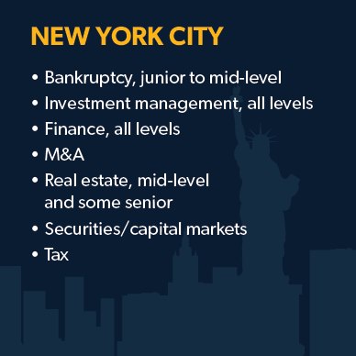
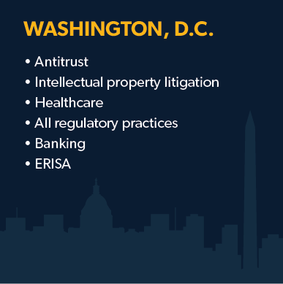
East Coast Market Overview

Slide 30
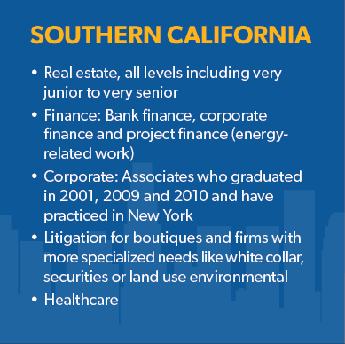
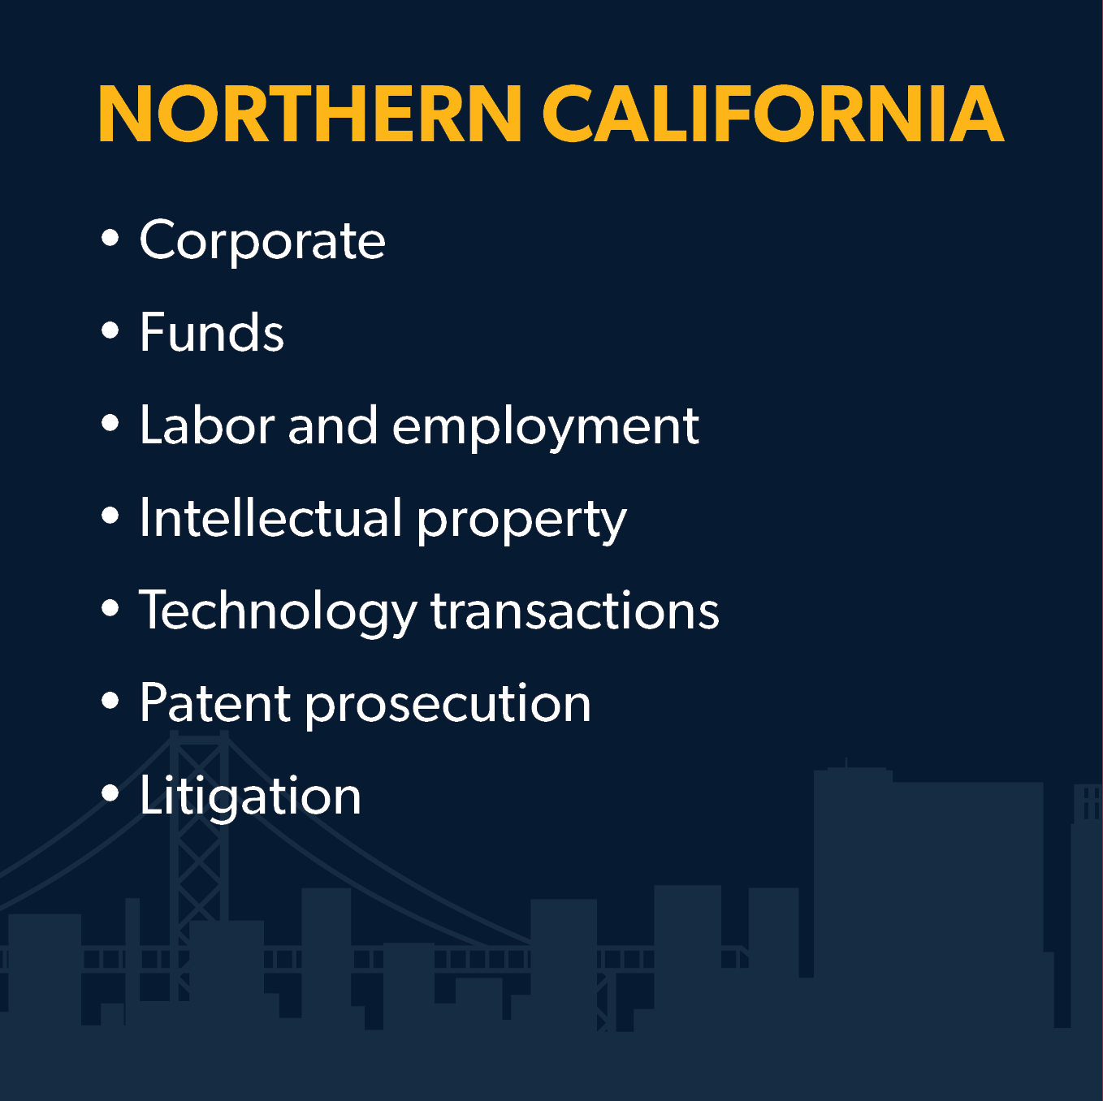
West Coast Market Overview
PACIFIC NORTHWEST
Corporate (EC/VC, M&A)
Litigation (general)
IP (litigation)
Notes:
Need to fix this slide
Pacific Northwest
Corporate (EC/VC, M&A)
Litigation (general)
IP (litigation)

Slide 31
Other Markets Overview
Atlanta:
  M&A / PE
  Finance
  Real Estate
  Tech Trans / Data Privacy
  IP (Prosecution, not litigation)
  ERISA
  Healthcare
Boston:
  IP (litigation and prosecution),
  tech trans and licensing,
  M&A and PE, ECVC,
  general commercial litigation, white collar (growing practice),
  real estate (transactional and land use),
  L&E (transactional and litigation/counseling)
Charlotte:
  M&A / PE
  Finance – ALL, but especially fund finance
  Real Estate
  Erisa
  Healthcare
  IP (Prosecution, not litigation)
Chicago:
  Corporate/M&A/Finance/Capital Markets
  Litigation (Mostly Commercial & Some White Collar/Investigations)
  Real Estate
  Health Care
  IP- Litigation & Prosecution
  L&E
Miami
  LATAM work
  M&A
  Litigation (commercial litigation, and international arbitration)
  Real Estate (all kinds)
  construction,
  Bankruptcy, tax,
  Trusts and Estates
  Healthcare (growing)
Austin, Texas
  Tech/IP related practices (ECVC, tech transactions)
  Life Sciences related practices (Corporate/M&A/PE, Hard IP)
Dallas, Texas
  Corporate, (M&A, Finance)
  IP
Houston, Texas
  Corporate (M&A, Finance)
  Oil & Gas-related practices
  Litigation
  Bankruptcy
Philadelphia
  Corporate, especially in M&A
  Real Estate
  Litigation, for well-credentialed candidates
  Employment Law
  Employee Benefits

Slide 32
International Markets
Asia
  Hong Kong (Mandarin Skills preferred, but sometimes not essential, depending on market demand)
    Capital Markets,
    FCPA
    M&A,
    Funds
  Seoul:
    Capital Markets,
    M&A
    Venture Capital
  Singapore:
    Corporate, M&A
  Tokyo:
    Corporate, M&A, Capital Markets
Europe
  London:
    capital markets,
    PE and arbitration
  Paris/Frankfurt/Madrid:
    M&A/PE
    capital markets

Slide 33
10
How might current market conditions impact your practice group selection?

Slide 34
10. How might current market conditions impact your practice group selection?
WHAT’S HOT:
Practice Areas
Corporate
  M & A
  Finance
  Private Equity
Cyber Security & Data Privacy
Regulatory/White Collar (anticipated increase in 2022)
Litigation
Industries
Emerging Companies/Venture Capital
Financial Services
Healthcare
Life Sciences
Technology

Slide 35
Final Thoughts
Ask for advice
Express concerns or fears
Ask questions

Slide 36
Questions?
Ru Bhatt PARTNER, LAW FIRM Practice Group rbhatt@mlaglobal.com | Stephanie Biderman PARTNER, LAW FIRM PRACTICE GROUP sbiderman@mlaglobal.com

