Slide 1
Principles of Participatory Action Research
Mela Chiponda
Women’s University in Africa

Slide 2
What is Participatory Action Research
PAR is a research process involving collaboration of the ‘outsiders’ and the ‘insiders’ with a view to deepening a shared understanding of the world by trying to change it.
Researchers utilizing these methods identify a problem along with participants (who are the co-researchers) and carry out a process of fact-finding, conceptualization, planning, implementation and evaluation to solve problems and generate new knowledge at the same time.
PAR emphasizes a strong link between research and action, meaning that research generates information and knowledge which is used to inform action.

Slide 3
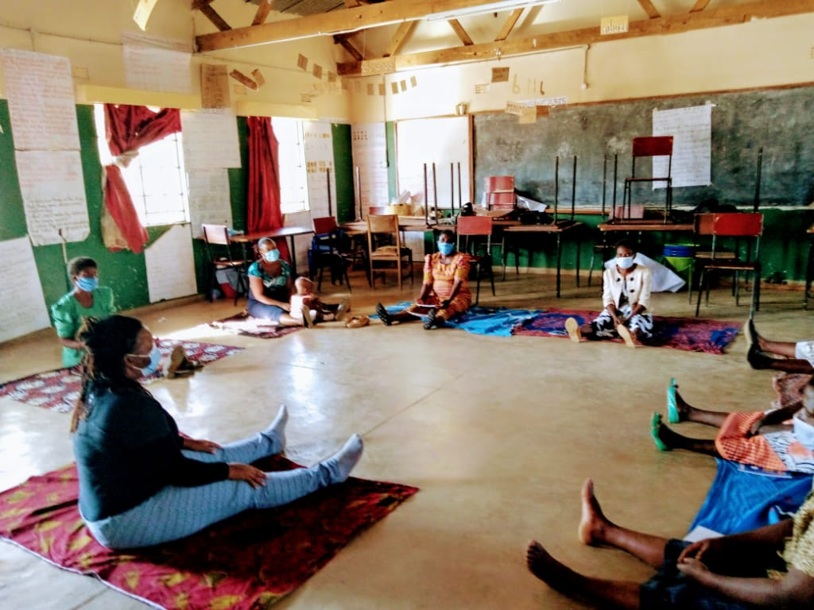
PAR is a collaborative process

Slide 4
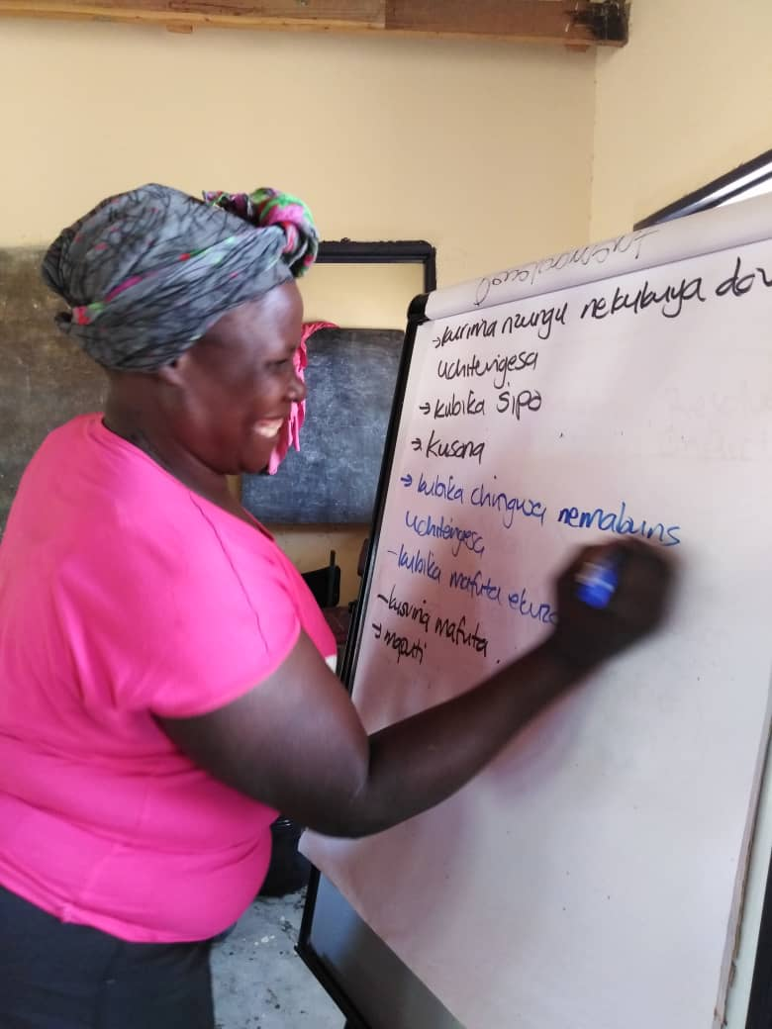
PAR is:
Collective
Rooted in people’s experiences and lives
Respectful of the knowledge that people hold
Empowers people to understand the world through their efforts to change it
Shifts power in the research process by deeply involving those that otherwise would be research subjects

Slide 5
Principles of PAR
Participation
Full inclusion and appreciation of people’s knowledge
Individual and collective action
Conscientisation and social change
Researcher flexibility and responsiveness
Recognising different sources of people’s oppression

Slide 7
Tools used in PAR
Tools used for PAR data collection include:
Backward and forward visioning
Historical timelines
Transect walks
Storytelling
Body mapping
etc

