Slide 1
Participatory data collection
in the villas of Buenos Aires.
Felipe Mesel

Slide 2
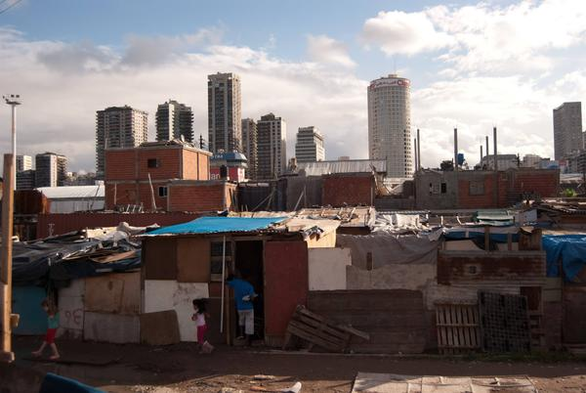
Epistemological disputes in Buenos Aires villas
Villas (informal settlements) began in 1930 in the City of Buenos Aires. The public policies towards villas fluctuate from omission to massive eviction.
Not only State discrimination, but also a epistemological discrimination (knowledge gap). First academic investigations were qualitative (e.g. ethnographies).
Relevance of qualitative studies but without public data they could be seen as “exotic” ways of building knowledge.

Slide 3
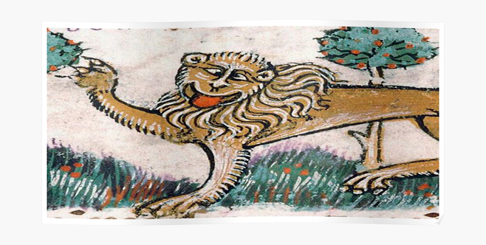
Epistemological disputes in Buenos Aires villas
“Until the lions have their own historians, the hunting stories will continue to glorify the hunter”, Eduardo Galeano.

Slide 4
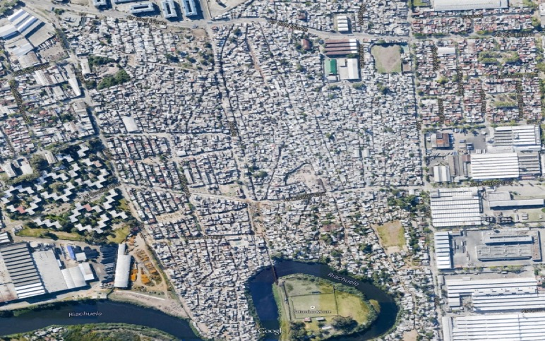
Where are we standing?
Villas weren’t part of official maps.
10% of the population of Buenos Aires (300.000 inhab.) was erased.
“The map is usually read as a static, anonymous and true image that, supported by the institutional legitimacy of a scientific discipline -cartography-, offers an exact vision of the world”, Carla Lois (2000).

Slide 5
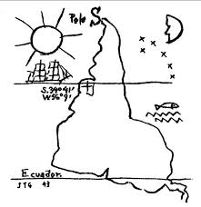
Critical cartography: Maps are discourses
“That’s another thing we’ve learned from your Nation,” said Mein Herr, “map-making. But we’ve carried it much further than you (...) we tried a hundred yards to the mile. And then came the grandest idea of all! We actually made a map of the country, on the scale of a mile to the mile!”
“Have you used it much?” I enquired.
“It has never been spread out, yet,” said Mein Herr: “the farmers objected: they said it would cover the whole country and shut out the sunlight! So we now use the country itself, as its own map, and I assure you it does nearly as well. ...”
Lewis Carroll, Sylvie and Bruno Concluded, 1893, Ch. XI, p. 169
http://www.mi.sanu.ac.rs/~kosta/O%20strogosti%20u%20nauci.pdf
Torres García (1944): “Inverted map of South America”.
Notes:
http://www.mi.sanu.ac.rs/~kosta/O%20strogosti%20u%20nauci.pdf

Slide 6
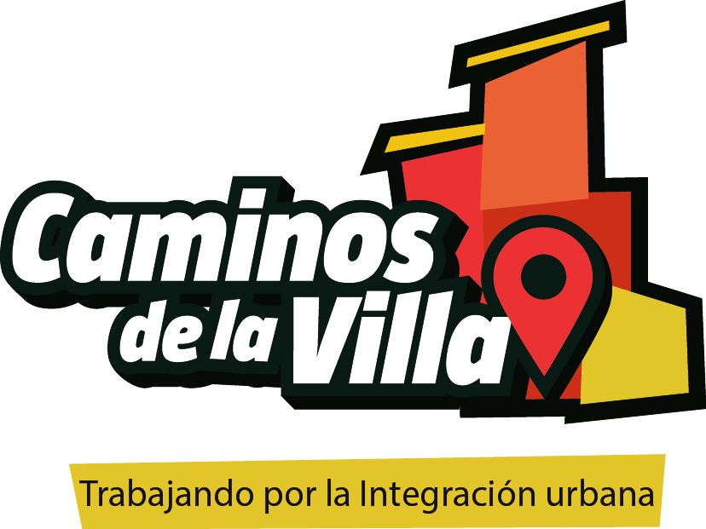
Data collection
https://caminosdelavilla.org/
Notes:
https://caminosdelavilla.org/

Slide 7
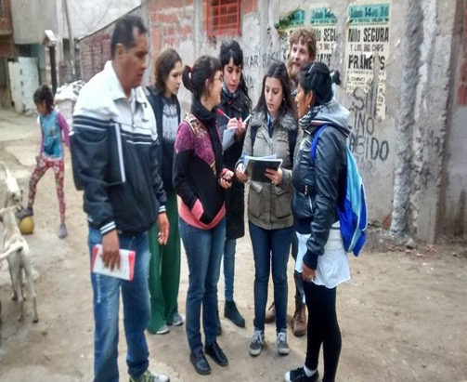
1st phase: Participatory mapping (2014).
“Maps are not value-neutral objects but rather reflections of the interests and world-views of their makers” (Harley, 1988).
Workshops in 24 informal settlements (up to five meetings prior to starting the mapping to train volunteers).
Mapping through the use of a GPS device and marking a physical map (then both were cross-referenced).
The hybrid tool was useful to produce:
A common narrative of the urban space.
A dual process: Community adds informations to the map but also inform themselves about how to read and use a map.
A new tool for communicating with official authorities.

Slide 8
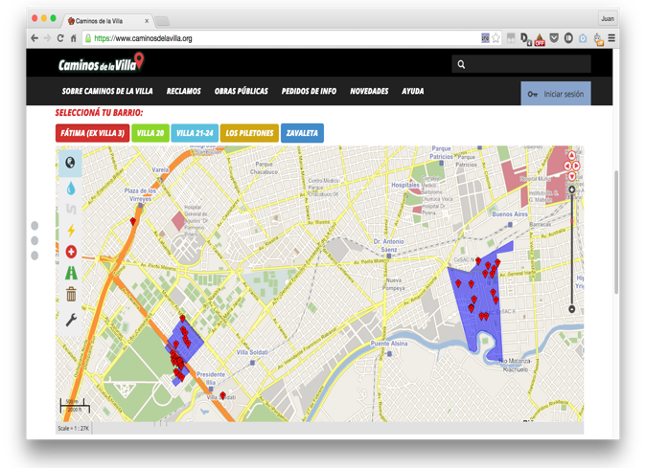
2nd phase: A digital crowdmapping platform
“The head thinks where the feet tread”, Paulo Freire.
A “know by doing” process (making and using maps):
Workshops on how to use the platform to mark service gaps on the digital map.
It invites users to add information about infrastructure problems. First aim: upload complaints to provide evidence. Problems!
New participatory mapping process to document community landmarks and resources in each villa.

Slide 9
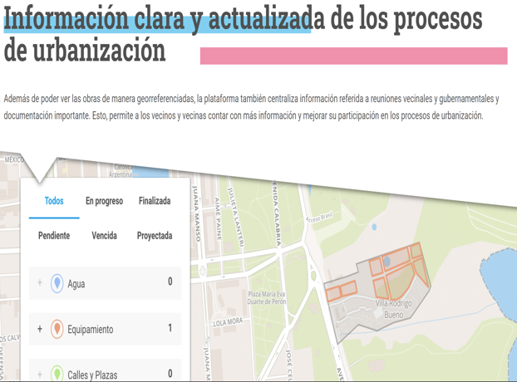
3rd phase: Caminos de la Villa as a repository of information
Provide information for community advocacy about the schedules, budgets and public works data of the city’s integration projects.
During COVID-19 pandemic: highlight the disparate impact of the virus within the city based on official government statistics.
Notes:
burden

Slide 10
Action-research project: Legal Empowerment on informal settlements in Buenos Aires, La Paz and Quito.
Aim: identify, analyze and strengthen the use of legal tools and strategies, the development of legal empowerment and promotion of effective access to justice, in informal settlements.
Thus, there were three specific objectives:
Produce knowledge.
Strengthen the community and its claims with legal empowerment.
Influence policy-makers.

Slide 11
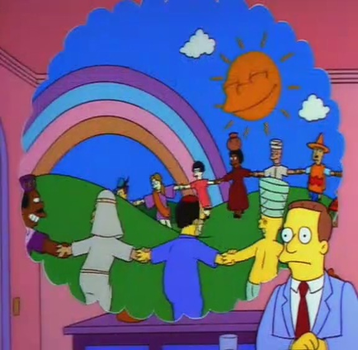
How do we understand “Law” in a LE PAR?
Socio-legal perspective:
Where is the Law located? Where is the Law performed?
These questions will determine our methodology.
“Normative questions . . . hinge not merely on clashes of values but also on rival factual claims, both with respect to specific incidents and events and with respect to determining and constraining social structures” (Mills, 2017).
Critical Legal Theories: Legal Neorealism (Antonio Azuela).
Materialist and decolonial approach: Peripheral and situated legal production.

Slide 12
Outcomes
Law (abstraction)
Equality Respect
Social Justice
Freedom of Speech
Education
Law (experience)
Injustice
Frustration
Long times
Bureaucracy

Slide 13
Quotes
“The Law is like a utopia in the neighborhood. The only right is the right to fight ”.
"I have the right to think about how and where I want to live beyond what the experts tell us".
"We know our rights, the issue is that they are not taken into account (...) the Law is a tool to enforce what corresponds in the face of a justice that is so far from reality (...) the greatest difficulty is the language, it is like a difficult wall to cross ”.
Legal productivity of urban conflicts: Conflicts become processes of collective elaboration of a legal situation, a modality of diffusion of legal knowledge.
“I knew all the rules but the rules did not know me… Guaranteed” (Eddie Vedder)

Slide 14
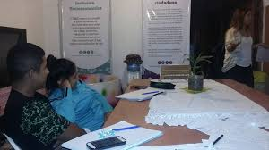
PAR Methodologies:
Iterative and incremental process: articulation between actions and reflection processes.
Interviews.
Participant observation.
Focus Groups.

Slide 15
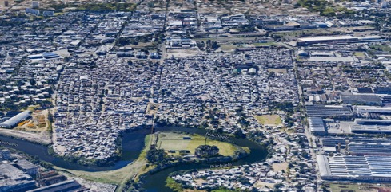
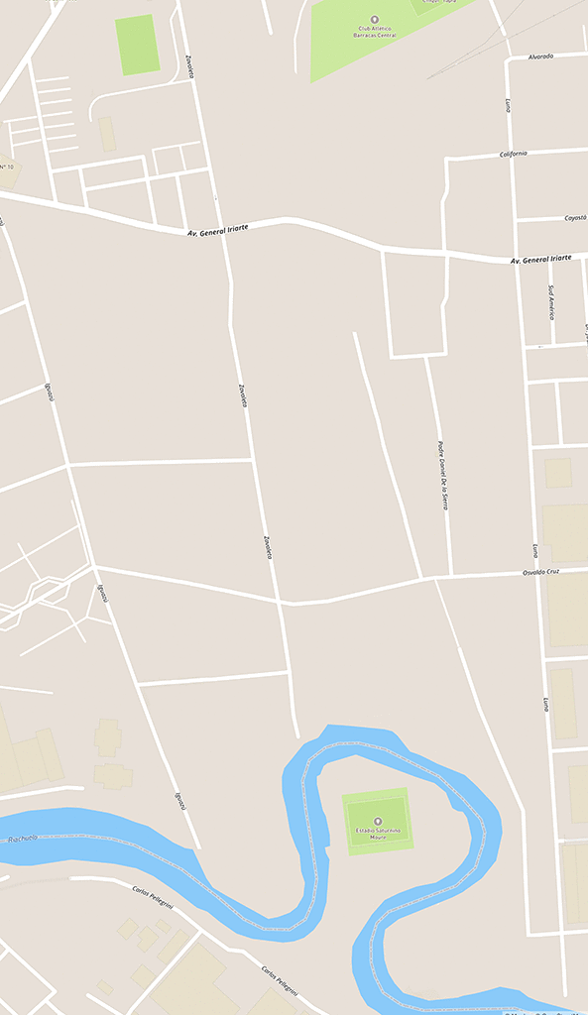
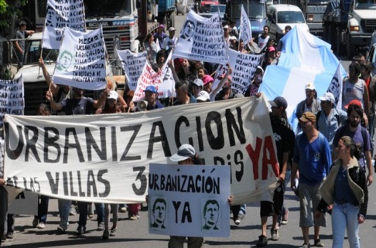
Conclusions: Effects
Mapping project:
Empower communities in the production of information by providing a strategy to contest space.
Make visible territorial conflicts and rights violations in segregated neighborhoods.
Mobilize community to break into the urban imaginary.
Law empowerment project:
Legal productivity of urban conflicts: By writing these experiences they will remain as a legacy and a tool box for the future generations struggles.

Slide 16
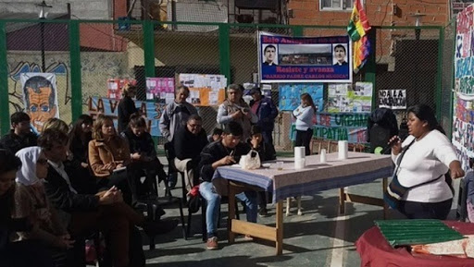
Methodological considerations
How are you dealing with the double role (engaged actor- researcher)?
What is the role of community?
Burdens and languages.
Methodologies and objectives as part of the same process. Methodologies must contribute to the aim. How is methodology contributing to a more expansive distribution of power?

Slide 17
Gracias

Slide 18
What role does the research play in the context in which the group is acting? How would you work with the community to help them design their research? Which methodologies seem most appropriate to use? What considerations would you make about these methodologies (e.g. limitations/ ethical dilemmas)?
For your discussion, let's take into account the following aspects:
Representativeness: How much participation is enough?
External deadlines vs. political grassroot process.
Accountability towards the community.
Ownership of data (protocols).
Diffusion formats.
Validity.
Objectivity.
Bias.
Rigurosity.

Slide 19
3 case studies:
1) An indigenous community of 700 families in Ecuador is affected by a mega-project to build a highway and a hydroelectric dam. The government -led by a left-wing party- identifies that this infrastructure is a priority for the development of the country. However, there weren't participatory procedures for prior consultation to define whether the community is interested in the work.
In a first approach to the community, organized through a local council made up of political leaders who have the greatest material and symbolic resources -such as knowing how to read and write-, we identified that the leaders and the vast majority of the community are against the project. However, one of the leaders tells us that, among the community, there is a significant percentage that agree with the project because they understand that those works will provide greater connectivity with the rest of the country and employment opportunities. The group's aim is to carry out a participatory action research so that the community can participate in the decision process about the construction of the road and the dam. (Group 1; Group 4)
2) An organization of South American migrants, mostly undocumented, in the South of the US, is facing heavy criminalization by law enforcement authorities. The organization noticed that migrants who are more publicly exposed and politically involved are more likely to be the target of deportation proceedings. In this context, the group’s aim is to collaborate with the organization through an action-research project that shows the criminalization of the migrant population and helps to address the situation. (Group 2; Group 5)
3) A group of women living in a favela in Northeastern Brazil are mobilizing to fight gender-based violence. The Mayor of the City decides to start a process of urban regeneration and integration of the favela, offering to improve housing conditions, provide public services and build community spaces. To this end, the government begins to develop spaces of participation for residents to decide some of the relevant aspects of the urbanization project. However, no space has been opened to discuss gender violence and how the project could contribute to reduce it. In this regard, the group’s objective is to identify, through an action-research project, the main concerns the group of women faces and to make them visible so that the urbanization project takes into account gender issues. (Group 3)

Slide 20
Plenary
Which methodologies have emerged during the discussion as most appropriate? What are the methodologies and tools that you are using in your work? What considerations have you discussed in your group, and how do these resonate with your working experiences?
Please, bring your own questions to discuss :) .

