Slide 1
Legal Empowerment Learning Lab
2020-2021
Notes:
POtential music https://www.youtube.com/watch?v=ASggQcPT1zM OR this one? https://www.youtube.com/watch?v=U6Uus--gFrc
Mela and Emese welcome everyone and if tom can do it, we will do a 10 minute meditation. We will invite Tom to lead it.

Slide 2
Where We Have Been, Where Are We Going
Fall 2021
(the last Thursday
of every month)
Oct 202o
March 2021
Case example of an FPAR success Methodological examples Continuing our collaborative article
Introduction to Legal Empowerment
Participatory Data Collection
2020 |  |  |  | 2021
The
Future
Is now!
Summer 2021
Nov 2020
Jan 2021
Shared Struggles, Carrying Complexity
Collective Data Analysis
Ethics and Care
Responding to Delegitimation
What can we nurture into the future?
Introduction to Participatory Action Research
Community-led Research Design
Notes:
Emese can do the review of where we are and an overview of our fall plans (teatimes every third wednesday and sessions every fourth Thursday, as well as the COVID PAR work)

Slide 3
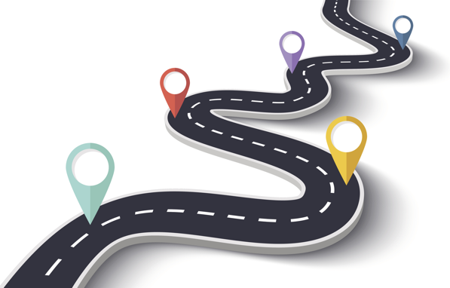
Roadmap
Opening: Tom
Is it ok to record?
What are PAR methods?
Examples we’ve collected from our community
PAR methods in your context: Pairs
PAR methods in your context: Collective
See you at tea time and at next month’s gathering!
Notes:
Tom
Emese can do the roadmap?
Hi dear mela! Looks like you may have lost connection. I’m so sorry about that.

Slide 4
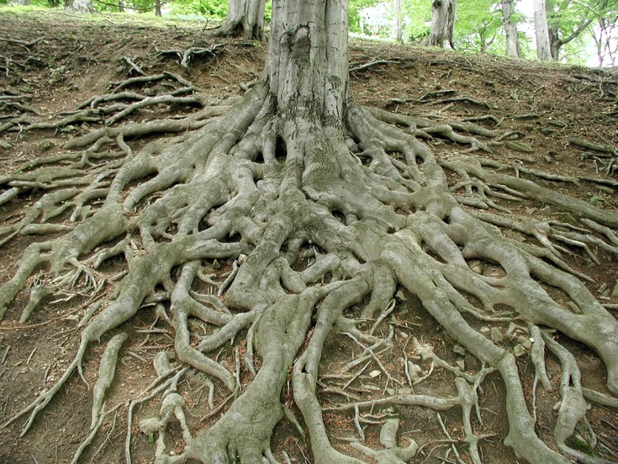
What is Participatory Action Research?
It is a FRAMEWORK
Engaging in research WITH communities interested in documenting, challenging, and transforming conditions of injustice.
Shifts power AWAY from traditional bearers of power to the people.
It is political work that is about popular education, research, and learning at the same time.
Notes:
Mela present?

Slide 5
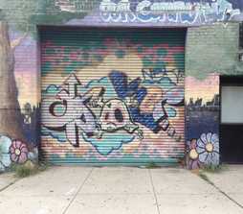
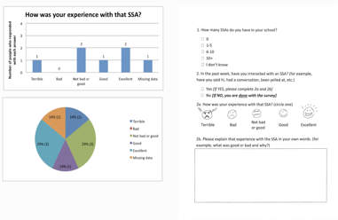
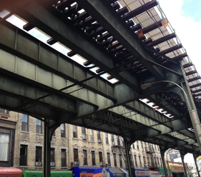
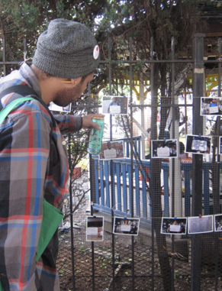
What is Participatory Action Research?
Is NOT limited to any particular methodologies. It can be statistical. It can be narrative.
It is not limited to text. It can be a song, a dance, a photograph an artifact.
The key is POWER. Where is it centered?
Images are of methods used by the Bushwick Action Research Collaborative.
Notes:
Mela?
Methodology that can be done differently to suit a particular context a particular group of people. It comes from where the people are at. THe methods can include anything. They are not written on stone.

Slide 6
What is research? And how do we start?
When we engage in meaning making as a community, we are engaging in research.
Start where people are.
(How do people express their stories? The personal will always tell the story of the structural)
Start where you are.
(What communities do you belong to?)
Notes:
Mela

Slide 7
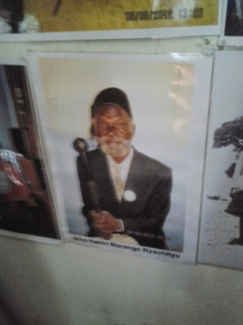
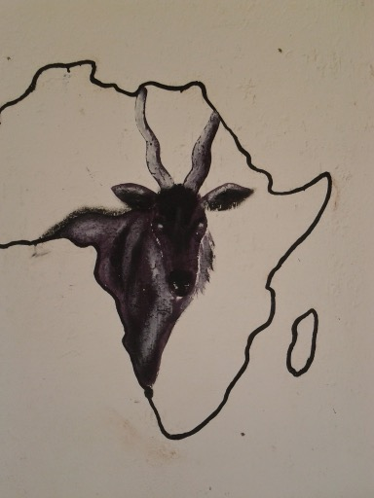
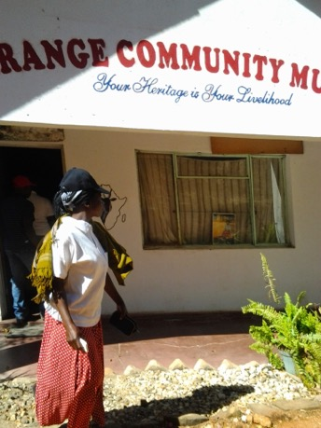
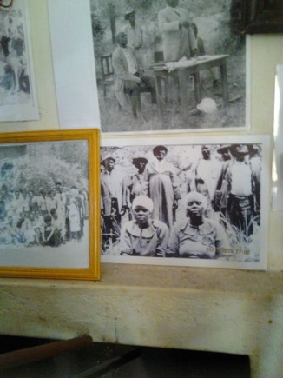
Photos to tell the story of the land
Notes:
INtended to present a case against forced displacement. A success story. For those who want to go and not live together with the mines, can go. Those who want to live together can stay behind. Most stayed. To retain connection.

Slide 8
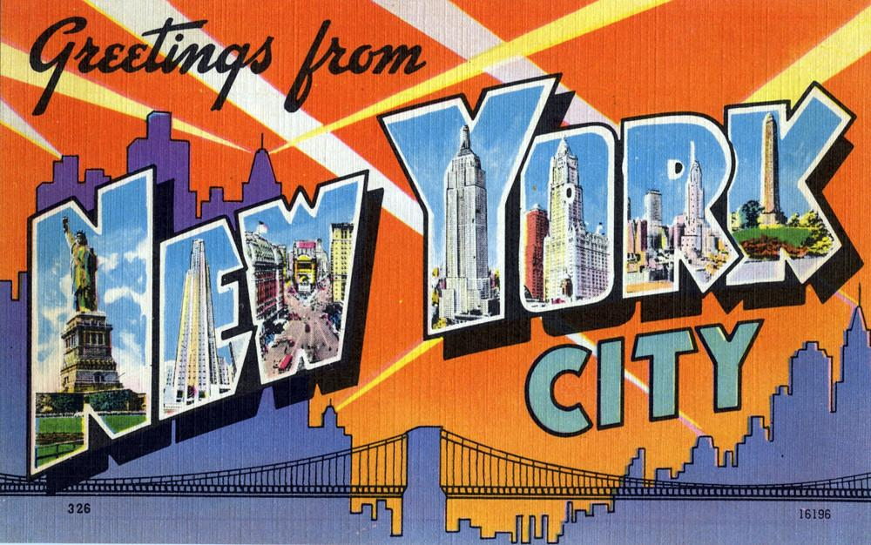
Letters:
Storying connection and survival
New York City Public School students, between the ages of 15 and 19
Letter writing. The young people were invited to write a letter to someone at their school that offered them support.
We read these out loud and had discussions as a community. These conversations were a way of lifting themes collectively and connections that could then be rolled into reports and articles to influence policy.
Notes:
Emese

Slide 9
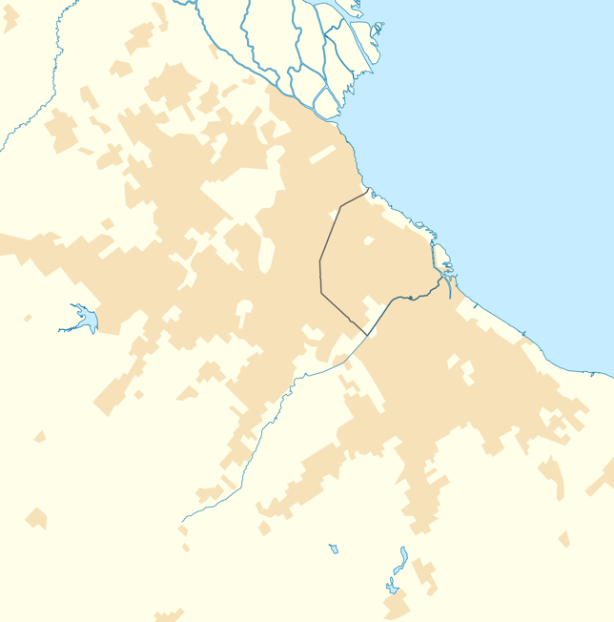
Participatory Mapping:
Refusing erasure
Slum-dwellers living in informal settlements in Buenos Aires City, Argentina
Participatory mapping in informal settlements.
Informal settlements contain 10% of the City of Buenos Aires population. However, on official maps and the most widely used online maps they looked like gray spots within the city. A group of neighbors from different settlements participated in a project to map their neighborhoods and make them appear on official maps.
Caminos de la Villa is the platform that allowed us to visualize the informal settlements of the city. Workshops were held with neighbors to learn how the platform works and make it more accessible and collaborative.
Notes:
If Felipe is here, we can invite to present on this

Slide 10
Participatory Survey Development: Refusing categories
LGBTQIA youth in NYC
Participatory survey development. A very rough draft of a survey about LGBTQ+GNC youth experiences was drafted. This was handed out to about 100 young people who came to a survey development party. There was food and beverages and over the course of three hours, students worked in small groups to make edits and suggestions on this survey.
A group of young people worked collaboratively with the researchers to analyze findings.
Notes:
EMese

Slide 11
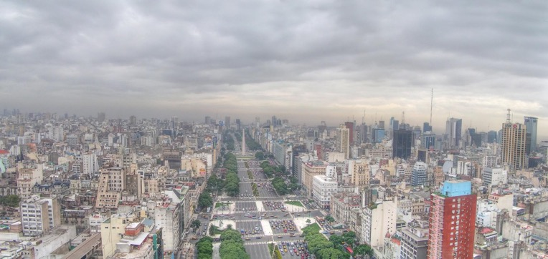
Strategic Participatory Litigation:
Translating legal processes
Slum-dwellers living in informal settlements in Buenos Aires City, Argentina
Strategic litigation to access public services. Different groups of slum-dwellers have sued the government of the city of Buenos Aires demanding the provision of basic services in their neighborhoods, such as water or electricity, that are constitutionally guaranteed.
We have systematized the positive and negative results of these processes in various materials that have been discussed with the neighborhood groups.
Notes:
Felipe

Slide 12
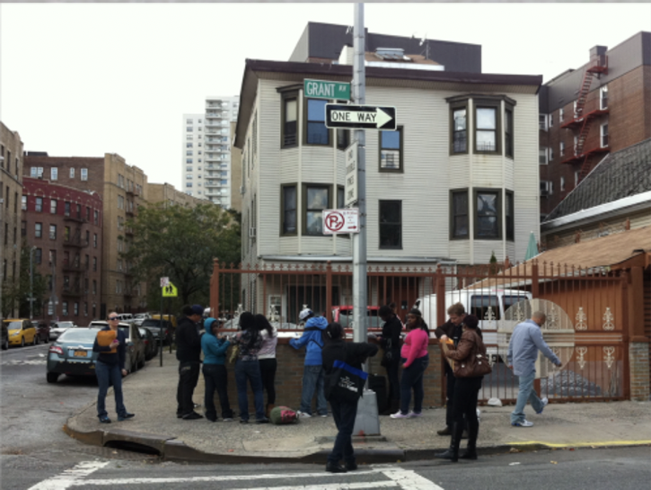
Critical statistical analysis:
Engaging with existing data
Over-policed black and brown residents of New York City.
Statistics about stop and frisk practices were gathered and projected on a building. People passing by were able to respond to and add to the information that they saw.
The community members who were also co-researchers engaged in conversations with people who had questions or who were responding to what they saw. This served as information dissemination, consciousness raising, but also active analysis as these conversations informed next steps and the narrative going forward.
Notes:
If Maria or Michelle are here, we’l invite them to speak

Slide 13
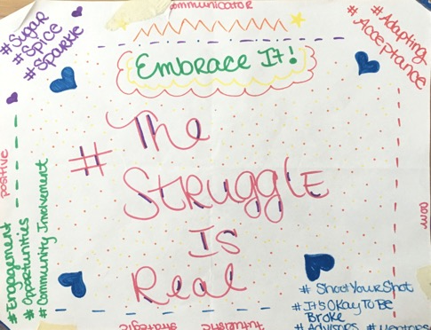
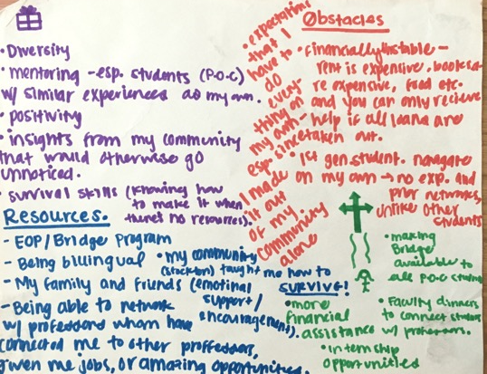
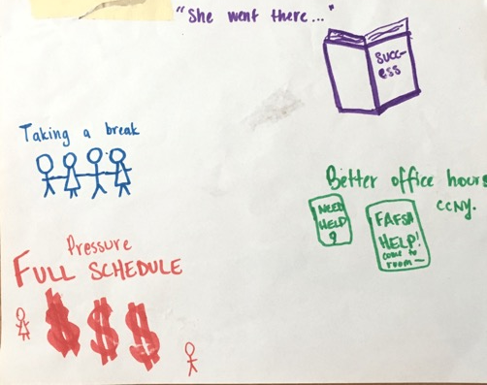
Mapping obstacles and resources:
Speaking back to student success literature
First generation, economically precarious, LGBTQIA, BIPOC undergraduate students throughout the United States.
Engaging with the academic dominant literature and narrative about student service and education outcomes, a group of students co-created a public facing space to invite other students to gather resources for survival.
This PAR project - which began with this mapping exercise - lasted over five years and included students attending public universities from five states. By building these relationships over time a space was opened up for monthly conversations that then shaped the steps taken and resulted in a published article to speak of these experiences. The group embodied and enacted practices that challenged dominant stories told about “marginalized” and “under-represented” students.
Notes:
Emese

Slide 14
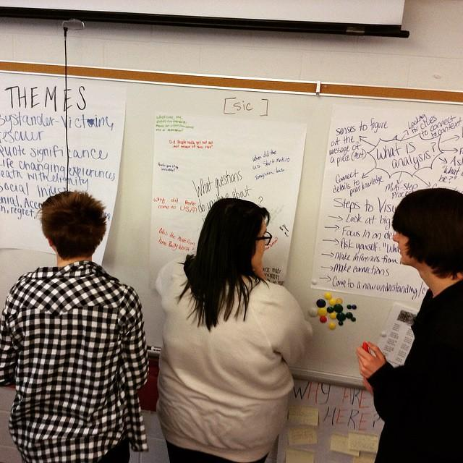
Mapping obstacles and resources:
Interrogating the intersection of multiple systems
College students who were formerly in foster care.
Visually mapping their journey to college. With the instructions to use red for what got in the way, green for people or opportunities that helped you, purple to represent your wonderful personal spirit and drive.
When completed these were hung on a wall and everyone did a gallery walk. Following that, in small groups, students discussed connections, surprises, and other things they noticed. After that, people were invited to share about their map. When one person shared, questions were asked about who else experienced specific pieces shared and hands were raised.
Notes:
Michelle? If she is here.

Slide 15
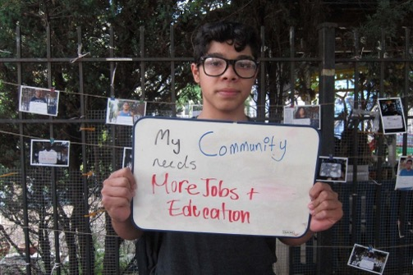
Sidewalk science:
Interrogating the intersection of multiple systems
Sidewalk Science is a set of techniques, strategies and activities designed to bring our research, literally, into the streets and engage the community in dialogue about our findings.
Youth in Bushwick, Brooklyn used Sidewalk Science to share our ongoing research with the larger community, setting up research stations on the sidewalk and asking community members to contribute in multiple ways: populating a “crowd-sourced” map of the neighborhood, providing answers to basic research questions like “what does our community need?” and “what does our community have?” among others, or simply taking the time to learn about the project.

Slide 16
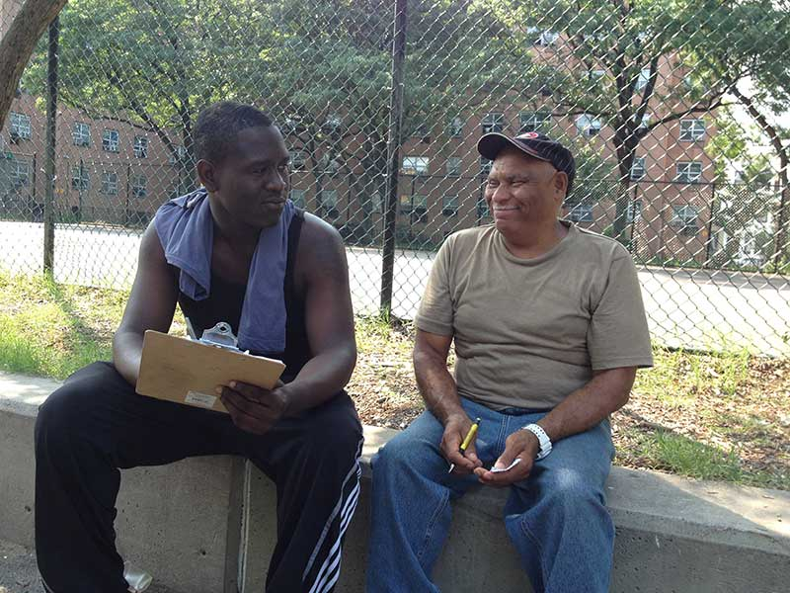
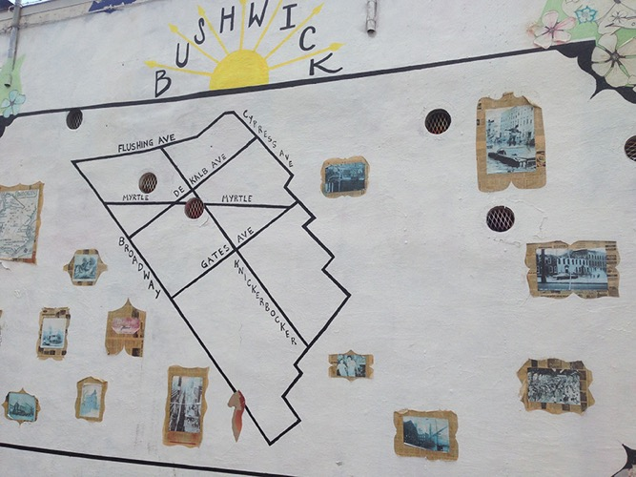
Walking and visual mapping:
Documenting neighborhood assets and understanding community
#wickwalk is a multi-method digital research method we developed for learning about Bushwick, to provide a foundation for thinking about the development of a community school in the neighborhood.
Aided by maps, cameras, and interview questions, our research team set out in small groups (including Bushwick residents and non-residents, and both adult and youth co-researchers) on walking tours of different segments of the neighborhood, mapping routes and landmarks, photographing, observing, and talking to people on the street.
These tours aimed to document the neighborhood’s “assets,” think about who is a part of “the community,” and to think about what residents could use from a community school. In addition to paper documentation, we used Twitter to post photos of and reflections on the neighborhood with our hashtag #wickwalk, helping build an online repository of our observations and experiences.

Slide 17
Swimming around the constellation of methods
In pairs: Which methodologies (either ones in the constellation of methods we collected or others you know) speak to the needs and preferred ways of expressions in your community?
If you are thinking about the COVID project, what methods can you imagine resonating with the community you are engaged with?
Notes:
Mela -- Tyler set up groups - Working in Jamboard--integrate images and words into their mapping of possibilities
https://jamboard.google.com/d/161T2Apuu3ytUjmP8ouDe1SfSodKMK2Tqv2YQk38G4HE/edit?usp=sharing

Slide 18
A parting gift: Poem by Haki R. Madhubuti

