Slide 1
Legal
Empowerment
Learning Lab
March 3, 2022

Slide 2
Community Circle:
The Ones We Carry
In celebration of International Women’s Month, and in celebration of you:
Share stories of women you’ve known, who you carry, who have have carried and nourished you (grandmas, ancestors, sisters, aunties, mothers etc)

Slide 3
Community Circle:
Our Struggles Today
Each of our stories of the struggles we are engaged in since we last met.
What are some new developments?
The personal is political, this is not just about work.

Slide 4
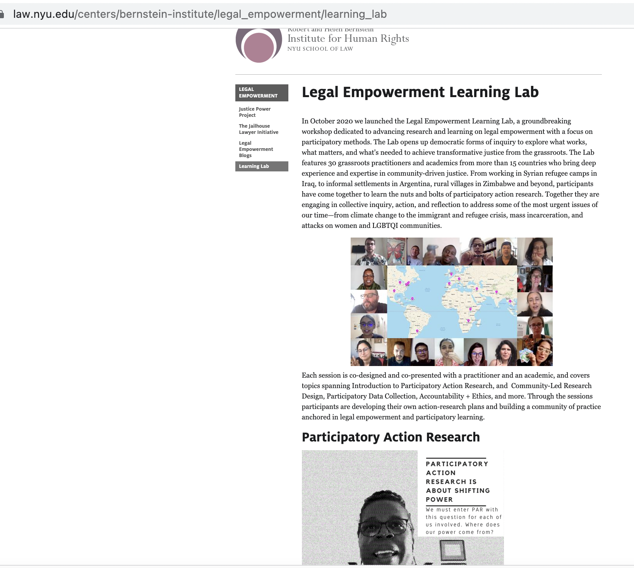
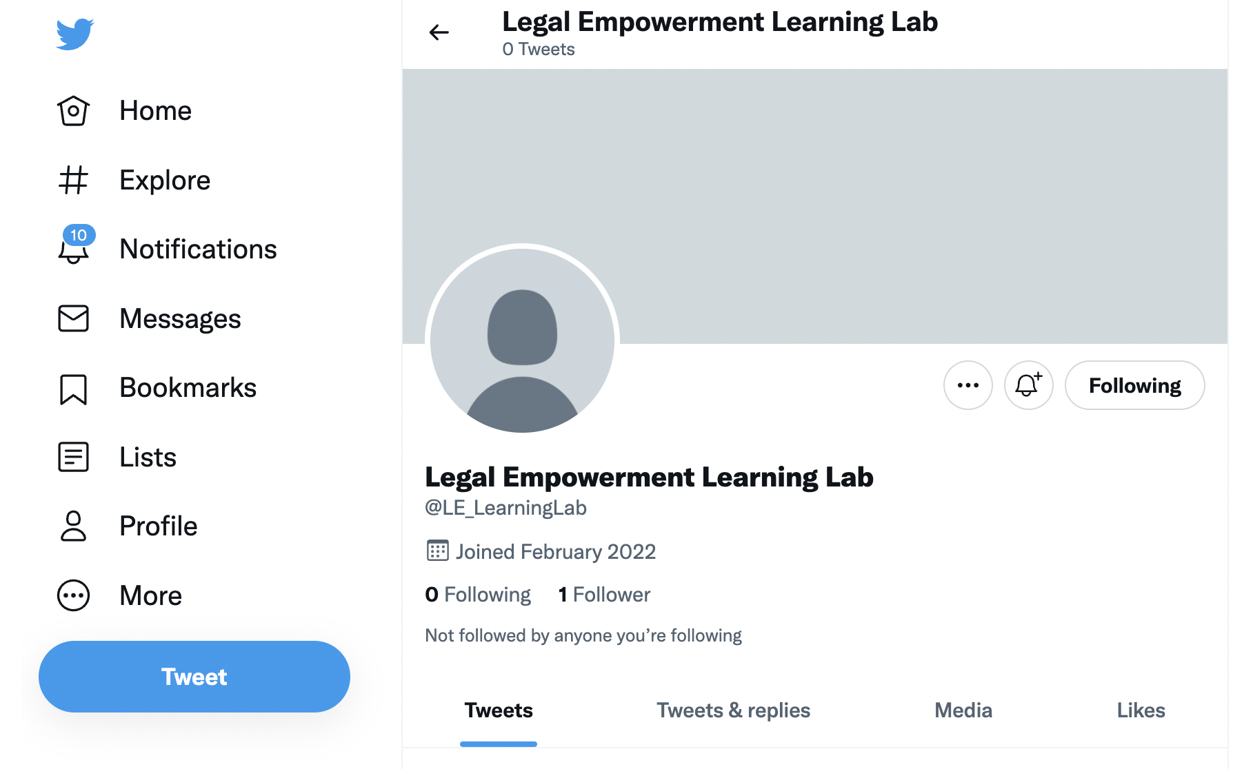
Carrying the story of the LE lab forward:
Website and Twitter

Slide 5
Monthly Learning Sessions and Tea Times

Slide 6
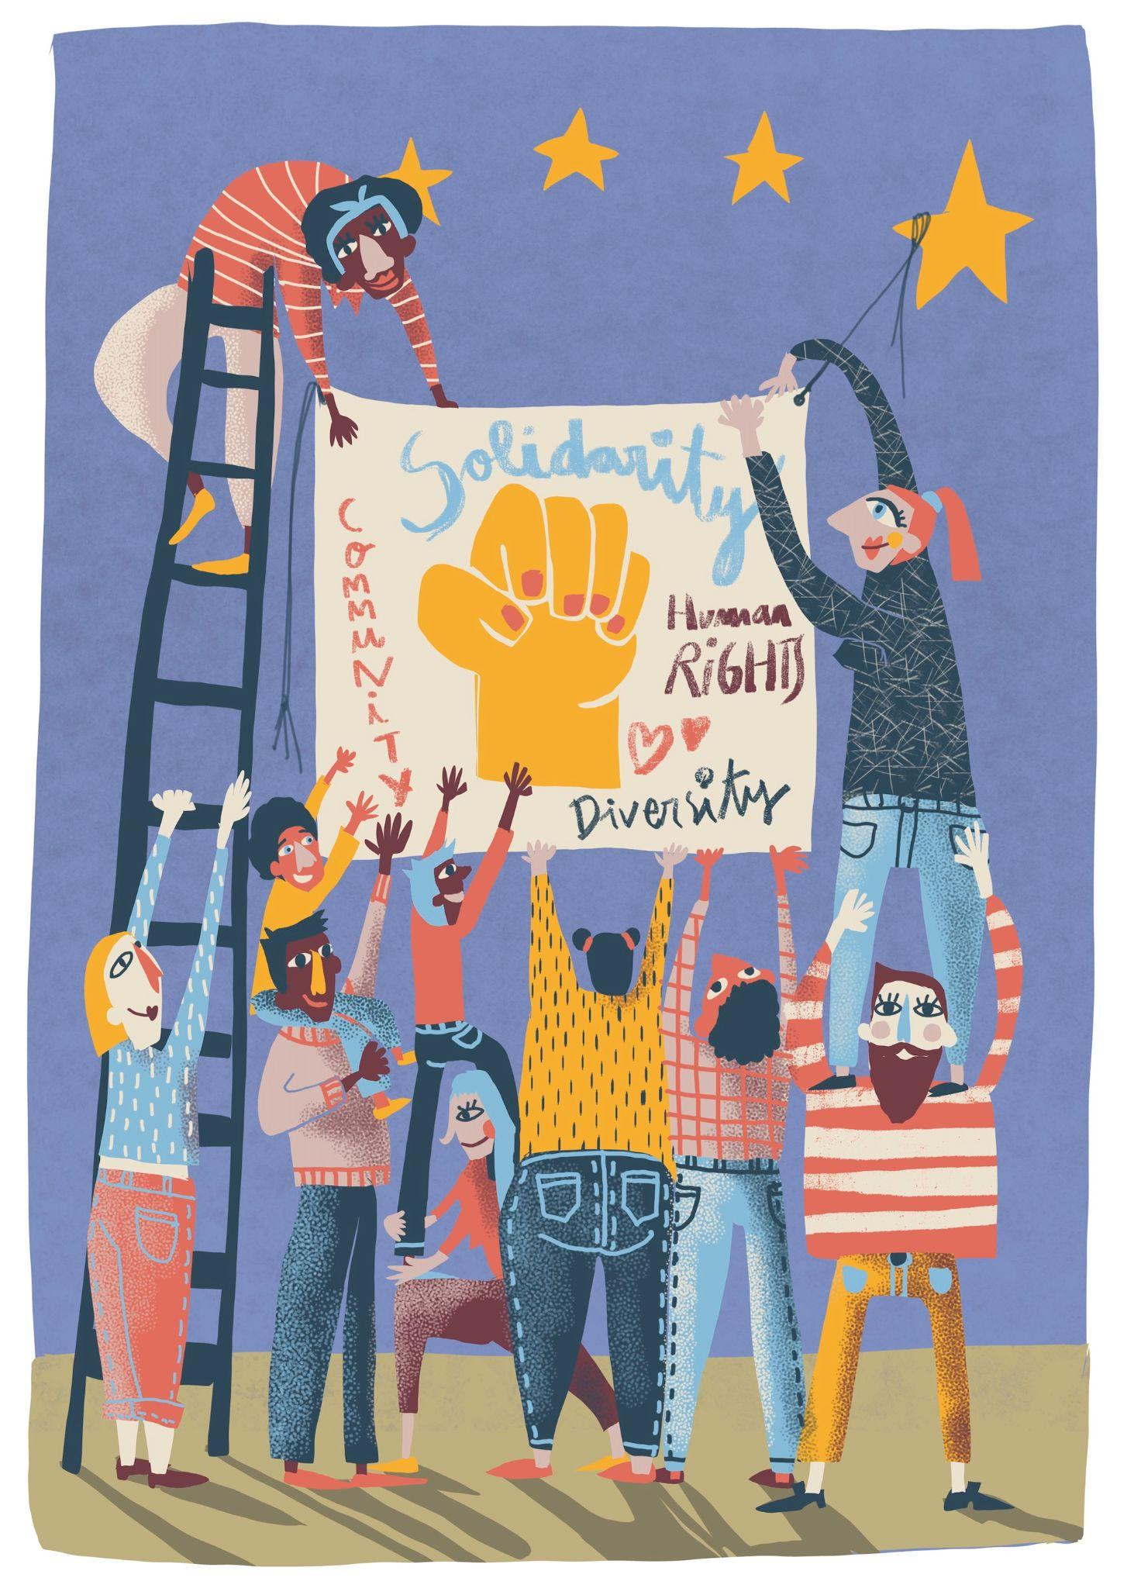
Tea Time
Thursday, March 24th
9 am

Slide 7
Monthly Co-Learning Session:
Thursday, April 6th
Aakanksha
How Participatory engagement deepened the understanding of and the response to the issues faced by pregnant women seeking healthcare during COVID

Slide 8
Monthly Co-Learning Session:
May
Antonio
Weaving participatory strategies into mobilizing for large scale campaigns. The impacts of local PAR on global policies.

Slide 9
Monthly Co-Learning Session:
June
Tim and Phoebe
How can participatory practices be integrated to streamline certain legal procedures and how can this also improve implementation of new policies/practices?

Slide 10
See you at Tea Time and next month’s session with Aakanksha!

Slide 11
When I think how far the onion has traveled
just to enter my stew today, I could kneel and praise
all small forgotten miracles,
crackly paper peeling on the drainboard,
pearly layers in smooth agreement,
the way the knife enters onion
and onion falls apart on the chopping block,
a history revealed.
And I would never scold the onion
for causing tears.
It is right that tears fall
for something small and forgotten.
How at meal, we sit to eat,
commenting on texture of meat or herbal aroma
but never on the translucence of onion,
now limp, now divided,
or its traditionally honorable career:
For the sake of others,
disappear.

