Slide 1
Legal Empowerment Learning Lab
Session 4: Participatory Data Collection

Slide 2
Roadmap
What’s Outside Our Windows
Schedule + Team Updates
Participatory Data Session
Next Steps
Notes:
Sukti

Slide 3
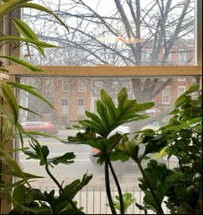
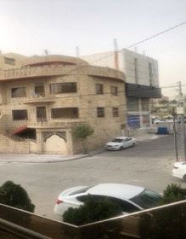
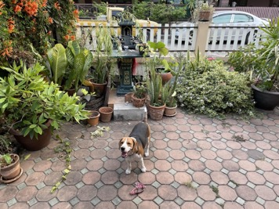
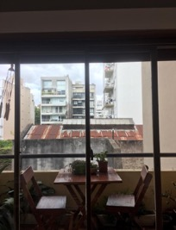
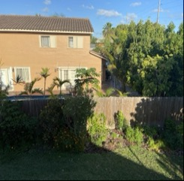
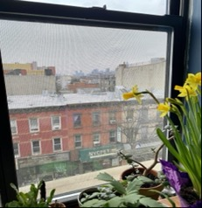
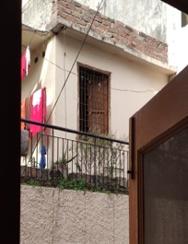
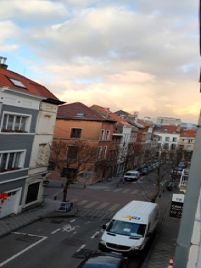
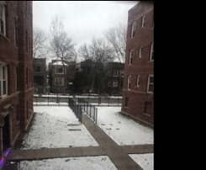
What’s Outside Our Windows
Notes:
Sukti

Slide 4
Learning Lab Schedule
Oct 202o
March 2021
Participatory Data Collection
March - July 2021
Introduction to Legal Empowerment
Accompaniment Sessions
Small Group Sessions
2020 |  |  |  | 2021
Nov 2020
Jan 2021
July 2021
Participatory Data Analysis
Approaches to Measuring Empowerment
Accountability and Ethics
Communication Strategies
Case Studies
Introduction to Participatory Action Research
Community-led Research Design
Notes:
Sukti

Slide 5
Reflections and Accompaniment Sessions
Reflections
One on one discussions & learning questions
Dilemmas that arise as the “rubber hits the road”
Community and communities
Timelines: internal v external
Mela Chiponda and Emese Ilyes joining the Institute’s team to support the LE Learning Lab
Accompaniment sessions with participants on learning questions and action-research plans
Small group sessions
Support co-design of summer sessions
Synthesis document
Notes:
Sukti

Slide 6
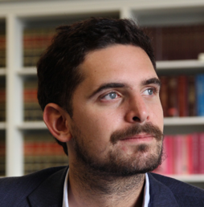
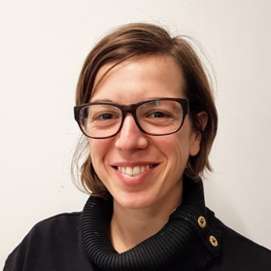
Participatory Data Collection
Felipe Mesel is a human rights lawyer and researcher for the Asociación Civil por la Igualdad y la Justicia (ACIJ), an organization dedicated to furthering democratic practices and rule of law in Argentina. Felipe works alongside marginalized communities, with a focus on demanding public services for individuals living in informal settlements through community-driven data collection and strategic litigation. At ACIJ, he co-leads an interdisciplinary action-research project that examined urban segregation in the informal settlements of Buenos Aires, La Paz, and Quito. He also serves as a law professor and housing advisor for the Ombudsman of the City of Buenos Aires.
Francesca Feruglio is a human rights researcher, trainer and activist. Currently she is the Coordinator of the Working Group on Monitoring of the International Network on Economic Social and Cultural rights. In addition, she develops legal education programs focusing on housing and welfare rights in England for Law for Life, the foundation for Public Legal Education. Francesca also co-founded Nazdeek, a legal empowerment organization in India. She has been involved in research, advocacy and capacity building with grassroots groups, international NGOs and academic institutions and focuses on socioeconomic rights and issues around citizens’ participation in democratic governance.
Notes:
Meg

Slide 7
Thank you!!
Notes:
Meg

