Slide 1
Legal Empowerment Learning Lab
Session 3: Community Led Research Design

Slide 2
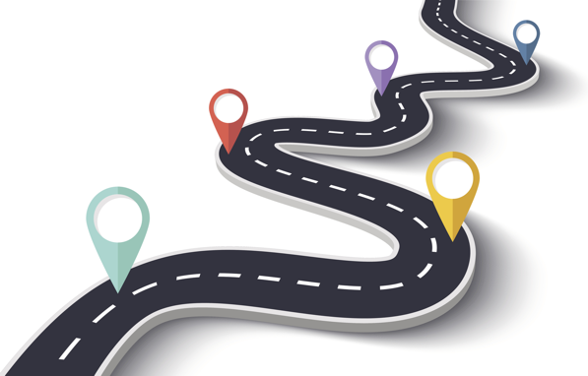
Roadmap
Welcome BACK
Community Led Research Design
Breakout Groups
Wrap Up and Next Steps
Notes:
Sukti

Slide 3
Learning Lab Schedule
Oct 202o
March 2021
Introduction to Legal Empowerment
Participatory Data Collection
2020 |  |  |  | 2021
Summer 2021
Nov 2020
Jan 2021
Participatory Data Analysis
Approaches to Measuring Empowerment
Accountability and Ethics
Communication Strategies
Case Studies
Introduction to Participatory Action Research
Community-led Research Design
Notes:
Sukti

Slide 4
Learning Doc
Update after each session, if possible
Fundamental questions raised around theory, ethics, methods, sustainability, and relationships to other fields of learning and action
One-on-One and small group sessions planned throughout the Spring
Notes:
Sukti

Slide 5
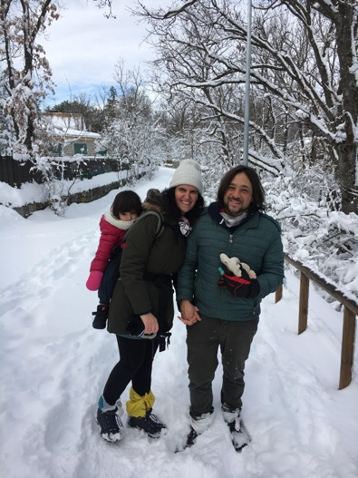
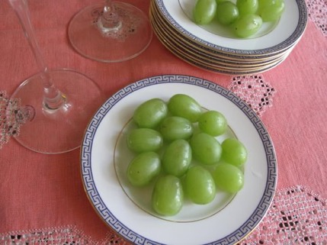
Community Reflections: Practices to Mark a New Year
Me and my wife celebrated the new year evening with our families and relatives and watching people's celebration from our apartment's balcony.
- Dyari
Eat 12 raisins at midnight. - Felipe
Dance! And a new year lunch.
- Shreya
Eat 12 grapes at midnight
- Antonio
Our tradition is to start the year with a walk in nature. We always try to spend the holidays close to some good place to walk; this year it snowed a lot!
- Luciana
Notes:
Sukti

Slide 6
Community Reflections: Still we Rise
Lots of people set out goals or resolutions for the new year. 2020 threw off many of our plans and forced us to re-think our idea of a successful year. What is something that you achieved or accomplished in 2020 that made it feel like a success to you?
I learned to be more patient and less distressed over things that don't go as planned. - Felipe
I managed to sustain all my friendships and relationships with family. - Shreya
2020 taught me that I have the ability to adapt very quickly. - Dyari
I was able to sustain hope and movement: exercise routines, yoga, random parties for my toddler, organizing new justice work! - Ariadna
Notes:
Sukti

Slide 7
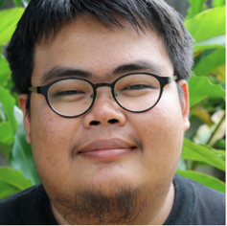
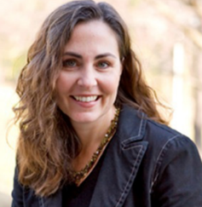
Community Led Research Design
Tom is a native of Chiang Mai, Thailand where he currently works as Asia-Pacific Program Coordinator for the International Accountability Project, a human rights advocacy organization that seeks to end forced eviction and create new global policy and practice for development that respects people’s homes, environment and human rights. Tom is a community trainer, a teacher, a traveler, and a Mekong activist. He supports local communities and civil society groups to promote their right to information and meaningful participation and to ensure development is designed and lived by the same people.
Carol Anne is an Associate Professor of International Education in the Department of Humanities and Social Sciences. Her scholarship brings together interdisciplinary and comparative approaches to examining education policy and practice. Her current research projects address three areas: (1) teachers lives and work, i.e. understanding how international policies and organizations impact teachers and classroom practice; (2) defining educational quality and school achievement beyond standardized tests through a rights-based framework, and; (3) using participatory/action research to study the impact of poverty and inequality on education.
Notes:
Meg

Slide 8
Thank you!!
Notes:
Meg

