Slide 1
Legal Empowerment
Learning Lab
Session 2: Intro to PAR

Slide 2
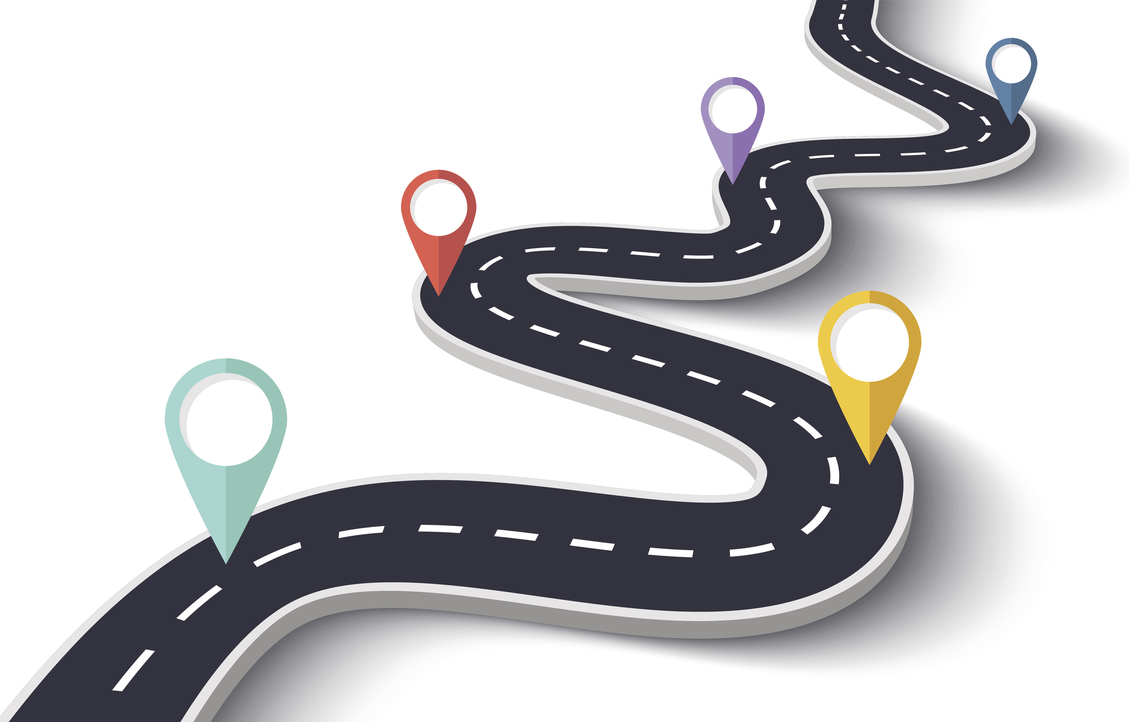
Roadmap
Welcome BACK
Reflection + Community Building
Introduction to PAR
Breakout Groups
Wrap Up and Next Steps
Notes:
Sukti

Slide 3
Learning Lab Schedule
Oct 202o
March 2021
Introduction to Legal Empowerment
Participatory Data Collection
2020 |  |  |  | 2021
Summer 2021
Nov 2020
Jan 2021
Participatory Data Analysis
Approaches to Measuring Empowerment
Accountability and Ethics
Communication Strategies
Case Studies
Introduction to Participatory Action Research
Community-led Research Design
Notes:
Sukti

Slide 4
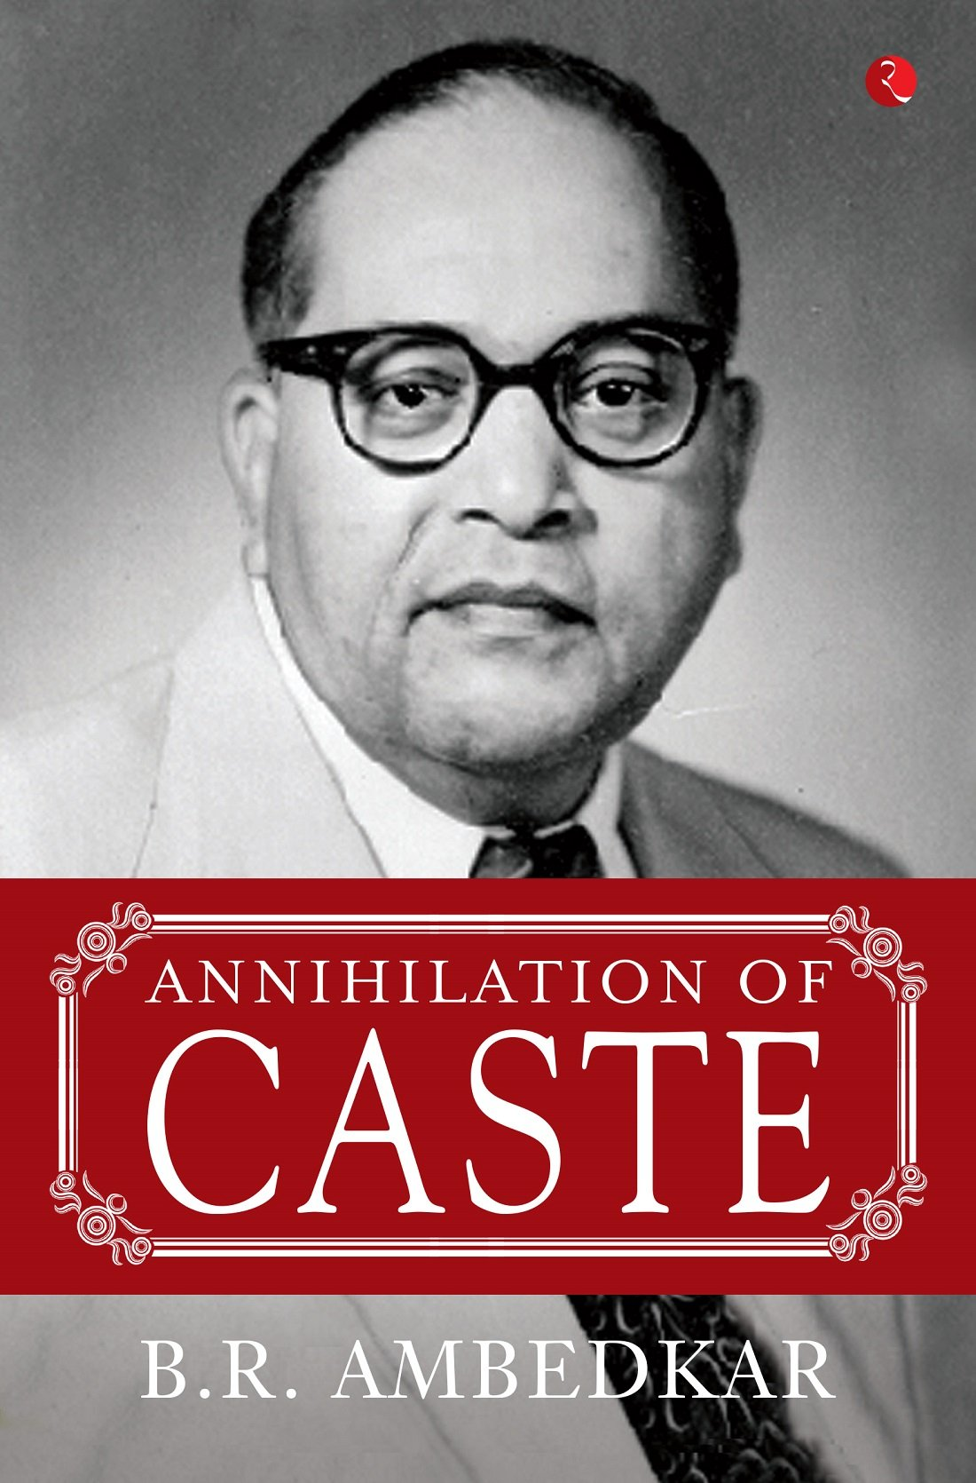
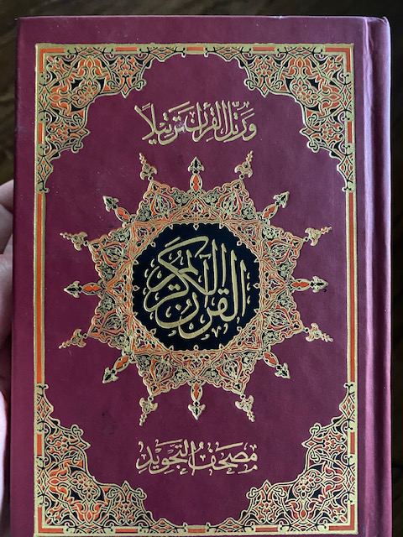
Community Reflections: What Sustains Our Work
This is a book written and published by the author of the Indian Constitution who also transformed the caste system in India. The fact that we never studied it in school was a realization that there are important voices and sources of knowledge that are constantly erased and made invisible because of their location in the society.
-Shreya Sen
This is my Tajweed Quran. I am not a religious person but studied Arabic for over 6 years in the Middle East and at the University of Chicago. For me—studying Arabic and Islamic Jurisprudence (Shariah Law) indirectly paved my path to the nonprofit field and I reflect often about the people, places, and environments I interacted with during these times when I see this Quran.
-Larry Pande
Notes:
Sukti

Slide 5
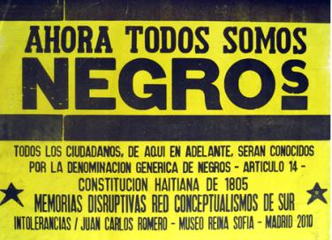
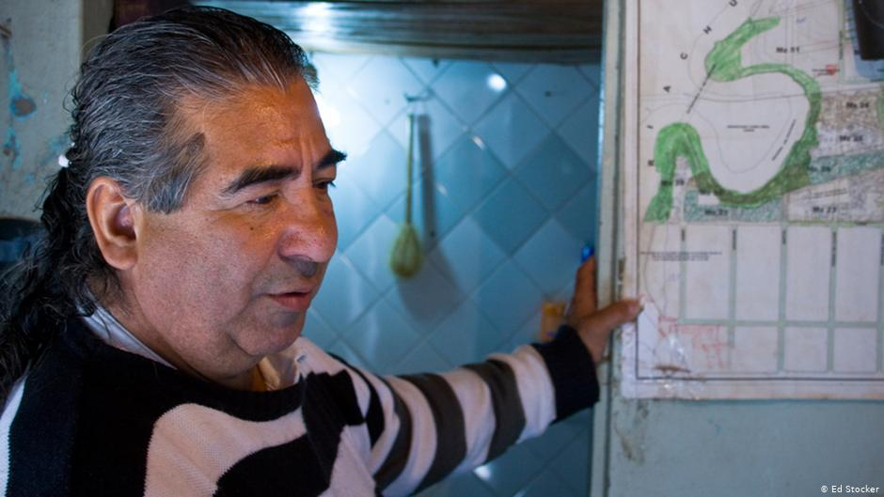
Community Reflections: What Sustains Our Work
Coco Rivero (Villa 21-24) "Always, without losing the tenderness."
-Luciana Berkovitch
A sentence from the Constitution of Haiti after its revolution: "Now we are all black. All citizens, from now onwards, will be known by the generic denomination of Negroes".
Article 14, Constitution of Haiti of 1805.
-Felipe Mesel
Notes:
Sukti

Slide 6
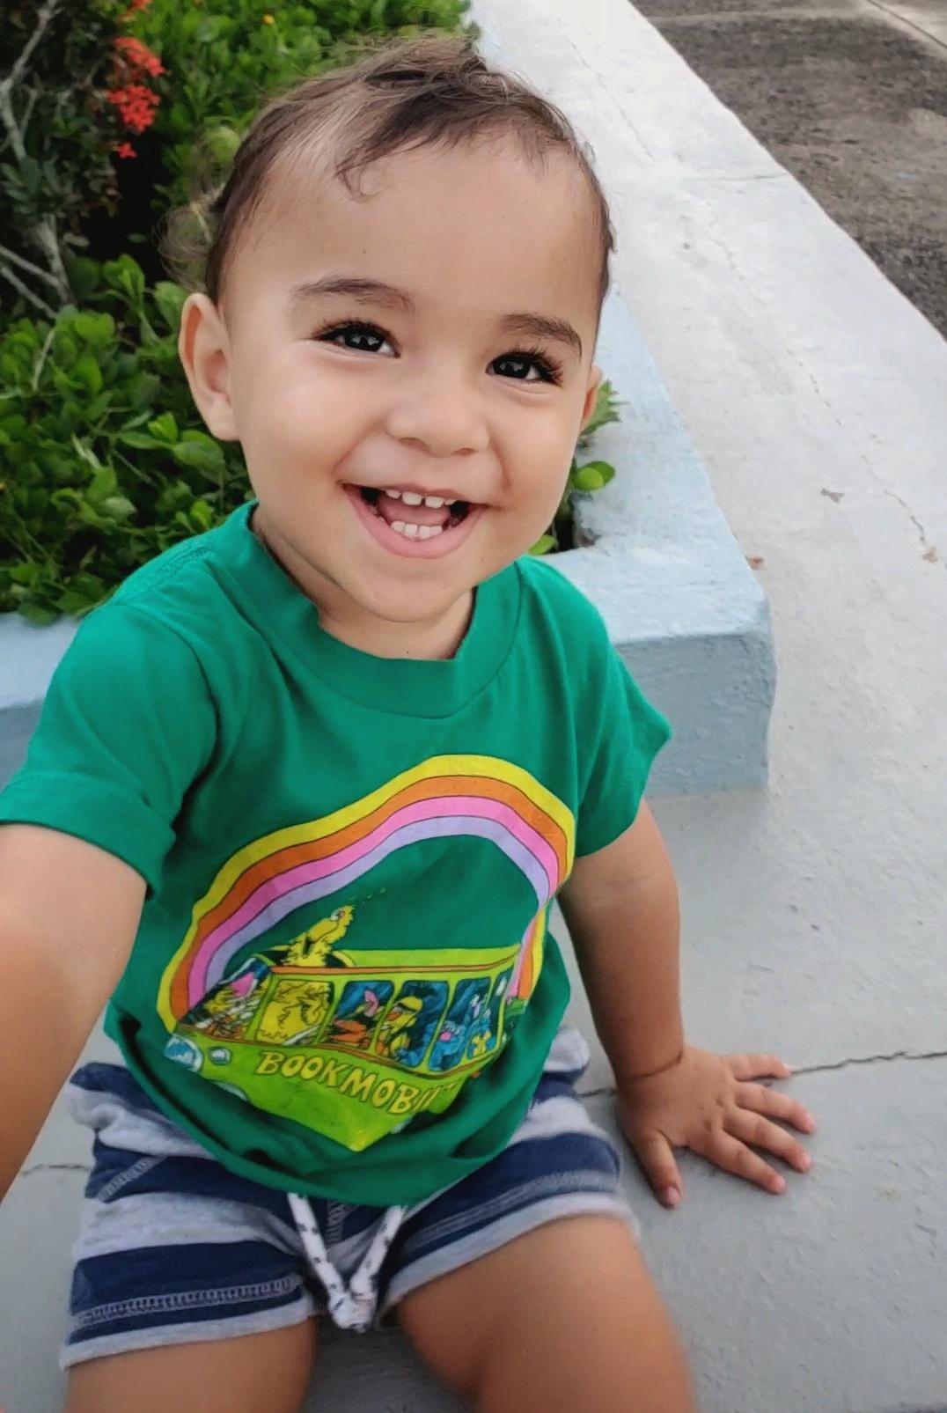
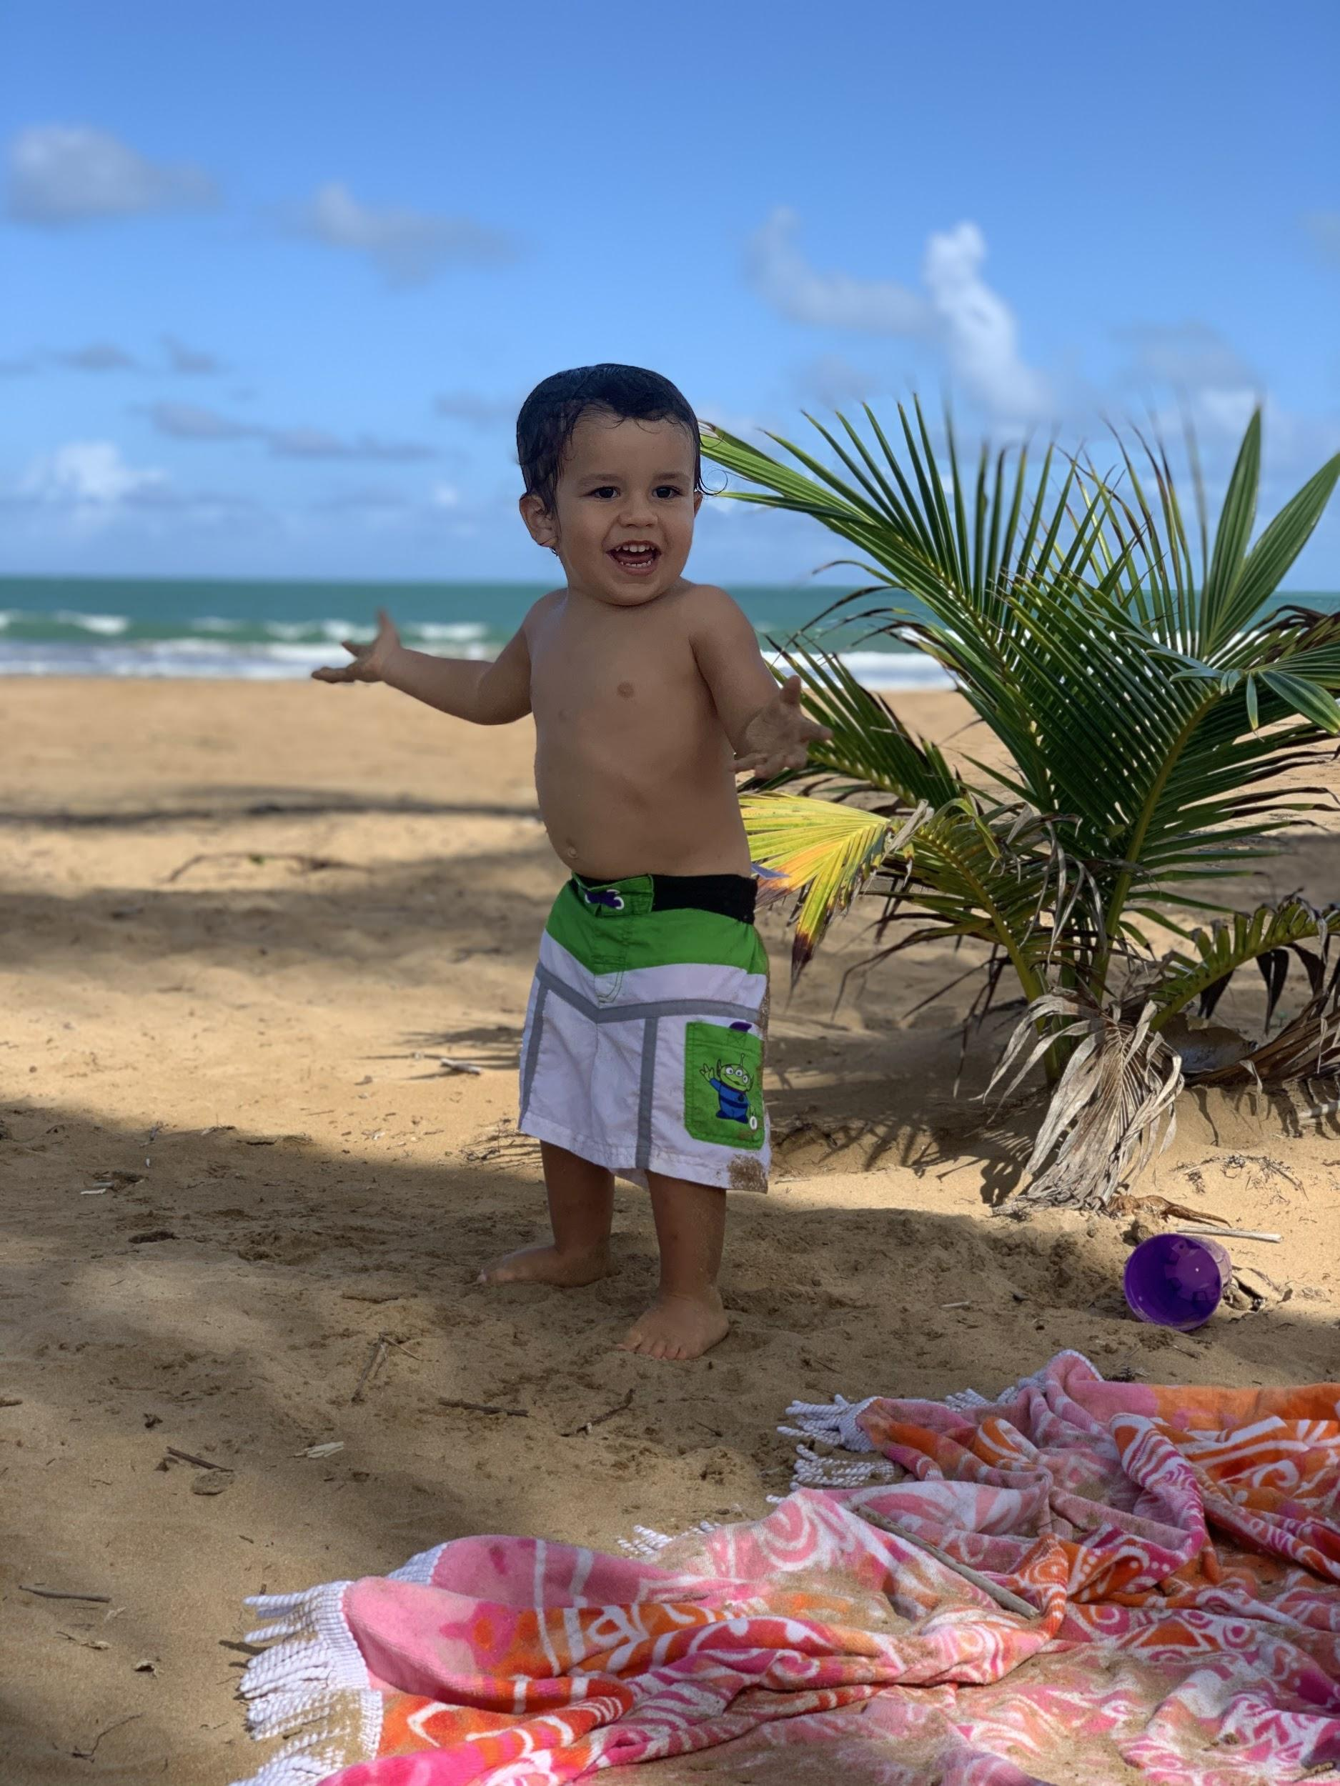
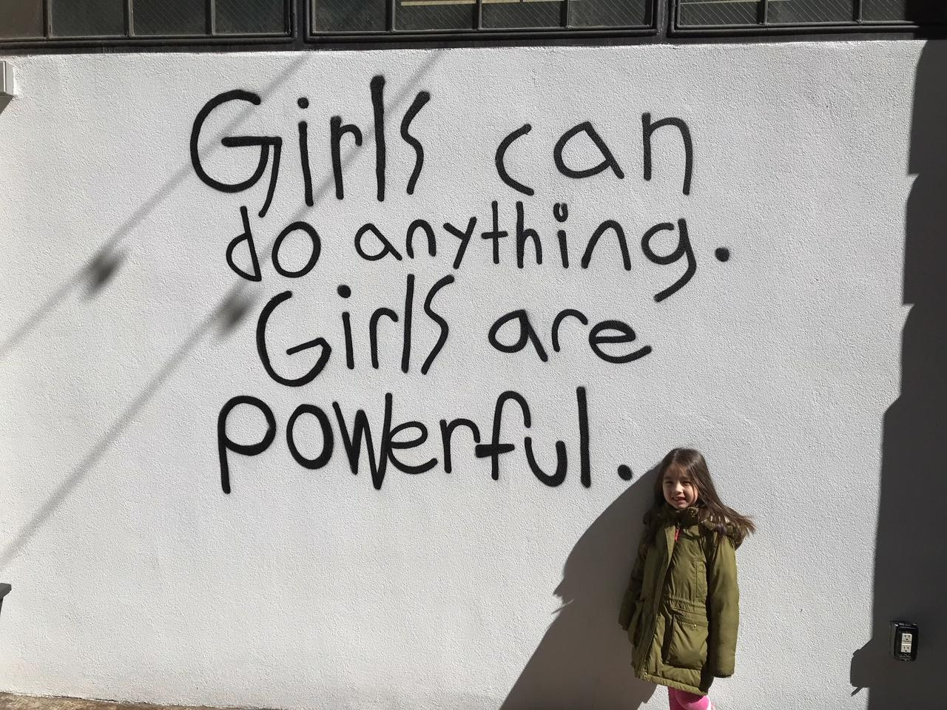
Community Reflections: What Sustains Our Work
Even before he existed, everything I've worked for has been for this kid. Silvio and his generation deserve a better world.
-Nicole Diaz
I trust and sustain justice work because everything continues to be possible. This is Lucas Imar, my son, my favorite animal, wonder and hope. He is named Lucas Imar, because of the light (luz) and the sea (mar)
-Lcda. Ariadna Michelle Godreau Aubert
-Matthew Barnett
Notes:
Sukti

Slide 7
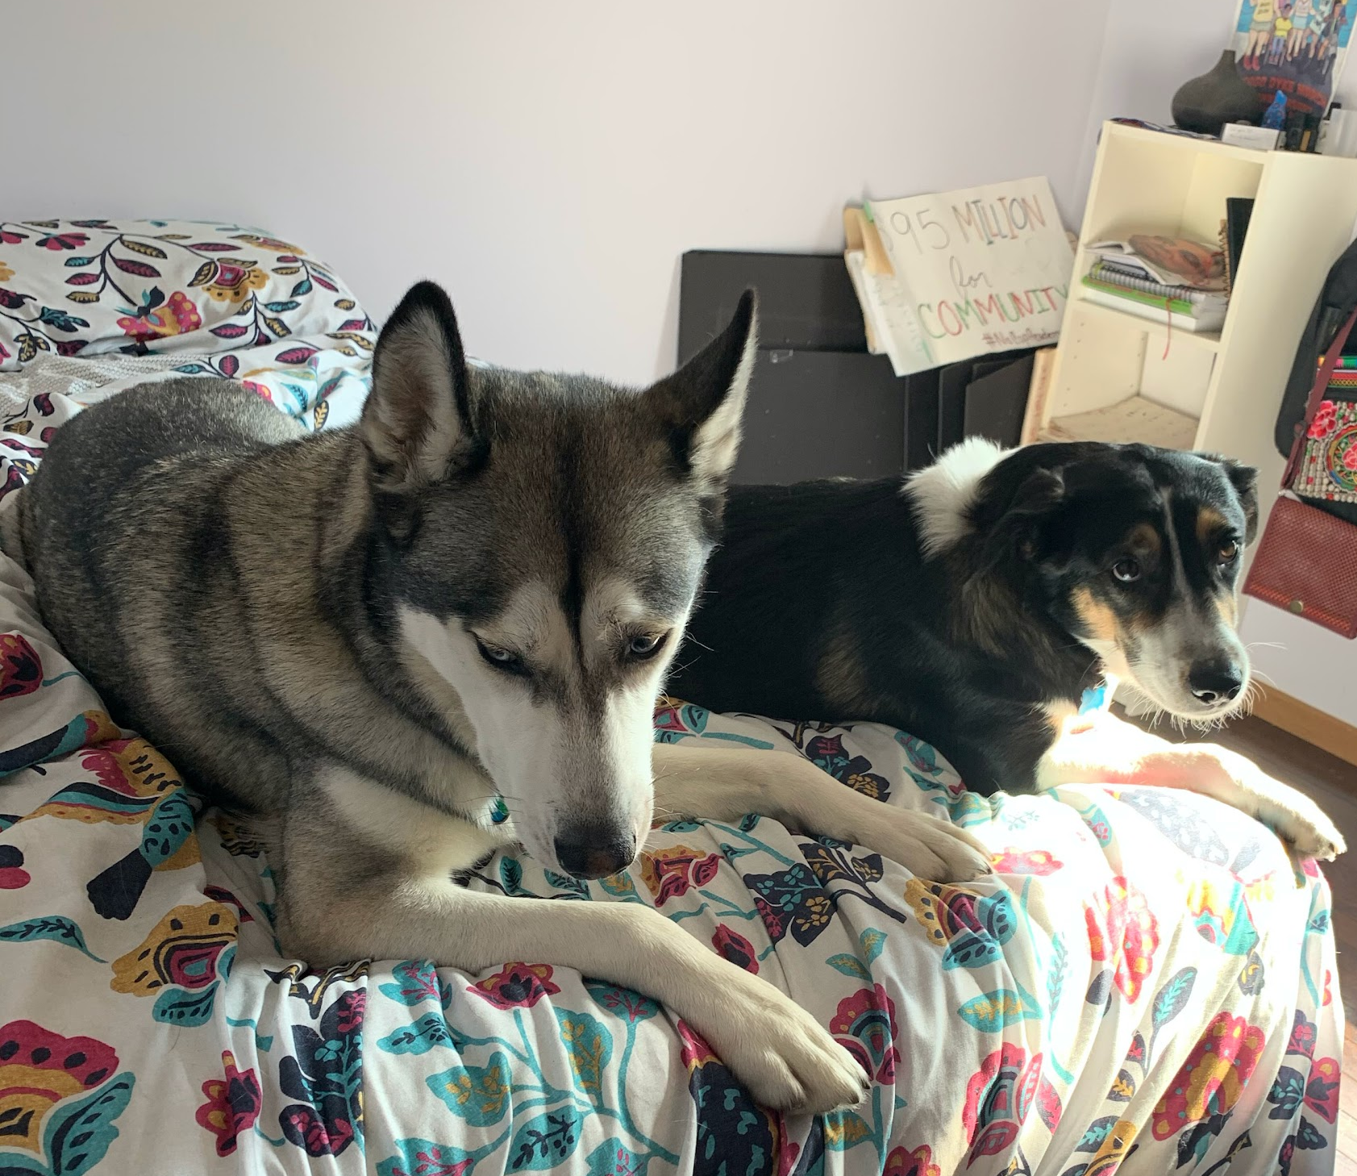
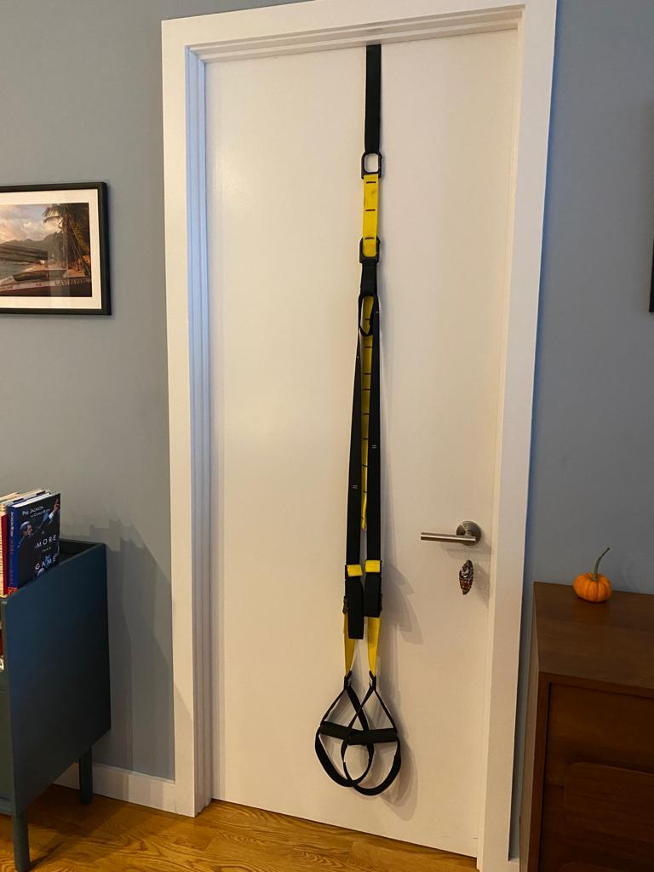
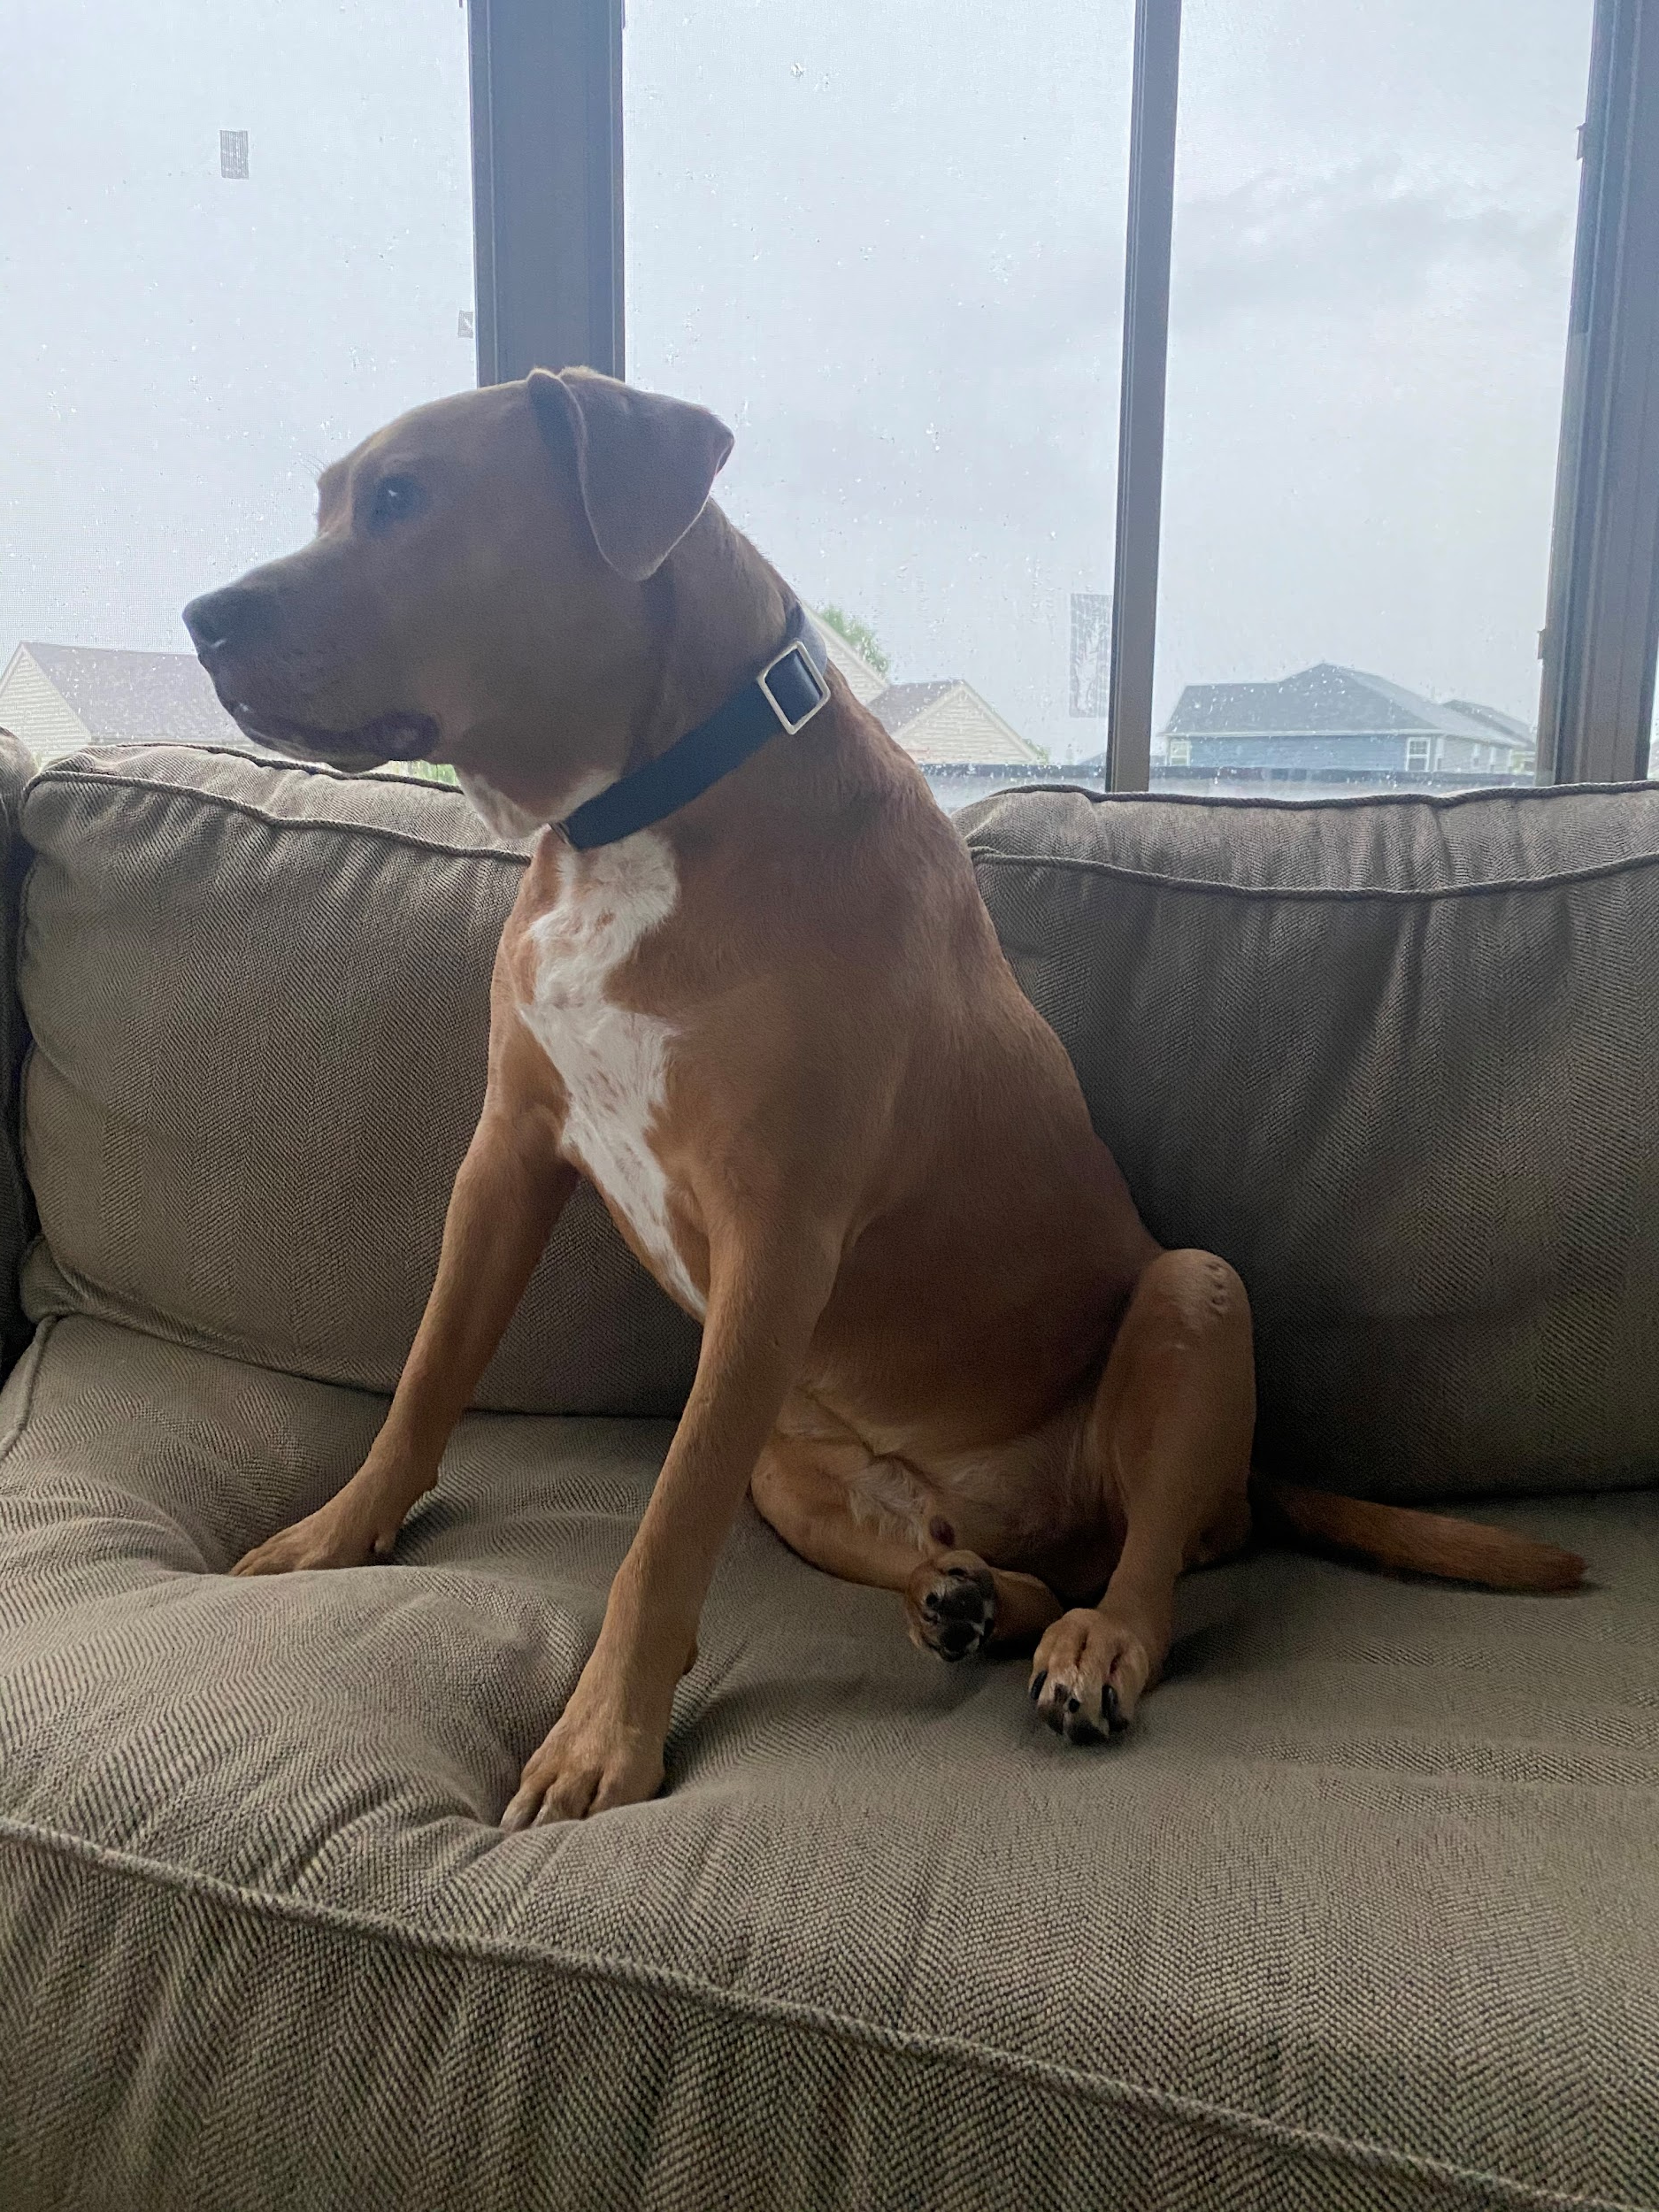
Community Reflections: What Sustains Our Work
My pup brings me joy. He was abandoned twice, injured and came with a lot of “battle scars” when I met him. How could we prevent “injuries” or be conscious of long-term healing? -Bindhu Vijayan
This is my TRX. Since 2010, it offers full body heart pumping workouts, and keeps my brain and body energized and spirit lifted.
-Ellie Happel
This is a picture of my two pups. They keep me company and keep me active and also bring so much joy which are all important for me to have as I do this work.
-Arianna Salgado
Notes:
Sukti

Slide 8
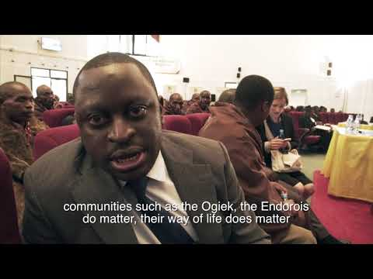
Community Reflections: What Sustains Our Work
It’s not a photo, but I do have a video which always lifts my spirits, of the Ogiek winning their case in the African Court of Human and Peoples’ Rights. It’s hard not to smile or be uplifted!
The Ogiek’s fight is far from over, and things are hard for them right now - but the fact that this marginalised community, numerically small in number and with very little political leverage, managed to take their case to the highest human rights court in Africa, and WIN, is to me the embodiment of legal empowerment and resilience. - Lucy Claridge
Notes:
Sukti

Slide 9
Reflections from Session 1
Principles
Commit to creating non-hierarchical spaces
Exercise empathy and embrace uncertainty, humility, and vulnerability
Be rooted in self-determination
Acknowledge our privilege; name and engage in power mapping
Push back against “extraction” of knowledge
Use an intersectional approach/analysis
Centering perspectives of those most impacted
Manage our expectations/support - people learn differently, different energies
Build trust
Starting from a commitment to relationships
Exercise deep listening and learning from each other and respecting/supporting self determination
Communities should be authors of academic pieces
Themes
Boundaries: Who is part of the community and who is part of the same conversation?
Importance of translation - Isolation among communities with languages that are not commonly translated.
Challenge of methodology - institutions of power will recognize data only in specific ways.
how do we still create that space that is accessible based on education/language/background?
Tensions between lawyers and communities
Community Building
Notes:
Sukti

Slide 10
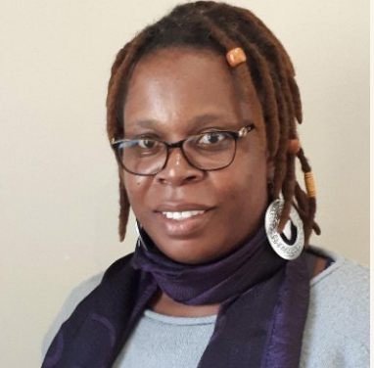
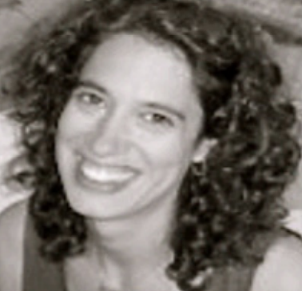
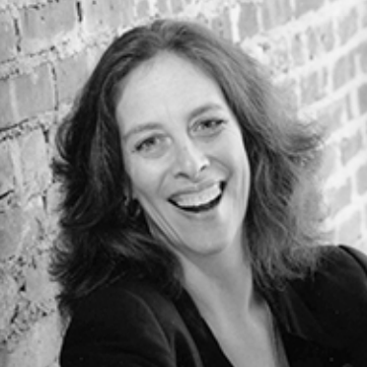
Introduction to Participatory Action Research
Mela is a development expert and researcher who identifies as an African Feminist with a passion for use of liberating participatory methodologies for women and other groups who are pursuing justice and equity in various spaces. Her research is embedded in participatory action approaches and seeks people-driven reforms in a journey towards economic and social justice.
Maria is the Director and co-founder of The Public Science Project at the CUNY Graduate Center and has been engaged in critical participatory action research projects nationally and internationally with schools, prisons, and community-based organizations seeking to further social justice.
Michelle is a Professor of Critical Psychology, Women’s Studies, American Studies, and Urban Education at the Graduate Center, a founding faculty member of The Public Science Project., and a critical scholar and activist committed to critical participatory action research with a focus on racial and gender justice in schools, the carceral state and youth organizing.
Notes:
Meg

Slide 11
Collective Brainstorming
Notes:
Meg

Slide 12
Thank you!!
Notes:
Meg

