Slide 1
Legal Empowerment Learning Lab
2020-2021

Slide 2
Roadmap
Welcome
Overview of LE Learning Lab
Introduction to Legal Empowerment
Jailhouse Lawyer Initiative
Breakout Groups
Wrap Up and Next Steps
Notes:
Sukti

Slide 3
Power in this Room
Who We Are
30 Activists, practitioners, researchers, academics from 15 countries. Some of us are are directly impacted others are allies/partners. We work on the most pressing issues of our time spanning refugee and immirant rights, health rights, climate justice, indigenous rights, dalit rights, racial justice, gender justice, housing justice, education rights - the list goes on and on
Some of us are new to legal empowerment, others have been doing community-driven justice work for decades
Some of us are new to research and learning, while others live and breathe the power of PAR
We are tired, we are resilient, and we are bound by a belief that true transformation is rooted in community
Spectrum
Notes:
Sukti

Slide 4
Learning Lab Objectives
Open up democratic forms of inquiry to explore what works, what matters, and what’s needed to achieve justice from the grassroots
Build a community of practitioners and researchers invested in legal empowerment and participatory research
Support the co-design and co-execution of participatory research on legal empowerment and spur scholarship that is more responsive to the needs of grassroots communities
Notes:
Meg

Slide 5
Learning Objectives for the Sessions
Create a vibrant space for collaboration between practitioners and academics committed to participatory legal empowerment research and learning by forging common vocabularies, concepts, and tools
Bring participatory action research theory, methods, and tools into research and learning about legal empowerment
Redistribute key legal empowerment and participatory research concepts, methods, and skills across a network of grassroots justice practitioners and academics
Notes:
Meg

Slide 6
Learning Objectives for the Sessions
Create accessible training sessions rooted in the concrete needs and demands of practitioners eager to learn with grassroots communities. Each training session to be co-designed and co-facilitated by a team of grassroots activists and researchers.
Participants gain knowledge and skills to incorporate participatory methods and legal empowerment into the creation of their action-research plans and overall organizing and program work.
Notes:
Meg

Slide 7
Learning Lab Schedule
Oct 202o
March 2021
Introduction to Legal Empowerment
Participatory Data Collection
2020 |  |  |  | 2021
Summer 2021
Nov 2020
Jan 2021
Participatory Data Analysis
Approaches to Measuring Empowerment
Accountability and Ethics
Communication Strategies
Case Studies
Introduction to Participatory Action Research
Community-led Research Design
Notes:
Sukti

Slide 8
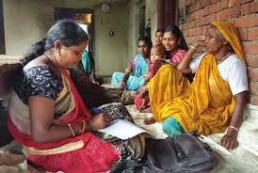
What is
Legal Empowerment?
More than 5 billion people live at the margins – pushed or kept out, often silenced, without access to meaningful justice. Denied healthcare, citizenship or fair pay, those unprotected by law have challenges that are real and relentless, yet they are often forced to navigate complicated legal systems without essential resources and education.
Legal empowerment strives for a different world – a rights-based methodology that centers people in their own fight for justice and creates opportunities to know, use, shape, and transform the laws and systems that impact their lives.
^{Community Paralegal Programs}
Alternate Dispute Resolution and Mediation
^{Public Interest Actions}
KEY: Affected Communities are leading these efforts
Notes:
Sukti

Slide 9
Legal Empowerment History
Insights from trade union and feminist movements which saw the “emancipatory power of popular education and therefore embedded rights awareness with self–reflection and collective action”
Roots in anti-apartheid movements, where women community paralegals partnered with lawyers, NGOs, and churches to document violations, provide legal assistance, and bear witness to injustice
Emerged as principal strategy to increase access to justice and achieve sustainable development with the 2008 United Nations Commission on Legal Empowerment of the Poor. Commission’s report anchored legal empowerment in human rights. SDG 16 rooted in “access to justice for all”
TODAY: 2300+ organizations in 190 countries are part of the Legal Empowerment Network convened by Namati.
Notes:
Sukti

Slide 10
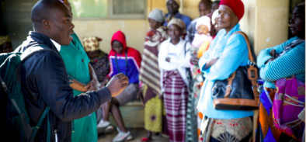
Legal Empowerment Approaches
Community Paralegal Programs Mediation
Accompaniment Community-driven Litigation
Know Your Rights Trainings Community-driven Campaigning
KEY: community in the lead, creating dynamic and diverse justice ecosystems
© Namati
Notes:
Sukti

Slide 11
Legal Empowerment and Human Rights
“Legal empowerment—led by the grassroots, with lawyers and other professionals in supporting, rather than leading roles—is a crucial part of the justice transformation that is needed. When rights-holders directly engage institutions affecting their lives, they demand that systems become more accessible and responsive to the daily challenges of the people. And when the law and legal systems are actively harming marginalized and oppressed peoples, a critical form of legal empowerment can ensure they are the authors of their own liberation and demands transformation of the law “
Notes:
Meg

Slide 12
Looking forward: Critical Legal Empowerment
Critical:
Building on insights of movement lawyering, critical race theory
Rejection of technocratic approaches
Requires self-reflection, humility, and a commitment to critical praxis
Legal:
Starts from recognition that law is often a tool of oppression
Seeks transformation of legal systems, not only inclusion
Empowerment:
Explicitly aimed at building power of communities & movements
Notes:
Meg

Slide 13
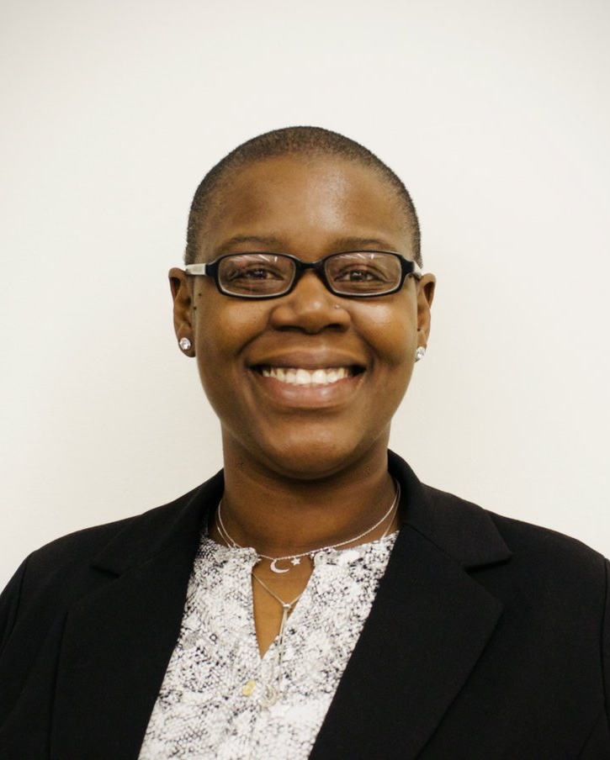
Jailhouse Lawyer Initiative -
A Legal Empowerment Project

Slide 14
“We must no longer identify with terms like “inmate” or “criminal”. We are human beings. We are U.S. citizens. That is why I frequently use the term Incarcerated Citizen. We may be incarcerated, but we are still citizens of this country, and we do have rights. We must never forget that, and never be afraid to enforce those rights. When we begin to think of ourselves as incarcerated citizens instead of “offenders” we start to realize that the injustices we face on a daily basis are not normal, not warranted, not necessary, and not conducive to our rehabilitation and transformation. As incarcerated citizens we are aware of our rights as well as the codes and policies that govern the prison staff, and we hold them accountable for their violations, but most importantly, we hold ourselves accountable, and carry ourselves with an air of dignity and respect.” Brandon T., Texas, February 2019

Slide 15
How many people are incarcerated in US prisons?
6 million
1.5 million
2.2 million
500,000

Slide 16
c) 2.2 million

Slide 17
What is a “Jailhouse Lawyer”?
An attorney who is incarcerated, but continues to practice law inside prison.
An incarcerated person who helps other incarcerated people with legal matters.
An attorney paid by the state who works in prisons to help people who have convictions.
An incarcerated person who defrauds other incarcerated people out of money by claiming to help them on their case.

Slide 18
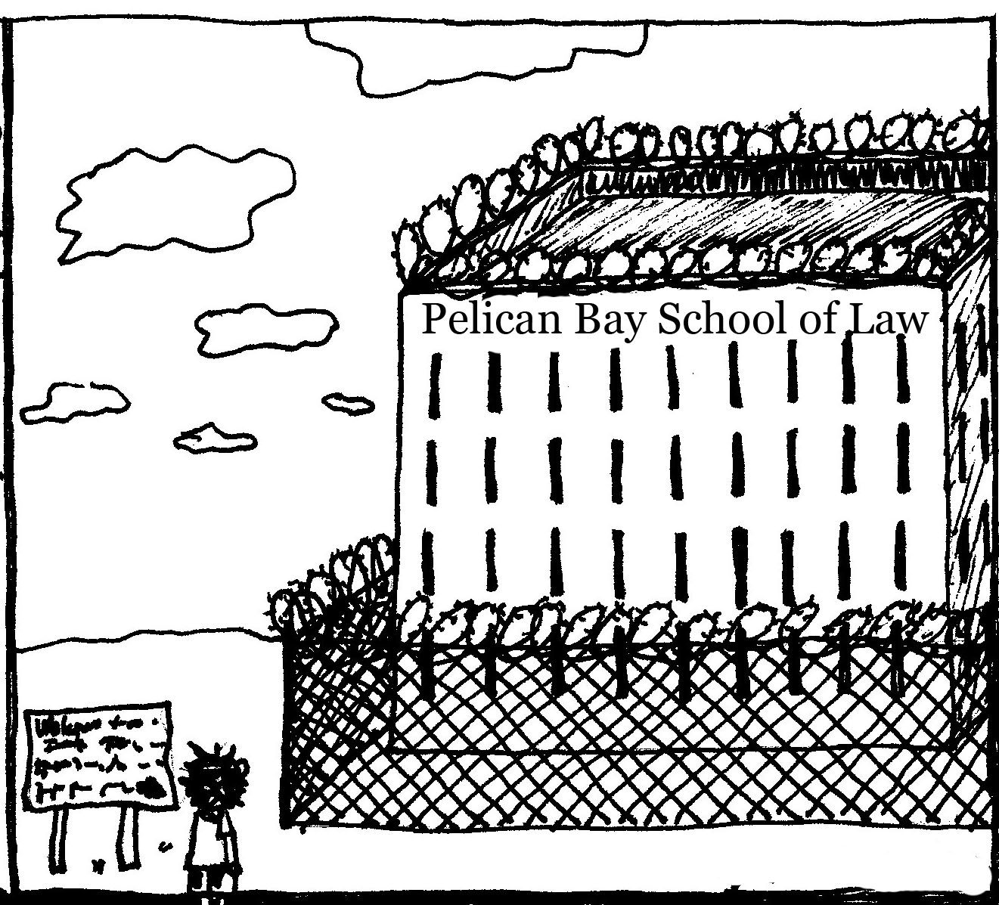
An incarcerated person who helps other incarcerated people with legal matters.

Slide 19
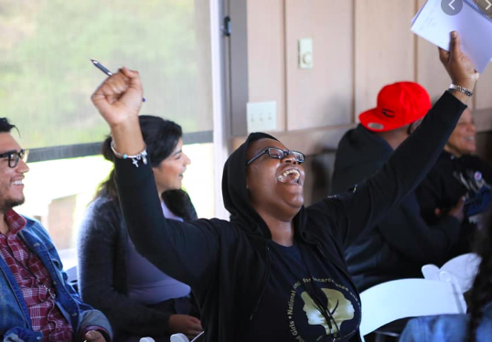
Jailhouse Lawyers Initiative (JLI)
Rooted in Legal Empowerment -
Directly impacted people should be empowered to know, use, shape, and transform laws as they lead their fights for justice.
Jailhouse lawyers are Community Paralegals within incarcerated communities in the US.
Legal empowerment is a way to break the cycle of incarceration from the inside out.

Slide 20
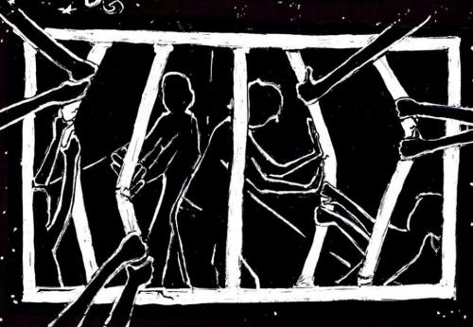
Jailhouse Lawyers Initiative
3 Main Goals:
Develop a network and national movement of former and current jailhouse lawyers.
Create opportunities for jailhouse lawyers to use the skills they developed on the inside after their release, through education and employment.
Co-design curricula, trainings, and resources with current and former jailhouse lawyers to build and shift power to jailhouse lawyers and honor their transformative work.
Notes:
Why is transforming the curriculum for JHLs is empowering for them. How does shift power of JHLs inside?

Slide 21
Deep Dive: Co-created Jailhouse Lawyer Curriculum
JLI is working in partnership with the law students at NYU Law and Florida State University, and an Advisory Board of formerly incarcerated jailhouse lawyers + attorneys to strengthen the legal research and education curriculum that is offered to incarcerated people in New York and Florida facilities. Plans to go national.
Criminal Justice is Civil Justice
Curriculum covers criminal law, family law, immigration, and collateral consequences + empowerment skills spanning counseling, interviewing, mediation, restorative justice and more.
`
Notes:
Highlight the participatory process of the curriculum design

Slide 22
Learning Question
Assess impact of curriculum [e.g. case outcomes, empowerment outcomes]
How to develop/design this in a participatory way (who are the folks involved, what methods will we use, what data is being collected)
Document the process of co-designing the curriculum with former jailhouse lawyers

Slide 23
Thank you!

