Slide 1
Legal Empowerment Learning Lab
2020-2021

Slide 2
Today
Welcome
Tea time
Carnival: Little responses of Horrors
Spect-Actors: Breakout Groups
Centering
One word
Notes:
Sukti

Slide 3
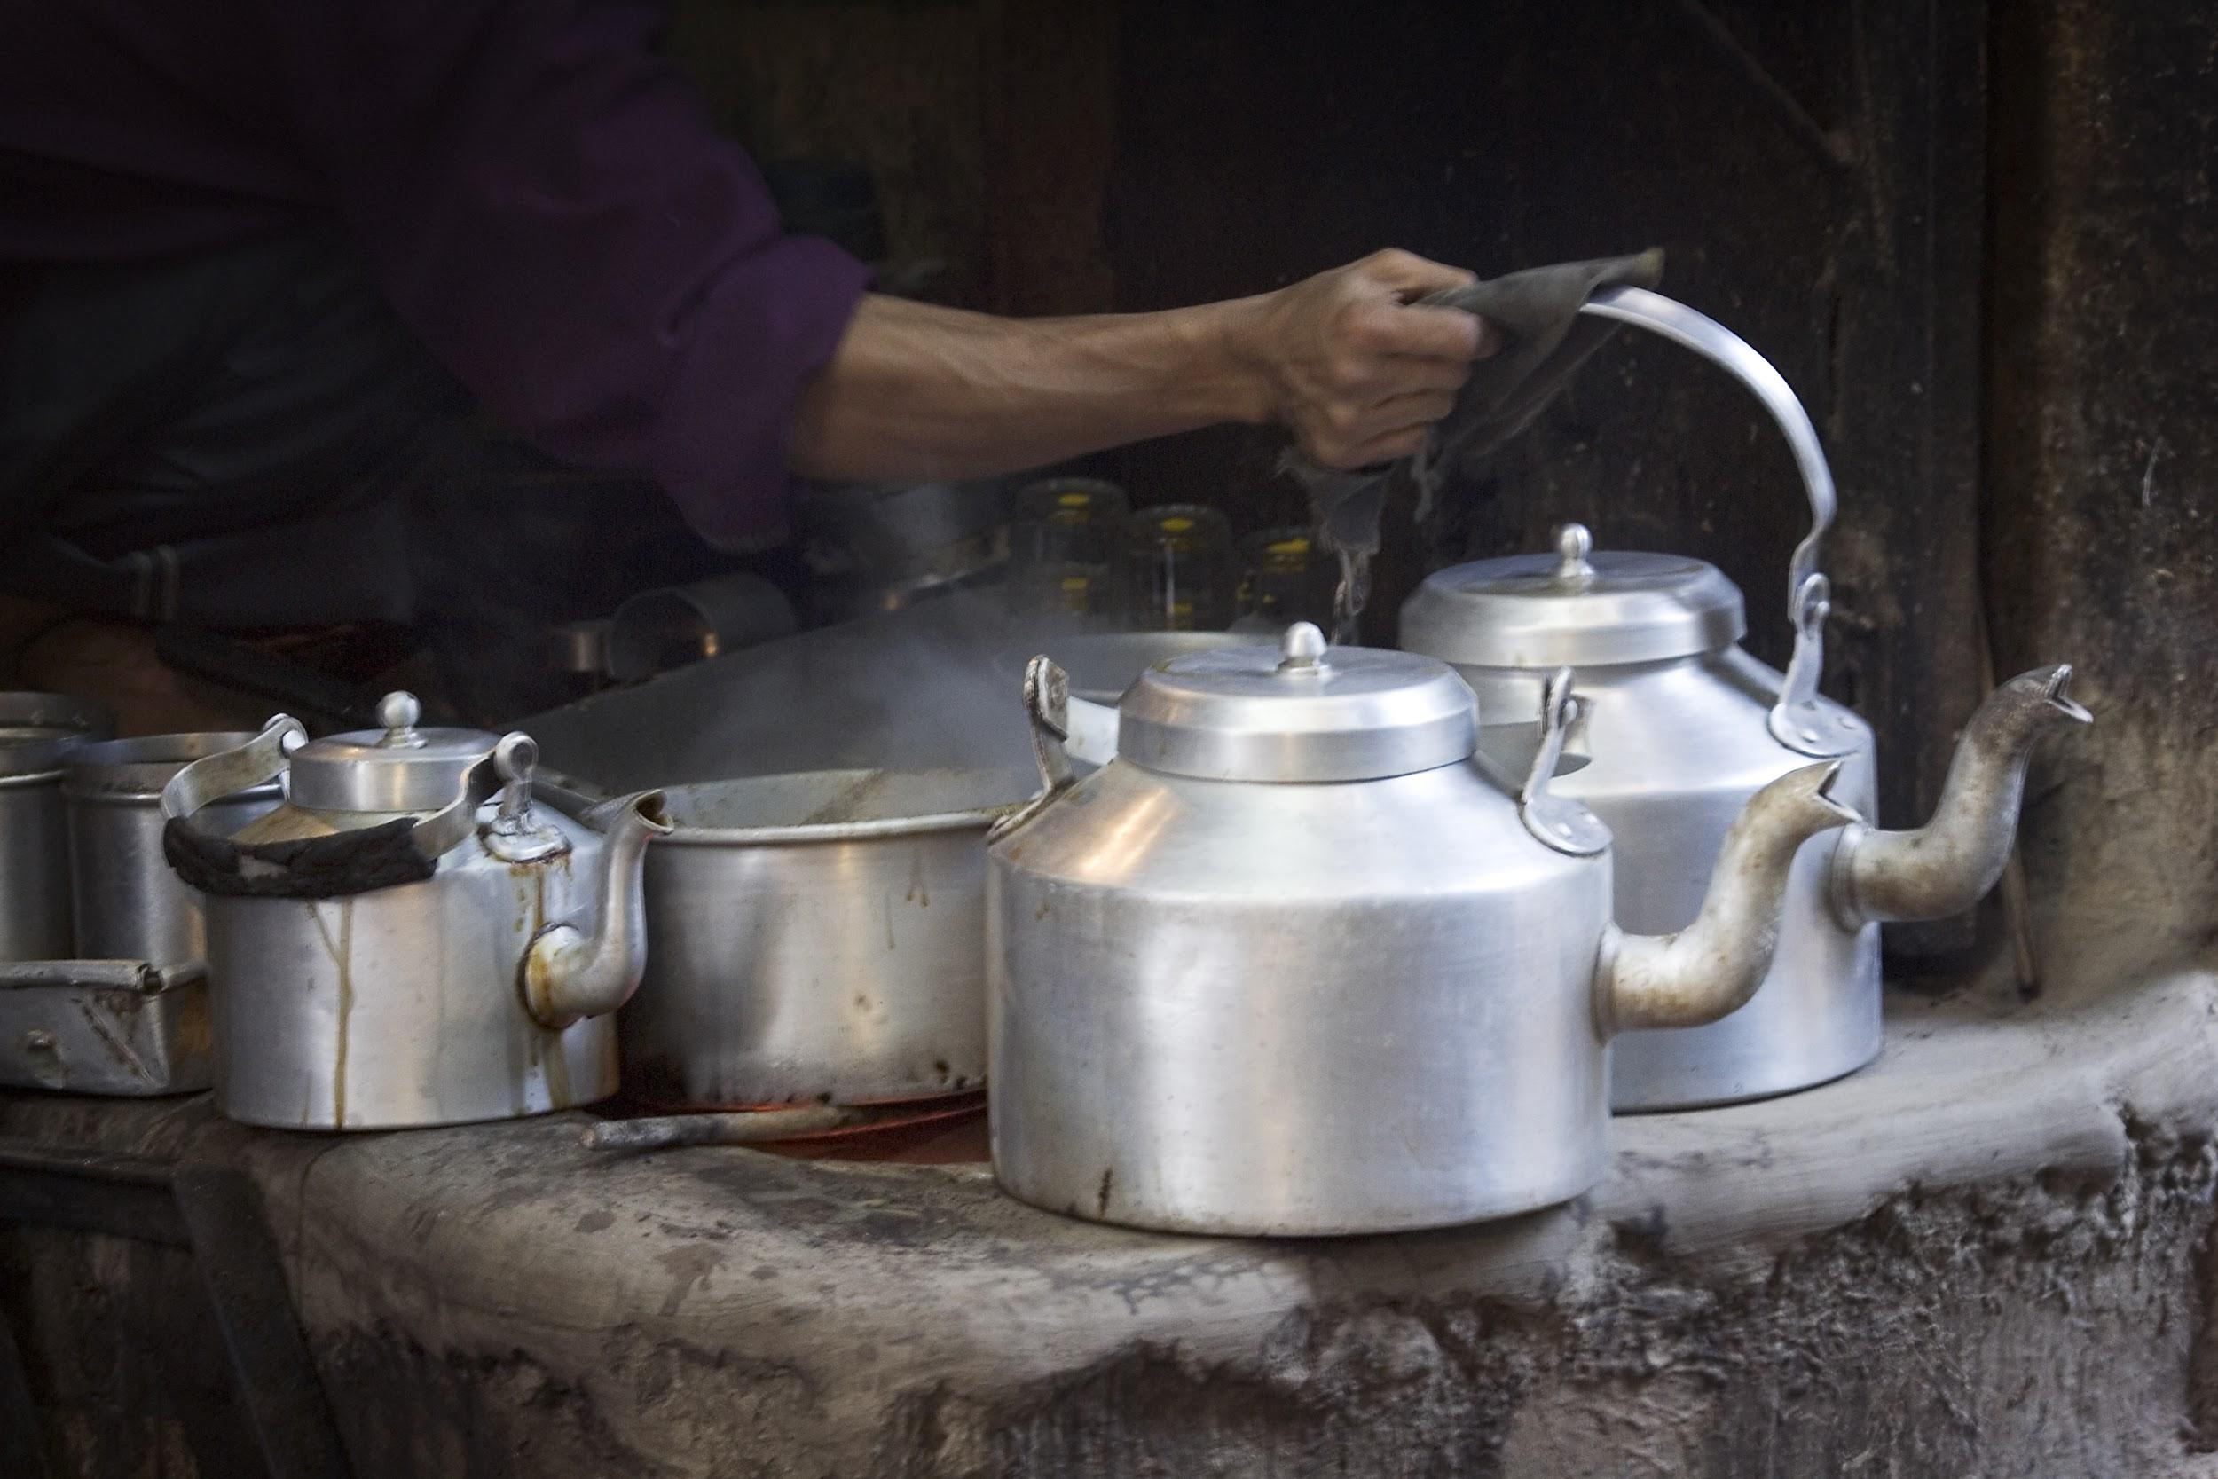
Tea Time: Prompt
Share an exciting AHA or “Wow, that makes sense” or “I didn’t think of that!” moment you had while working in and with community.
Notes:
Mela

Slide 4
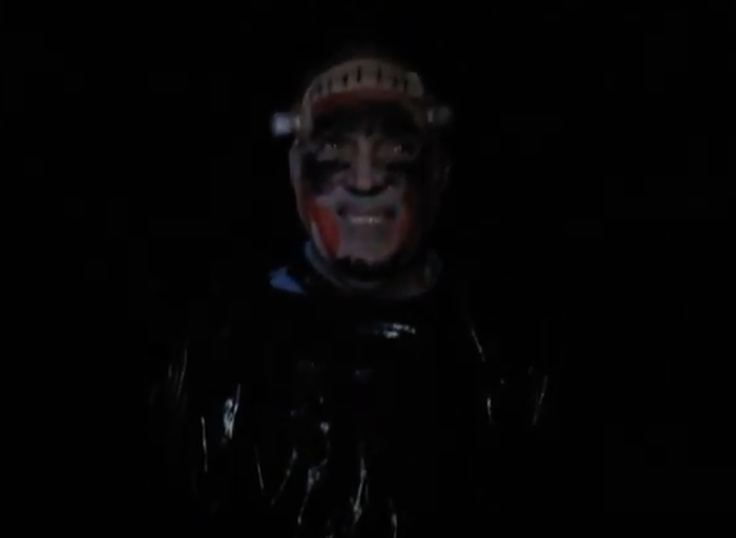
Bakhtin and Carnival
Strategies to destabilize hierarchy and imagine what else might be
Photo: still shot of video from a haunted house organized by artists surviving inside an institution for people with intellectual disabilities
Notes:
Emese

Slide 5
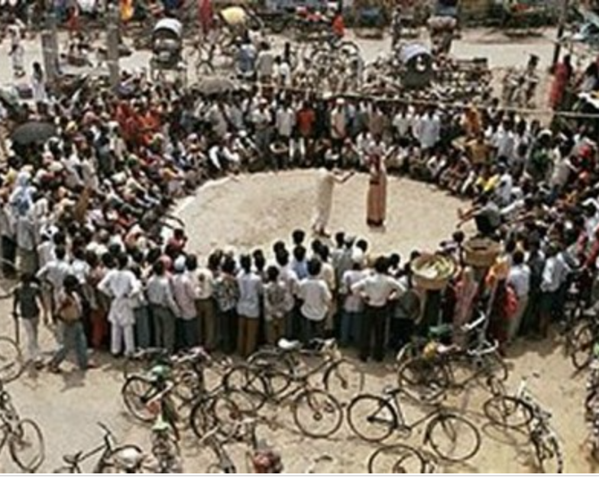
Forum Theater
Constructing responses to delegitimation collaboratively
An Adaptation of Theater of the Oppressed
Augosto Boal
Exploring solutions to oppression
Activates the imagination and inspires action
Interrogates agency and facilitates difficult conversations

Slide 6
In our groups
Best if everyone is unmuted. Choose whose experience you will create a skit from (or combine some or all into one story). Choose roles. One person is a note taker (and spect-actor).
Create skit. First, act it out as it was experienced. After, start the performance from the beginning and this time make changes. Anyone can STOP or HALT the action and ask questions, change the story.
Reflect together on what worked (and didn’t); who was assumed to have responsibility & agency to make change (& why); and what alternate interventions might be tried.

Slide 7
Thank you!

