Slide 1
Legal Empowerment Learning Lab
2020-2021

Slide 2
Today
Welcome
Our shared struggles
Break
Exploring power
Notes:
Sukti and Meg

Slide 3
Where We Have Been, Where We Are Going
Oct 202o
March 2021
Introduction to Legal Empowerment
Participatory Data Collection
2020 |  |  |  | 2021
Summer 2021
Nov 2020
Jan 2021
Shared Struggles, Carrying Complexity
Collective Data Analysis
Ethics and Care
Responding to Delegitimation
What can we nurture into the future?
Introduction to Participatory Action Research
Community-led Research Design
Notes:
Sukti and Meg

Slide 4
Week Overview
Care packages
Sessions
Monday: Struggles, Carrying Complexity
Tuesday: Collective Data Analysis
Wednesday: Ethics and Care
Thursday: Responding to Delegitimation
Friday: What Can We Nurture into the Future?
Notes:
Sukti and Meg

Slide 5
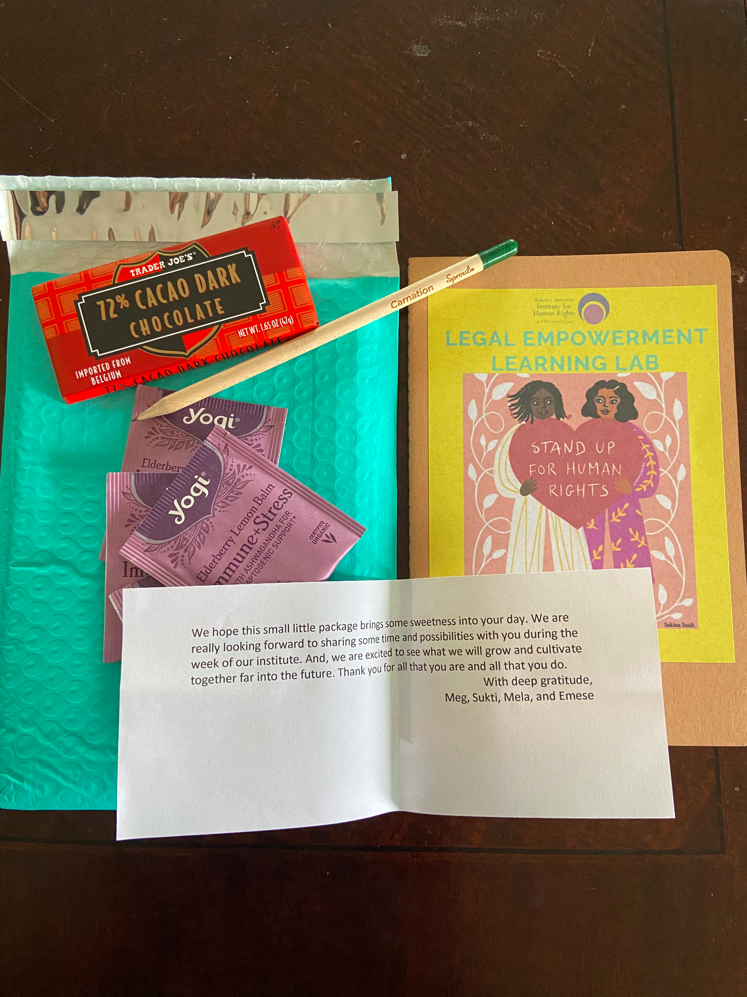
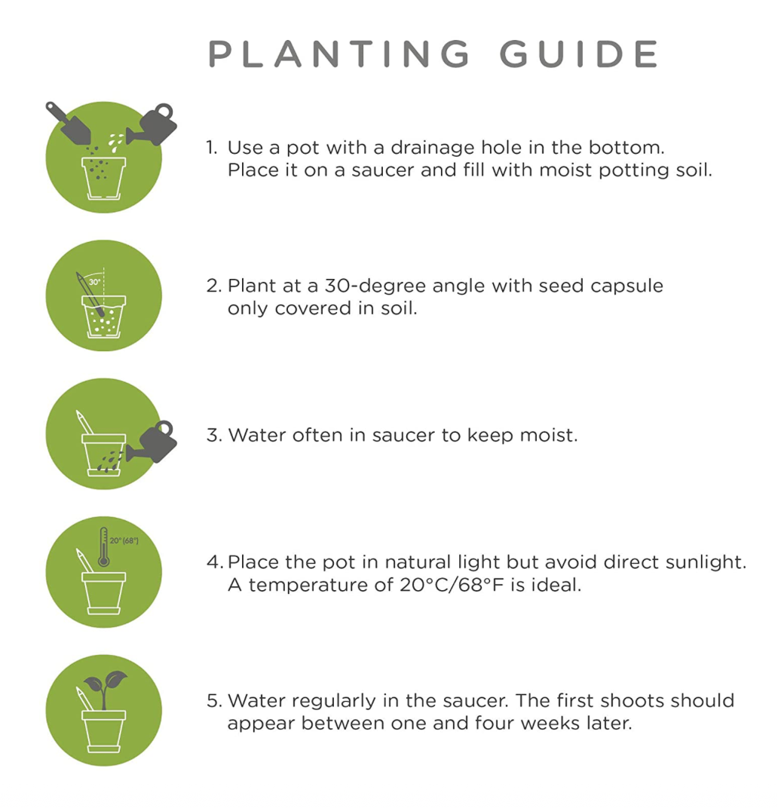
Care Packages

Slide 6
Prompts for group reflections
How do you think your collaborators (community members, government officials, etc) perceive you with respect to your power and positionality? What assumptions might they make about you and your intersecting identities?
In what ways do you earn trust from your collaborators?
How have your understanding of your privilege shifted over the years?
Notes:
Sukti and Meg

Slide 7
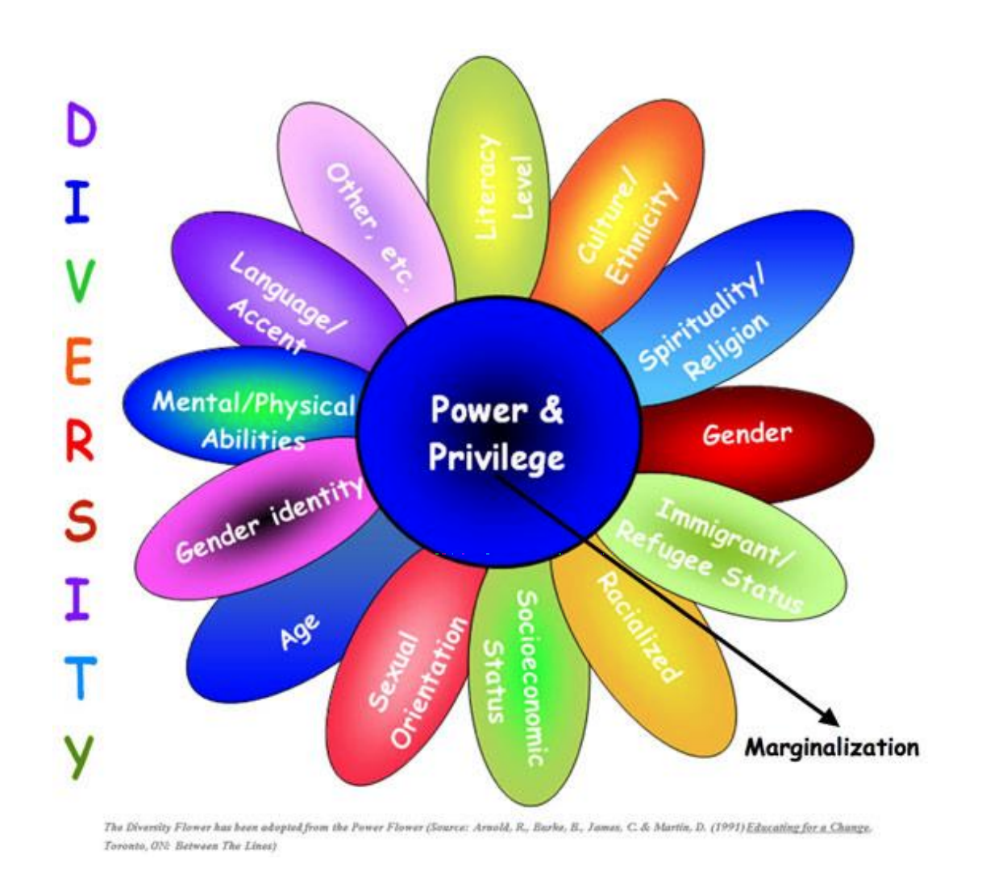
Power Flower
Notes:
Sukti and Meg

