Slide 1
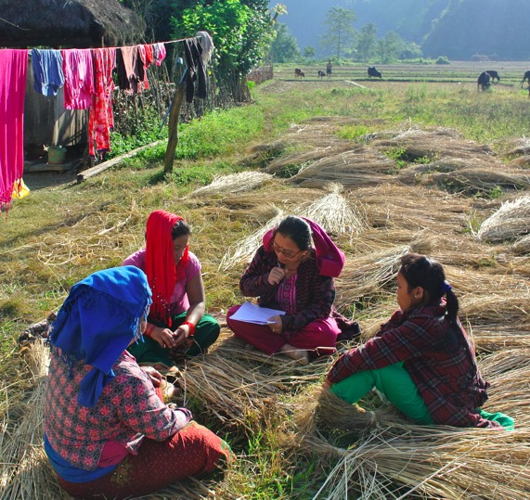
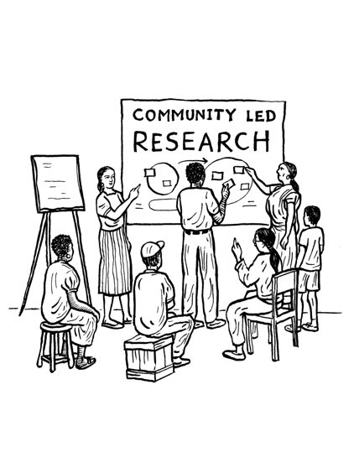
Community Led Research Design
Carol Anne Spreen, PhD, Associate Professor of International Education
Department of Applied Statistics, Social Sciences and the Humanities
Steinhardt School, New York University
Tom Weerachat, Asia-Pacific Program Coordinator
International Accountability Project accountabilityproject.org

Slide 2
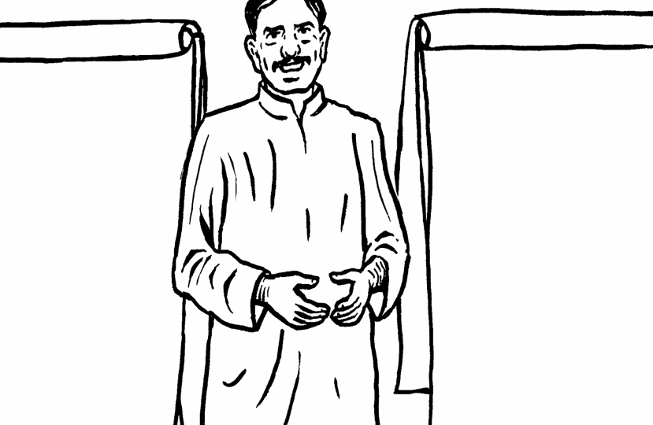
Agenda
Community-led Research Puzzles (Breakout Group Discussion)
Reflections in Plenary session
Virtual Reflection
Carol Anne’s Presentation
Tom’s Presentation
Break

Slide 3
I am uncomfortable with community-led research
I am very comfortable with community-led research
I have a wide range of advocacy tools available to me
Lucy
Sabrina
Bethany
MEG
Antonio
Sukti
Tyler
Erin
Felipe
Shreya
Aakanksha
Carol Anne
Dyari
Francesca
Ariadna
michelle
Poorvi
Tom
I have very limited advocacy tools available to me
NAME
NAME
NAME
NAME
NAME
NAME

Slide 4
Participatory Research and Education Rights in South Africa
Carol Anne Spreen, NYU
Notes:
4
Step back and into teaching role, offer conceptual reminders and a broad framework, I work with doctoral students and international researchers and teach about CBR so this may seem too theoretical or academic but I think it is important to build on ideas that Michelle, Maria and MTom will help make many ideas even more concrete.

Slide 5
South African Social Movements
History of mobilizing for right to basic education (anti-apartheid struggle, ‘76 student uprisings)
Negotiated compromise – 20 years on - still one of most unequal societies – highest inequality - GINI coefficient – no real redistributional frameworks
Public hearings to address inequities (TRC, PIH) but no legal standing
Significant legislation on education rights
(“jewel box” Constitution, SASA, funding norms and standards, redistributive frameworks) but
Vast inequalities remain - highest levels of ed inequality (fees, quality, resources, exclusion, lack of services)
Notes:
5
History and context are really important in doing this work – how is movement building and community engagement situated, what legal and social discourse is in place, how activated are puopulations

Slide 6
Community-Based Advocacy in SA
Active non-state actors – present challenges to state and social service sectors
Use the “human rights” rhetoric and issues of equity to bolster political mobilization/legitimation, BUT local realities are not often understood or realized legally
Distributional injustice – challenge policies that fail to address inequality in the distribution of resources and wealth
Cultural injustice – apartheid legacy (white & male) domination -exclusion and disrespect in public representations of day-to-day life situations (homogenization of rural, poor, discrimination against women, etc)
Associational justice – denial of participation in policy decisions that affect marginalized communities
Notes:
6
This is where its important to consider – what defines the community: outsider v insider, when organizing groups and identifying participants consider roles/inclusiveness//intersectionality –PLACEHOLDER - can have a discussion about this in the group activity

Slide 7
Education Rights Project (Principles)
Social movements/CBOs facilitate direct and expanded participation of poor and disadvantaged communities in policymaking
Partnerships between social movements and universities (“decolonize” and “fees must fall mvmts”) enabled the insertion of marginalized knowledge and experience into formal policymaking spaces and HEIs
Launched by UN Rapporteur on the “Right to education” provided legal discourse created possibilities for transformational activism around ed and other public service delivery
Notes:
7
Inside and outside influence. Links to broader movements, partnerships and international HR to “legitimize” movement/campaigns.

Slide 8
Education Rights Project: Approach
Uses PAR/CBR: to give meaning to the on-the-ground struggles of communities trying to achieve Constitutional Rights to basic education
Paint a picture of the reality of living in marginalized communities and the implications of poverty in realizing education rights PLUS a plan of action
Alternative methods to traditional policy approaches (disrupts formal policy/legal research analysis). (AVOIDs ”development/research fatigue”)
Community based researchers are central to this process. CBR’s participate in ways that support communities to articulate their concerns and the challenges they face and work towards multifaceted (local/regional and national)* solutions.
Notes:
8
Issues of legitimacy
To what extent should we try to use methods that are seen as ‘legitimate’ by power holders, but which constrain people’s ability to express freely?

Slide 9
ERP: Community-based/Participatory Action Research and Social Change
Informed by critical thinking and analysis of social, political and economic contradictions (Freire, Dreze)
Uses multiple methods, voices, approaches to seek variety of perspectives and understandings (WHO)*
Not a “method” or way of gathering data for legal cases – but a way of changing the nature of knowledge and transforming how community defines problems/possibilities and moves towards change (WHAT)
Becomes a transformative endeavor - emphasizes changes in thinking/doing not just informing about existing law/policy (WHY)**
Result = broad based public campaigns to change communities and policy
Notes:
9
*Attention to language, gender, legal status and role in community
** NYU job, journal article that 50 read or change community/national policy
Being mindful about power imbalances, between ‘donors’, ‘experts’, outsider researchers and community participants, as well as within communities. Are there tools/reflection frameworks to assist with this power analysis?

Slide 10
Methods for Community Engagement
Workshops on rights-based approaches generates list of concerns/approaches: (transportation, fees, HIV/Aids, water/electric meters, GBV)
Develop shared mission, shared budget, mutual/reciprocal goals
Co-develop interviews, surveys, focus groups, and observation/census protocol with community
Train local community-based researchers in data gathering/community mapping
Together collect, compile and analyze data
Findings are presented at community meetings with discussion over actions to be taken
Outcomes from the research develop into local/national campaigns/vision statements/manifestos aimed at improving education
Education workshops, art exhibits, radio programs and booklets were created and distributed
Actions involve working with other groups and orgs (SGB, religious groups, govt, CBOs, INGOs, education officials, parents) and legal advocacy groups (Equal Ed, HRF) around redress
Notes:
10
Is it necessary to first teach sampling techniques or in-depth interviews to the affected communities, or can we learn from community-built methodologies?
Used 4A Framework and ER indicators as backdrop
avoid an extractivist use for the research
ACTION : public campaigns/protests/town halls – work with other CBOs, INGOs, govt, religious leaders, media (fees/transport Equal Education, Refugees religious groups, immigration officials, save the children)
build trust relationship generated with the communities
How can our research help to develop other epistemologies?

Slide 11
Highlights from testimonials (on barriers to education – transport, safety, fees, registration)
“Smaller children, primary school children, get lost on their way to school. This happens usually when they cannot get into the bus because they have not paid and, as a result, have to walk about two hours to school. It is better that the government builds a school locally, instead of giving us subsidies” (Rondebilt community)
“In August, a neighbour’s child was knocked down by a car on his way to school. The child missed the bus and on his way to school crossed over the freeway (the N3). (Rondebilt community)
“‘I really do not think that the right to education applies to my community – because children that need to be at school are not at school because they cannot pay school fees. It really does not matter that there is law about school fees exemptions because schools are unwilling to implement it.” (DRD community)
‘I think that a reason for why some children are not at school has to do with the eviction from Diepkloof. People lost birth certificates and report cards. These are difficult to get back when you do not have money to make endless trips to the Department of Home Affairs”
Notes:
11

Slide 12
Working beyond the community
‘”We are trying to co-operate with many other communities around the issue of school fees. We have done this by holding joint workshops, protests and marches.
We also work with NGOs interested in the issue. These have opportunities for us to see that our problems are not that different from those of other communities and to learn from struggles of other people.
The media has not been very helpful to us whereas I believe that the media can - it can play a role in showing the kinds of problems we are faced with here and what we are doing to try to resolve them. When we invite the media to our activities they hardly ever come, when they do come they distort what we say and do”.
Notes:
12

Slide 13
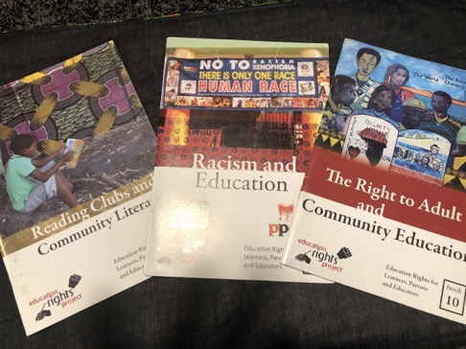
ERP Booklets and Campaigns

Slide 14
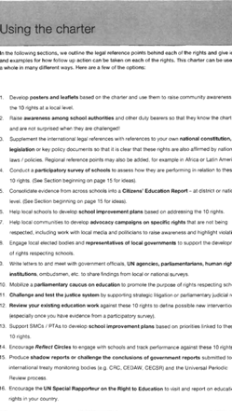
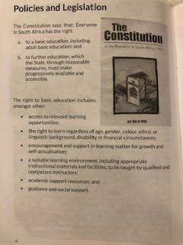

Slide 15
Impact on policy: new school fee/ funding schemes
Recommendations from the ERP to the Ministerial Review led to
a ‘Plan of Action for Improving Access to Free and Quality Basic
Education for All’. The plan included proposals to:
Prohibit the poorest 40 percent of schools (schools in quintile 1 and 2) from charging fees;
Revamp the exemption system, to include ‘hidden’ costs and uniforms and to make exemptions automatic where families qualify for welfare grants;
Provide basic minimum package per average learner not to exceed a R500;
Provide a basic minimum package for the poorest schools to provide for non-personnel, non-capital goods costing between R600 to R1000,
Re-prioritize existing budgets to prevent provincial shortfalls in complying with the new national minimum norms and new resourcing targeting tables.
Notes:
15
A result of these public campaigns, testimonials, news/media coverage and protests - government changed fee policy

Slide 16
Why/how is this different?
Participatory and community based research seeks to consciously transform the hierarchies of knowledge and power between the different groups present in spaces of formal education (theorists, researchers, policymakers, practitioners, students, parents, teachers, social movements and other forms of organized civil society.)
Interrogates commonly held ways of knowing by engaging with wider range of sources of knowledge/ (deep reservoirs of understanding, local ways of knowing/acting).
The question about “who is the community” raises fundamental questions and particular choices (which are not neutral) by CBR. Think of multiple communities and multiple subjectivities/identities
Consider “invited” vs “created” spaces – remove boundaries
Consider research/knowledge as a two way process
Notes:
16

Slide 17
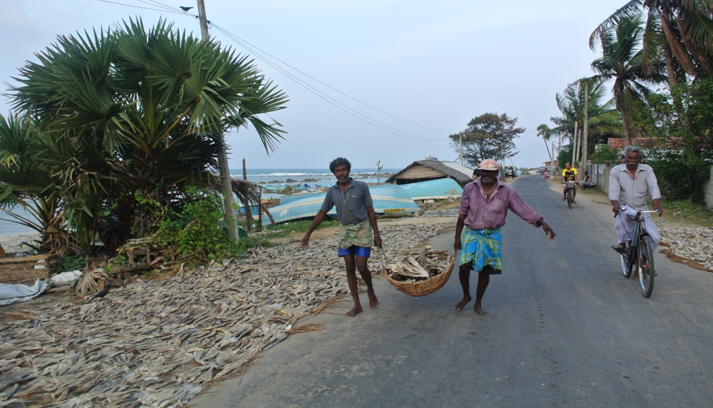
"Community, Data and Advocacy Walk into a Bank"
by Tom Weerachat

Slide 18
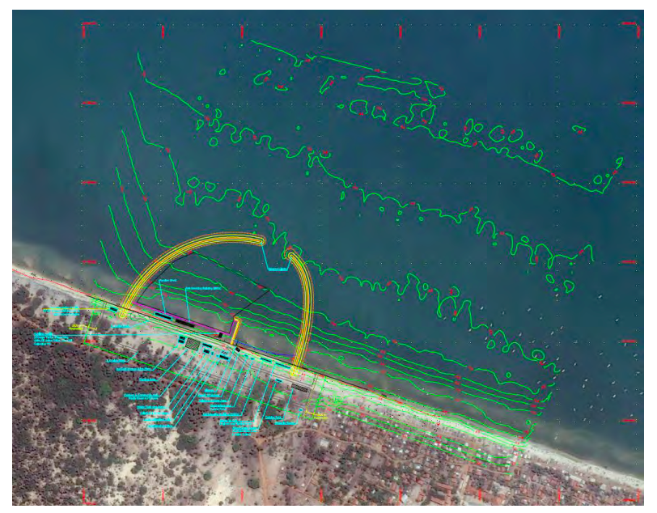
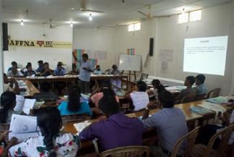
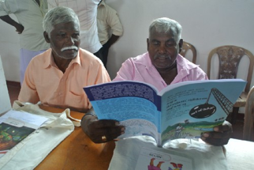
“We heard from the government that there will be development on fisheries and harbors in the area but they said the details will come later. After we learned from the Early Warning System that the Asian Development Bank would be involved in this project, we contacted communities and informed them about the plans.” Thilak Kariyawasam, Sri Lanka Nature Group
Ref: https://www.adb.org/sites/default/files/project-documents/49325/49325-001-tacr-02.pdf

Slide 19
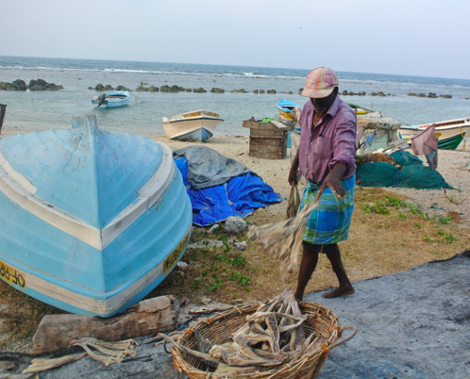
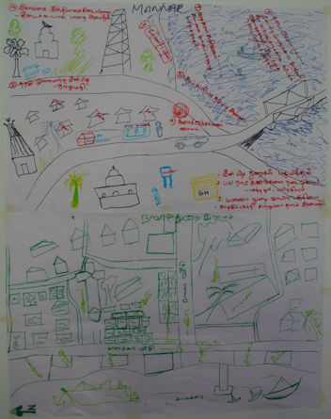
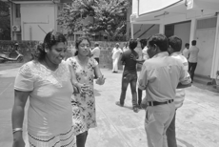
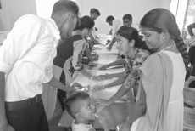
Objectives: to assess community members level of awareness about the Northern Province Sustainable Fisheries Development Project; access to information; opportunities for public participation and consultation; the perceived human rights and environmental risks associated with the project; the degree to which the project incorporated any community-led development priorities
Tools
Community Mapping
Community Discussion
Community-led Survey
Focus Group Discussion
Identify Targets & Influencers
The Research Team comprised of community members and a staff of Sri Lanka Nature Group as an advisor
The community-led research involved 400 affected community members from Mannar district including 16 fisheries villages in
4 Divisional Secretariats

Slide 20
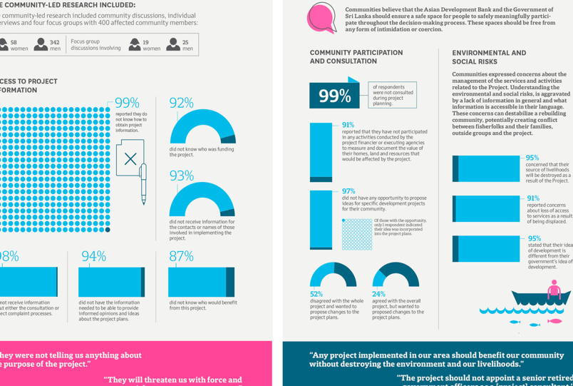
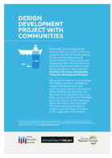
Read more http://bit.ly/SriLankaInformationDelayed See full infographic click here.

Slide 21
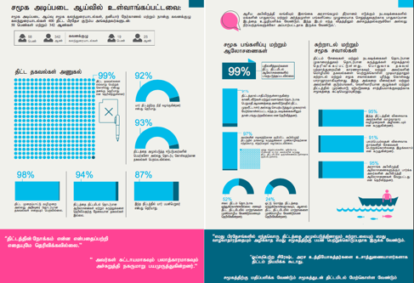
Community-led Research + Advocacy
Organize the people (Fisherfolks federations, Churches)
Request in-person meetings with the government
Write letters to the government
Share research findings with the Asian Development Bank’s Board of Directors together with demands before the project’s approval date
File complaint with the ADB’s Accountability Mechanisms

Slide 22
“In the past 30 years of war, we lost all our infrastructure facilities for fishing. We really need some facilities such as cooling facilities, fuel stations, training centers, small scale fishing harbors and anchorages. But, before starting any fisheries project, the project developers should discuss with relevant society members” - Community Member
“The communities’ intentions were never to stop the project but to request transparency and accountability and to offer their expertise in the design and implementation of the project to serve the people’s needs. Their wishes and demands have not been met. The adverse impacts of the project may have been averted now that the project has been dropped but the needs of the local fishing communities remain unmet.” More about the community-led advocacy: https://accountability.medium.com/plan-and-design-the-project-with-us-advice-from-sri-lankas-northern-province-fisherfolk-cdade9349efe

Slide 23
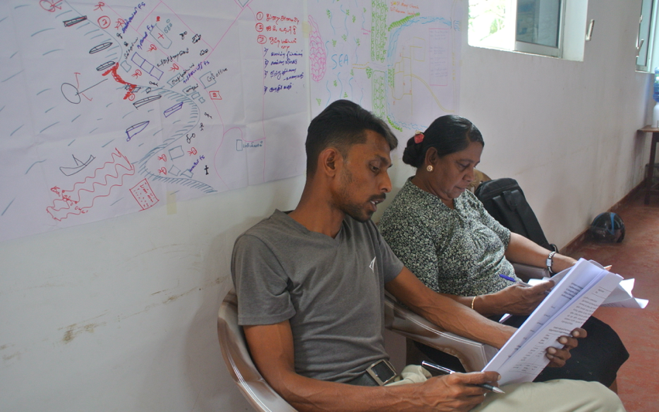
Challenges and Threats
“local communities have reported instances of intimidation by project management, government officials and ADB consultants. Community members report feeling pressured not criticize the project, with the implication that the government may stop providing support to fisherfolks if they continue to voice their concerns.” bit.ly/SriLankaInformationDelayed
“Please clarify if the enumerators had prior experience in administering similar surveys…. As you are aware poor methodology (questionnaire, sample selection etc.,) and planning leads to poor data and analysis and also the outcome presents a distorted view of the community. A robust methodology is required for results that are reliable. Without reliable results, it is not possible to be conclusive on what issues need to be addressed…”
A response from the Project Director re: Community-led Research Data

Slide 24
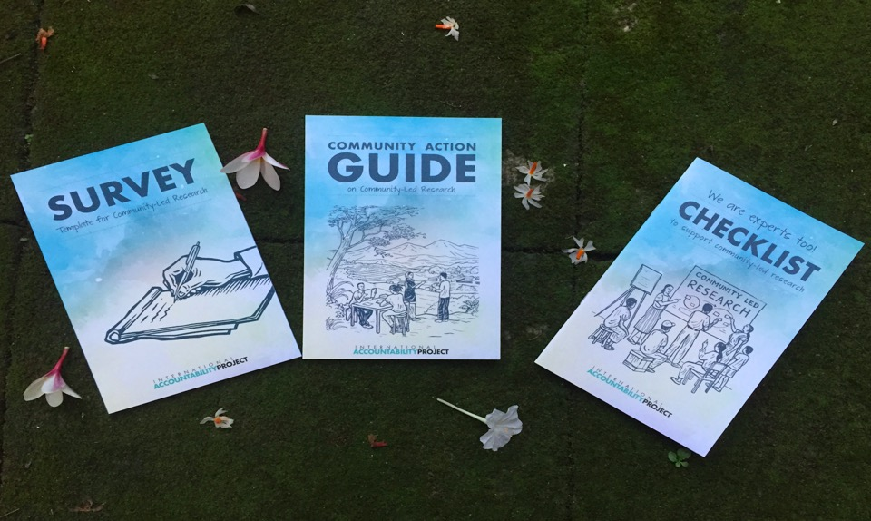
Community Action Guide on Community-led Research
Community Action Guide on Community-led Research
Read more and download the booklets>> En: bit.ly/WhatTodayDevelopmentNeeds
Es: bit.ly/desarrollodehoy
Download the booklets >> bit.ly/WhatTodayDevelopmentNeeds (Spanish: bit.ly/desarrollodehoy)
More materials bit.ly/iapcagweb

Slide 25
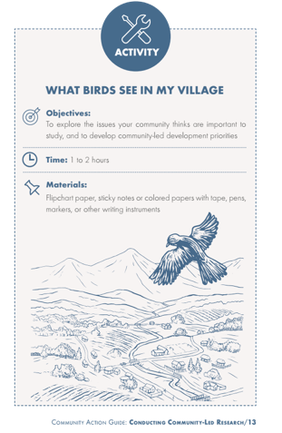
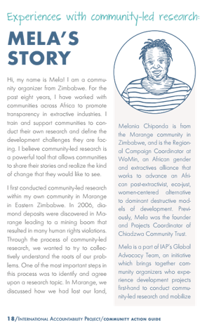
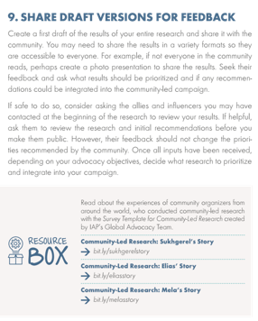
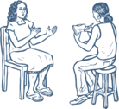

Slide 27
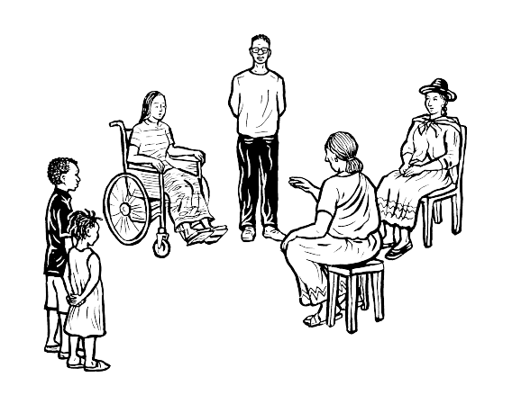
Community-led Research Puzzles
Please go to slides for your group 1.Meg (#28) 2.Sukti (#32) 3.Tyler (#36) 4.Tom (#40) 5.Carol Anne (#44) Each group will have 5 minutes to complete the puzzles by arranging all pieces in any order that make sense to the group.
Please discuss in your group while arranging the puzzles what each piece means and why they are in an order the group arrange.
Choose at least 3 suggested questions to discuss in your group in 15 minutes. Please take notes of key points into the slide of your group.

Slide 28
1

Slide 29
Group Discussion
1
What does the checklist of 12 steps in the puzzle bring up for you?
How do you ensure community-led approach (e.g., inclusiveness, representation of various groups/voices/thoughts, what times/spaces are needed, outsider v insider dynamic, intersectionality) in community-led research process?
-- When to assemble the research team to ensure community-informed choice of topic
-- Reflection and community engagement should be built into each step
-- Building the resesarch team is something that is iterative and evolves over time to ensure inclusivity and responsiveness to exclusions, dynamics along lines of gender, age, etc.
--Importance of being aware of the influence outside actors have
-- How does it change the research if you are already engaged with the community along the way? If research is part of a longer organizing process, how do we think about these steps? These tiles assume that there is an outside entity coming in. What about when the community is the entity doing the research?
-- The enormity of the research process is something that need to be dealt with
-- How do you do justice to the principles within constraints (time, institutional, etc.)
-- There are particular community members who have greater levels of consciousness about specific issues. How to bring those folks into the research team, facilitate conversations so that political development happens. Design the research so that it reflects the consciousness of those who have been most involved already in an ongoing campaign and reaches the desired goals, versus the results taking away from that goal

Slide 30
1
Which tools do you find most useful and work well in any parts of the community-led research process?
Comments
30

Slide 31
1
What has not worked so well in your community-led research design? Share some of the challenges in CLR and brainstorm solutions within your group.
Note...

Slide 32
2

Slide 33
Group Discussion
2
What does the checklist of 12 steps in the puzzle bring up for you?
How do you ensure community-led approach (e.g., inclusiveness, representation of various groups/voices/thoughts, what times/spaces are needed, outsider v insider dynamic, intersectionality) in community-led research process?
Note...

Slide 34
2
Which tools do you find most useful and work well in any parts of the community-led research process?
Comments
34

Slide 35
2
What has not worked so well in your community-led research design? Share some of the challenges in CLR and brainstorm solutions within your group.
Note...

Slide 36
3

Slide 37
Group Discussion
3
What does the checklist of 12 steps in the puzzle bring up for you?
How do you ensure community-led approach (e.g., inclusiveness, representation of various groups/voices/thoughts, what times/spaces are needed, outsider v insider dynamic, intersectionality) in community-led research process?
Engage community throughout is the one that we should continually return to.
Community engagement is an iterative process.
As shared goals become defined, interested and motivated people can opt in.
It’s not about creating boundaries as much as finding consensus, and people self select into that shared.
Opening opportunities to participate is a central tenet of the community led research, this will cut against the problem based approach of traditional research or NGO advocacy.
Do a risk assessment, but its difficult to predict.

Slide 38
3
Which tools do you find most useful and work well in any parts of the community-led research process?
Comments
38

Slide 39
3
What has not worked so well in your community-led research design? Share some of the challenges in CLR and brainstorm solutions within your group.
Note...

Slide 40
4
Humility

Slide 41
Group Discussion
4
What does the checklist of 12 steps in the puzzle bring up for you?
How do you ensure community-led approach (e.g., inclusiveness, representation of various groups/voices/thoughts, what times/spaces are needed, outsider v insider dynamic, intersectionality) in community-led research process?
Cyclical
Values that should be present throughout
Humility, addressing risks did feature at the top
To be sure that the research focuses on the need of the community- is able to articulate the concerns and priorities of the community-- and the process to define those priorities and concern are inclusive.
To whom is the researcher accountable. For and by the community.
Language and how it can exclude people from a space or a process
Being clear on roles and expectations

Slide 42
4
Which tools do you find most useful and work well in any parts of the community-led research process?
Comments
42

Slide 43
4
What has not worked so well in your community-led research design? Share some of the challenges in CLR and brainstorm solutions within your group.
Note...

Slide 44
5

Slide 45
Group Discussion
5
What does the checklist of 12 steps in the puzzle bring up for you?
How do you ensure community-led approach (e.g., inclusiveness, representation of various groups/voices/thoughts, what times/spaces are needed, outsider v insider dynamic, intersectionality) in community-led research process?
Note...

Slide 46
5
Which tools do you find most useful and work well in any parts of the community-led research process?
Comments
46

Slide 47
5
What has not worked so well in your community-led research design? Share some of the challenges in CLR and brainstorm solutions within your group.
Note...

Slide 48
Welcome! Pull up a chair around our circle
Name
Name
Feel free to share any
concrete examples and take-aways from today’s activities.
What has been different about doing this online?
What new insights can you share?
Name
Sabrina
Tom
Ariadna
Bethany
Meg
Antonio
Felipe
Shreya
Tyler
Aakanksha
Dyari
Luciana`
Sukti
Name
Name
Poorvi
Lucy
Name
Template by Training for Change
Notes:
Template by Training for Change • www.trainingforchange.org
HOW TO USE THIS SLIDE
Add your discussion or introduction question to the middle of the circle.
Add participants’ names around the circle and remove or add name shapes as needed
Use the circle to go around to answer the questions
Options and variations:
Use photographs instead of typed names
Put the name markers on the side of the slide and let people move them onto the circle themselves
Let people add their own names to the shapes
Include pronouns on the shapes
Put something else in the center of the circle, like a candle/fire, animated GIF
Use the circle for other circle-based activities, like appreciation circles, passing a “string” across the circle (draw lines using Google Slides or annotation tool)

