Slide 1
FINANCIAL ACCOUNT #S
Each group and journal has their own financial account number
The account number is used for reimbursements, fund transfers, room reservations, catering, etc.
Using the account number takes the form of a chartfield
NYU Law Chartfield:
Account – Fund – Org – Program – Project
SG: 65182 – 20 – 53441 – LSB## – M9809
J: 65182 – 20 – 53460 – WSQPG – MA###
All student groups have the same Fund, Org, & Project where only the Program # distinguishes the specific group. For journals, they share the same Fund, Org, & Program, but have different Projects #.

Slide 2
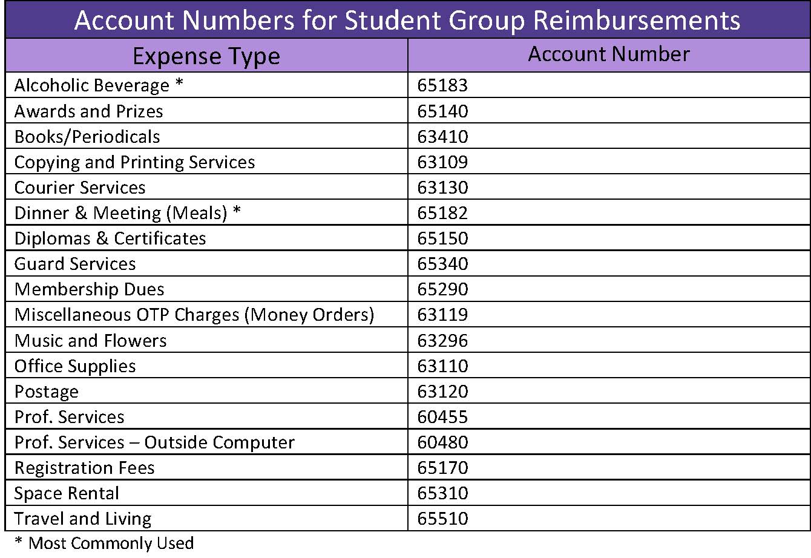
EXPENSE/ACCOUNT TYPES
If you have questions about the correct category for a particular expense, just email law.studentaffairs@nyu.edu and ask.
Examples:
Food = Dinner & Meeting
Movies for screening = Office Supplies
Printed t-shirts, bags, etc. = Copying & Printing Services
Gift cards = Awards & Prizes

Slide 3
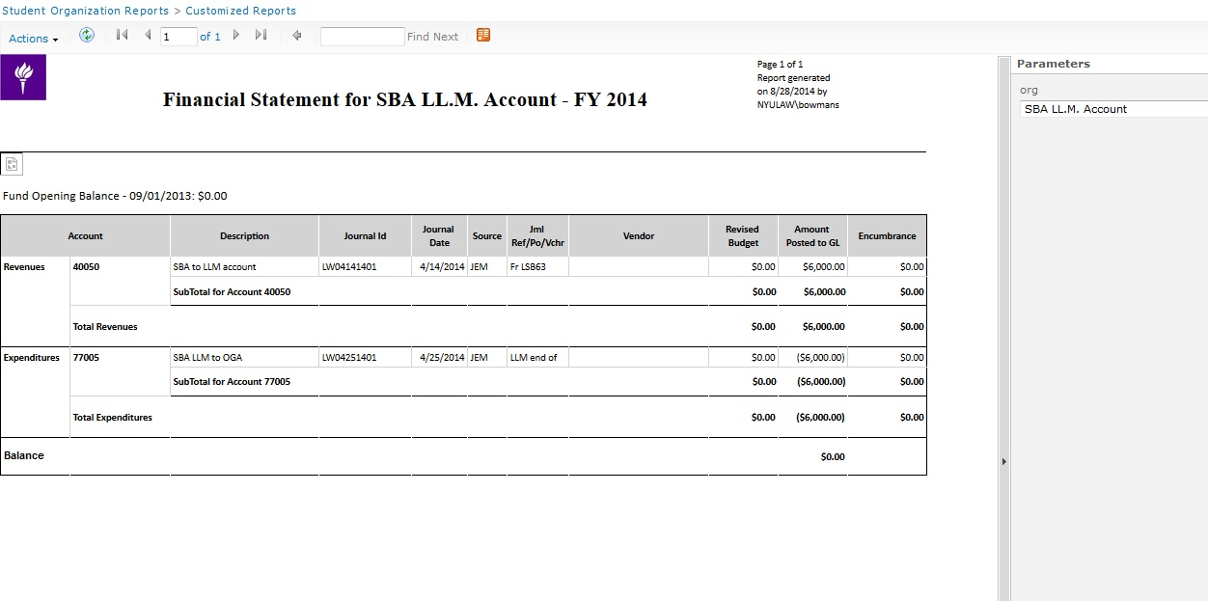
FINANCIAL REPORTS
All treasurers will be given access to Reports and a Box folder with this info
You will need to visit the IT Helpdesk to login and set up your password for the first time; you can only access Reports from an NYU networked computer
For questions related to Reports access, email law.helpdesk@nyu.edu
You can also email law.studentaffairs@nyu.edu for questions about your Box folder

Slide 4
FINANCIAL REPORTS
Focus on Amount Posted to GL column when trying to reconcile your budget. It will provide the true balance of group account.

